Slide 1
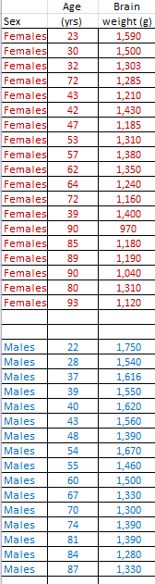
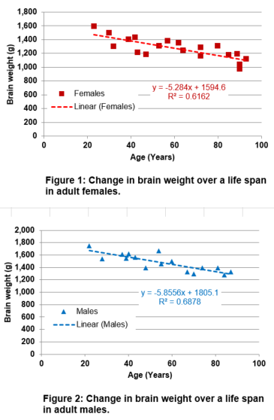

We are loosing brain mass as we age. Use linear regression to calculate the rate of brain loss.
THAT

Slide 2
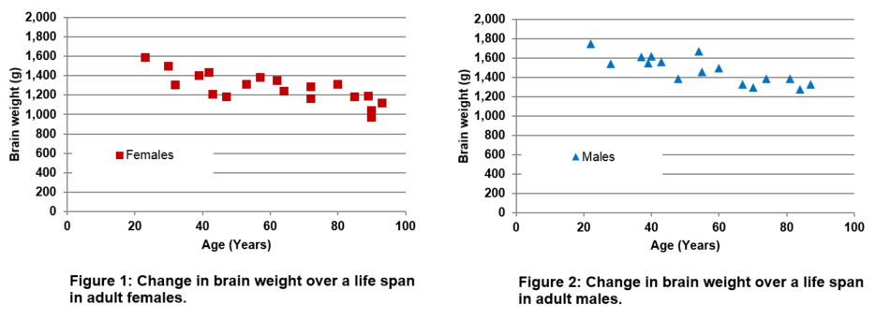
1- Make 2 XY (scatter) graphs: one for the males and one for the females.
You learned how to do XY scatter graphs in tutorial “Excel 7”

Slide 3
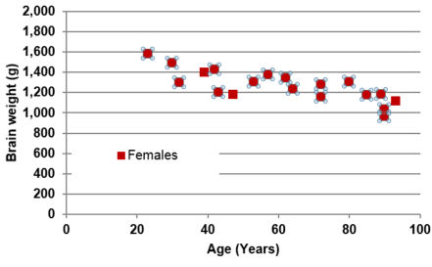
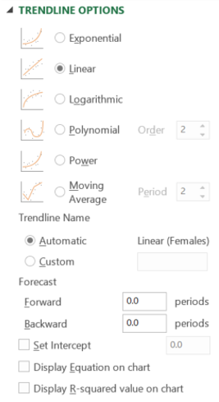
2- Draw the linear trendline for the females and calculate its equation.
2-a With your mouse, left-click on any one of the data points plotted on the graph. All the data points are selected
2-b Then right way, without changing the position of your cursor, right-click your mouse. A window appears.
2-c Click on “Add Trendline”.
Another window will appear.
2-d Tick “Linear”; “Display Equation on chart”; “Display R-squared value on chart”;

Slide 4
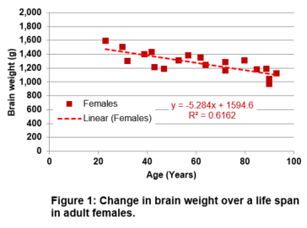
2- Draw the linear trendline for the females and calculate its equation.
2-e The linear trendline as well as its equation and R-squared appear on the chart”;

Slide 5
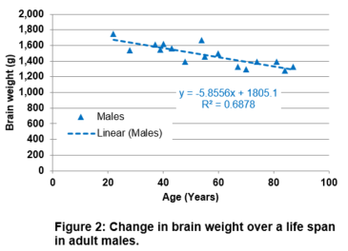
3- Draw the linear trendline for the males and calculate its equation.
Repeat the steps 2-a to 2-e but this time using the males’ data.

