Slide 1

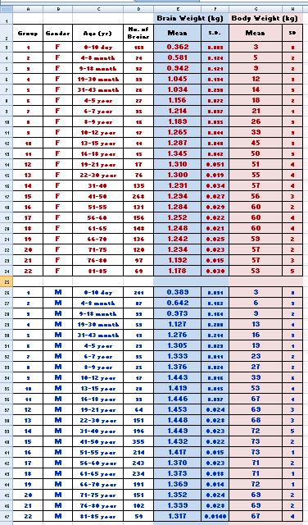
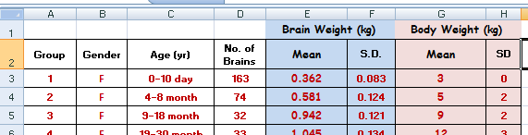

MAKING LINE GRAPHS WITH 2 OR 4 SERIES (and 2 Y axis)
Click here!
In this tutorial you will learn
how to go from this table to

Slide 2
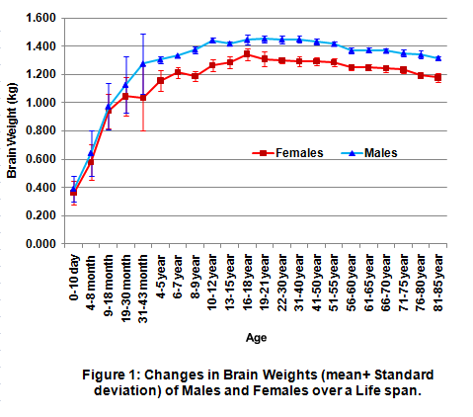
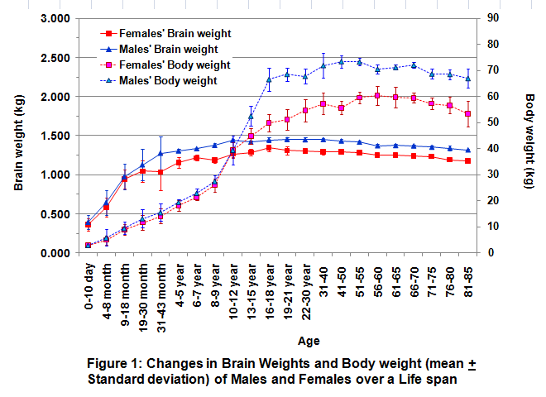
MAKING LINE GRAPHS WITH 2 OR 4 SERIES (and 2 Y axis)
1st
Y axis
2nd
Y axis
THAT
4 series
-> Average Brain weight of Females
-> Average Brain weight of Males
-> Average Body weight of Females
-> Average Body weight of Males
2 series
-> Average Brain weight of Females
-> Average Brain weight of Males
22 categories -> 22 age categories
22 categories -> 22 age categories

Slide 3
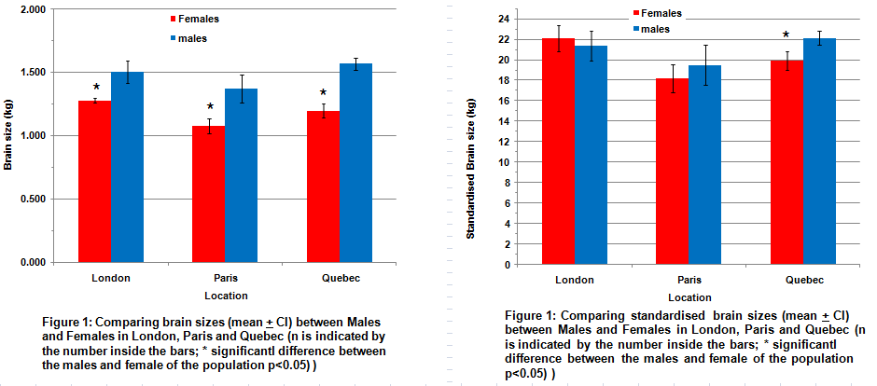
It looks like the brain of women are significantly smaller than the brain of men. If we standardise brain size relatively to body weight, there is no significant difference between genders except with the Quebecers.
Are these results meaningful? Brain weight may change over a life span... We do not know the age of our subjects and for all we know, we may compare old women with young males .... and observe the effect of aging as well as gender.
In this tutorial, we will investigate if brain size changes over a life span.

Slide 4
It looks like the brain of women are significantly smaller than the brain of men. If we standardise brain size relatively to body weight, there is no significant difference between genders except with the Quebecers.
Are these results meaningful? Brain weight may change over a life span... We do not know the age of our subjects and these samples may not be controlled for age. We may compare old women with young males .... and observe the effect of aging as well as gender.
In this tutorial, we will investigate if brain size changes over a life span.

Slide 5
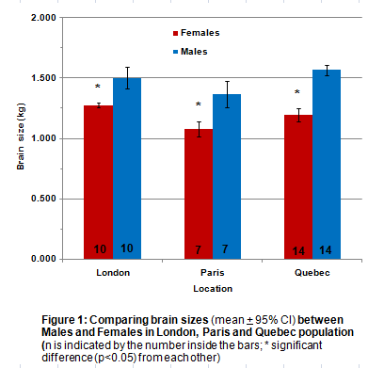
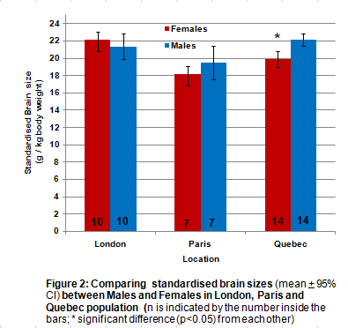
In Excel 5 we saw that the brains of women are significantly smaller than their male counterparts. If we standardise brain size relatively to body weight, there is no significant difference between genders except in the sample of the Quebecers.
Are these results meaningful? Brain weight may change over a life span...
We do not know the age of our subjects and for all we know, we may compare old women with young males .... and observe the effect of aging, not gender.
In this tutorial, we will investigate how brain size changes over a life span and in the process, ...

Slide 6
... we will learn how to
Make line graphs with 2 and 4 series;
Include a secondary Y axis on a graph.
I will assume that you possess a basic knowledge of Excel (see Tutorials 1,2,3,4&5);
To learn how to calculate means & Standard deviation, please go to Excel 2 (or 3&4).

Slide 7
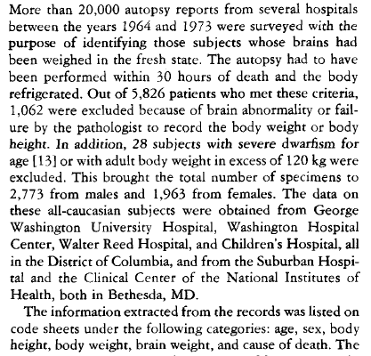
DATASET from your friend Anatole Dekaban
Excerpt from of his letter
His table

Slide 8
DATASET from your friend Anatole Dekaban
Anatole has done a lot already!
He separated the males from the females!
He ranked his subjects by age!
He calculated the mean and standard deviation in each age category!
Click on the magnifying glass to see the table in more details

Slide 9
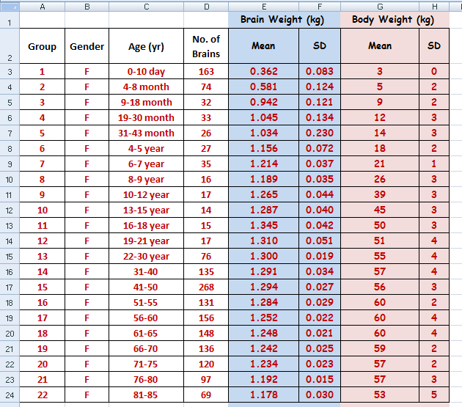

DATASET from your friend Anatole Dekaban
We do not have to calculate the averages or the standard deviation from the original data, it is already done!
See Excel 2 (or 3,4) to learn how to do it.
Pay attention!
In this tutorial, the error bars plotted on the graphs will be the Standard Deviations of these means.
When you do your Biol 363 papers, error bars will have to be Confidence Intervals
Click here to go back

Slide 10
DATASET from your friend Anatole Dekaban
Data: Females
Click here to go back

Slide 11
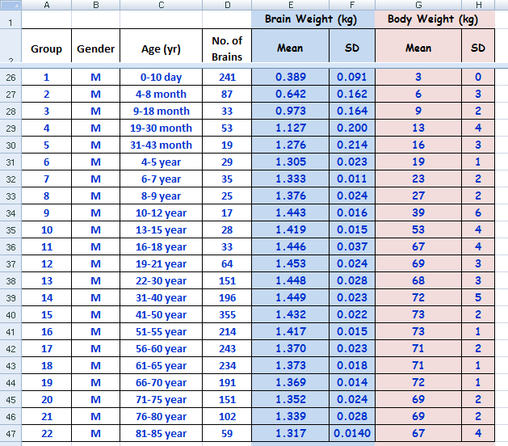

DATASET from your friend Anatole Dekaban
See the split of worksheet (go to excel 4 to learn about it!)
Data: Males
Click here to go back

Slide 12
and we will plot the average + STANDARD DEVIATIONS
We do not have to calculate the averages or the standard deviation from the original data, it has already been done for us!
Pay attention!
In this tutorial, the error bars plotted on the graphs will be the Standard Deviations of these means.
When you do your Biol 363 papers, error bars will have to be Confidence Intervals

Slide 13
Making line graphs -> 2 series

Slide 14
Making line graphs -> 4 series and 2 Y axes.

Slide 15
Anatole’s data suggest that there is no gender difference in brain size in young children. However when they reach their 4th birthday the brains weight of females and males start to show significant differences. Brains weight of males becomes significantly bigger than females of the same age and this difference is shown throughout human life span.
In Biol 363 we will assume that means are significantly different from each other if their confidence intervals do not overlap - (in “real life” you should be doing proper statistical analysis!)

Slide 16
Excel 6
Simple Table & Simple Bar Graph
BASIC KNOWLEDGE

Slide 17
Excel 6

