Slide 1
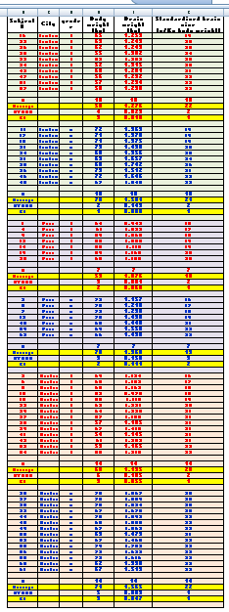

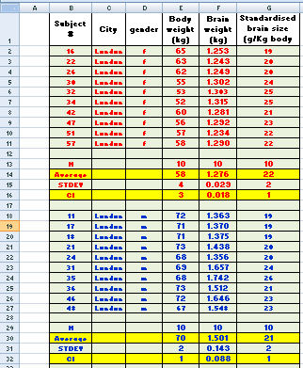
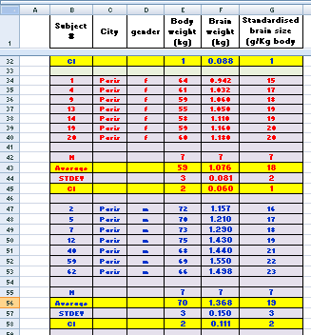
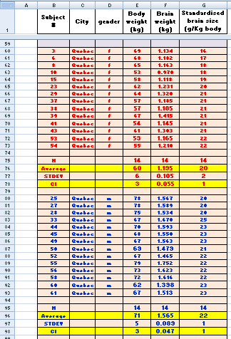
MAKING BAR GRAPHS WITH 2 or 3 SERIES
In this tutorial you will learn
how to go from this BIG table to
Click here!
1 All the females from London
2 All the males from London
3 All the females from Paris
4 All the males from Paris
5 All the females from Quebec
6 All the males from Quebec

Slide 2
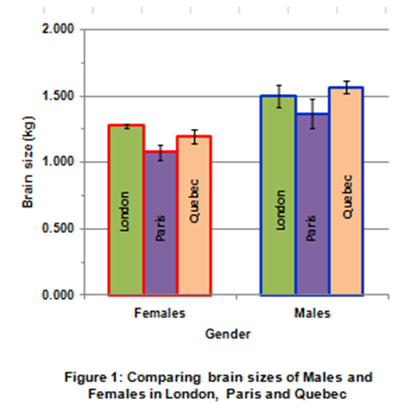
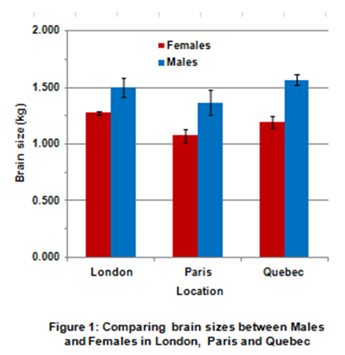
MAKING BAR GRAPHS WITH 2 or 3 SERIES
3 series
-> Average Brain weight of Londoners
-> Average Brain weight of Parisians
-> Average Brain weight of Quebecers
THAT
2 series
-> Average Brain weight of Females
-> Average Brain weight of Males
2 categories -> Female & Male
3 categories -> London, Paris & Quebec

Slide 3
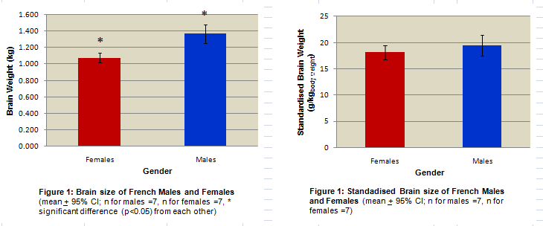

In Excel 2&3 we saw that females’ brains were significantly smaller than the males'. We standardised brain size relatively to body weight and this gender difference vanished
We gathered other data (from London and Quebec) to confirm our finding. We have now a big table and now we have to graph it.
I will assume that you possess a basic knowledge of Excel (see Tutorials 1,2,3 &4)
The big table is coming on the next slide

Slide 4
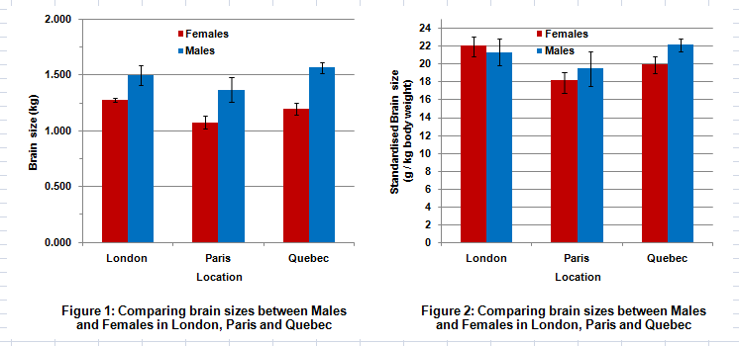
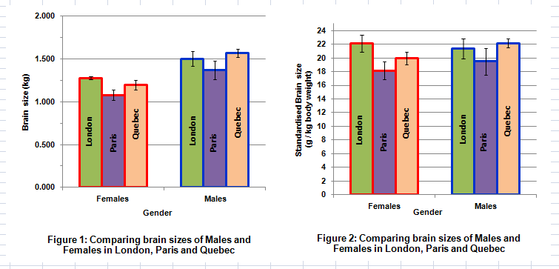
BAR GRAPHS WITH 3 OR 3 SERIES

Slide 5

Collapse the table –
This table is big and hard to manage. We just need the averages and confidence intervals for our bar graph so we will hide (not delete) all the rows containing values for individual subjects
1 All the females from London
2 All the males from London
3 All the females from Paris
4 All the males from Paris
5 All the females from Quebec
6 All the males from Quebec
Hide the subjects: you do not need them to make your graphs!
1- Select the rows you want to hide
2- Use the “Hide” tool to hide them

Slide 6

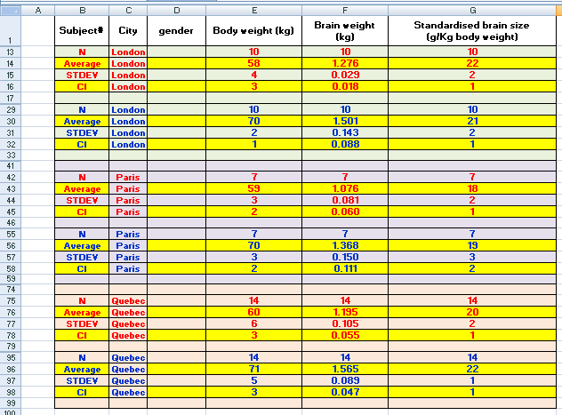

Collapse the table –
1- Select the rows you want to hide
2- Use the “Hide” tool to hide them
HIDE NOT DELETE!
I just hit delete and my data got deleted.
HIDE!
Don’t cry! Click undo”.
HIDE!
HIDE!
HIDE!
HIDE!
The table is smaller and easier to manage.
If you want your data to re-appear just hit “unhide”
HIDE!

Slide 7
Making bar graphs -> Table

Slide 8
Making bar graphs -> 2 series (Males & Females)
2 series
-> Average Brain weight of Females
-> Average Brain weight of Males
3 categories -> London, Paris & Quebec

Slide 9

Making bar graphs -> 3 series (London, Paris & Quebec)
3 series
-> Average Brain weight of Londoners
-> Average Brain weight of Parisians
-> Average Brain weight of Quebecers
2 categories -> Female & Male
You do not need to do this graph from scratch. Modify a copy of the graph you did previously (it’s faster)

Slide 10
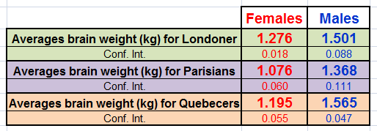
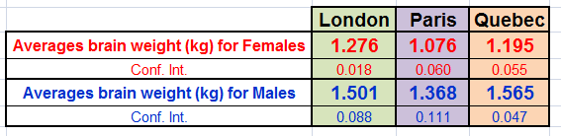
5- Making bar graphs -> Data series
3 series
-> Average Brain weight of Londoners
-> Average Brain weight of Parisians
-> Average Brain weight of Quebecers
2 series
-> Average Brain weight of Females
-> Average Brain weight of Males
2 categories -> Female & Male
3 categories -> London, Paris & Quebec

Slide 11
5- Making bar graphs -> Data series
3 series
-> Average Brain weight of Londoners
-> Average Brain weight of Parisians
-> Average Brain weight of Quebecers
2 series
-> Average Brain weight of Females
-> Average Brain weight of Males
2 categories -> Female & Male
3 categories -> London, Paris & Quebec

Slide 12

6- Making bar graphs -> graphing London, Paris & Quebec as series
3 series
-> Average Brain weight of Londoners
-> Average Brain weight of Parisians
-> Average Brain weight of Quebecers
2 categories -> Female & Male

Slide 13
7- Making bar graphs -> graphing Males & Females as series
2 series
-> Average Brain weight of Females
-> Average Brain weight of Males
3 categories -> London, Paris & Quebec

Slide 14
6- Making bar graphs -> graphing Males & Females as series
2 series
-> Average Brain weight of Females
-> Average Brain weight of Males
3 categories -> London, Paris & Quebec

Slide 15
7- Making bar graphs -> graphing London, Paris & Quebec as series
Don’t do this graph from scratch. Modify a copy of the one you did in Slide 6
3 series
-> Average Brain weight of Londoners
-> Average Brain weight of Parisians
-> Average Brain weight of Quebecers
2 categories -> Female & Male

Slide 16
Making bar graphs -> graphing the standardised Brain
...in less than 4 min.

Slide 17
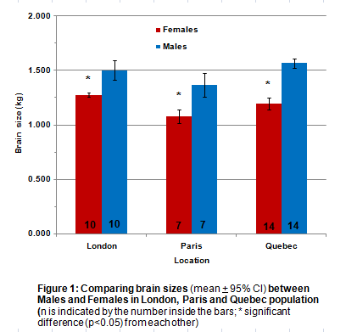
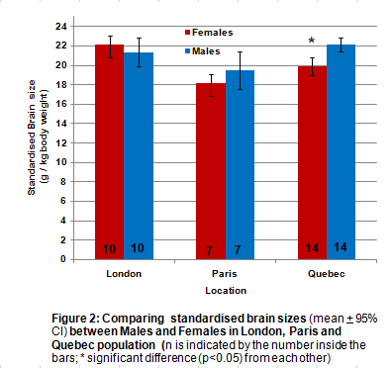
9- It looks like the brain of women are significantly smaller than their male counterparts. If we standardise brain size relatively to body weight, there is no significant difference between genders except in the sample of the Quebecers.
Are these results meaningful? Brain weight may change over a life span... We do not know the age of our subjects and these samples may not be controlled for age. We may compare old women with young males .... and observe the effect of aging, not gender.
(*) In Biol 363 we will assume that means are significantly different from each other if their confidence intervals do not overlap - (in “real life” you should be doing proper statistical analysis!)

Slide 18
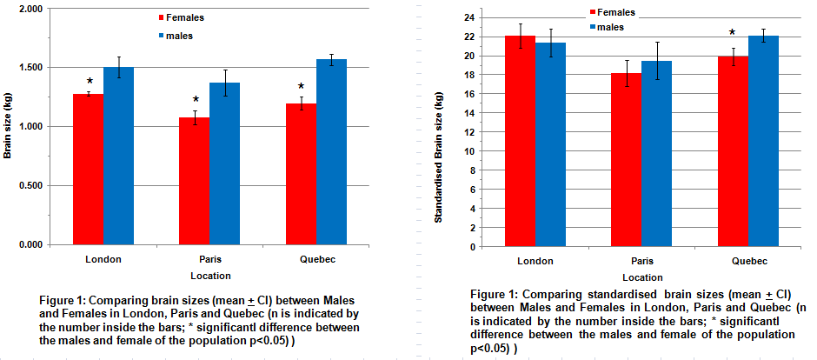
It looks like the brain of women are significantly smaller than the brain of men. If we standardise brain size relatively to body weight, there is no significant difference between genders except with the Quebecers.
Are these results meaningful? Brain weight may change over a life span... We do not know the age of our subjects and these samples may not be controlled for age. We may compare old women with young males .... and observe the effect of aging as well as gender.
(*) In Biol 363 we will assume that means are significantly different from each other if their confidence intervals do not overlap - (in “real life” you should be doing proper statistical analysis!)

Slide 19
Excel 5

