Slide 1
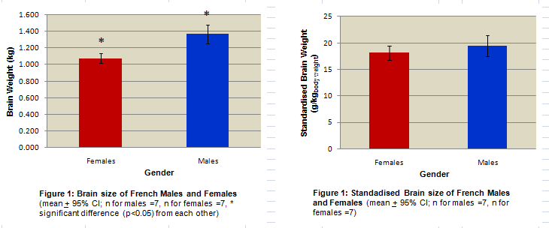
In Excel 2&3 we saw that females’ brains are significantly smaller than the males'. If we standardise brain size relatively to body weight, then there is no significant difference between genders.
We will gather other data (from London and Quebec) and see if we come up with the same trends
I will assume that you possess a basic knowledge of Excel (see Tutorials 1,2&3)

Slide 2
In Excel 2&3 we saw that females’ brains are significantly smaller than the males'. If we standardise brain size relatively to body weight, then there is no significant difference between genders.
We will gather other data (from London and Quebec) and see if we come up with the same trends
I will assume that you possess a basic knowledge of Excel (see Tutorials 1,2&3)

Slide 3
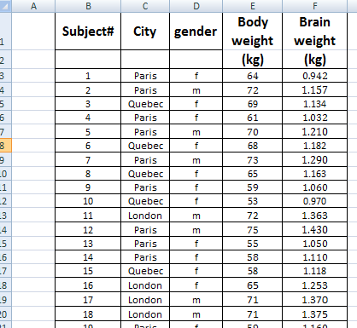
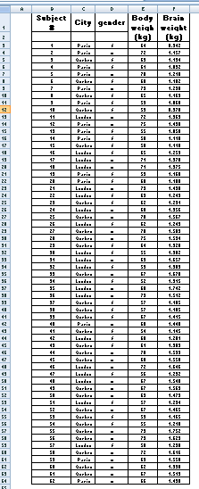


SORTING DATA (and splitting the spreadsheet)
In this tutorial you will learn how to go from
THIS
Click here!
to
YEWWW ...This is a Big Messy table!!
The cities are all mixed up ... and the genders all mixed up too.

Slide 4
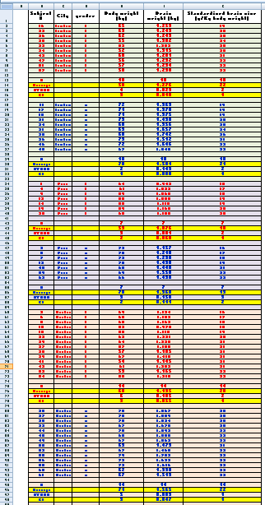
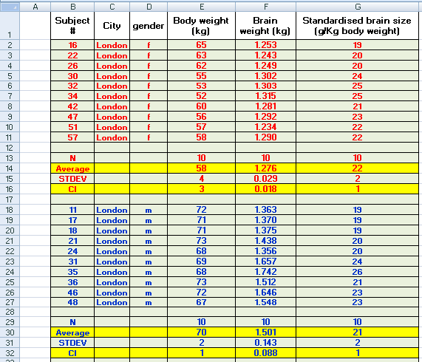

SORTING DATA (and splitting the spreadsheet)
THAT
Female
London
Male
Female
Paris
Male
Female
Quebec
Mmmm!
Nice & Tidy... and I did it in less than 5 min.
Male

Slide 5
SORTING DATA (and splitting the spreadsheet)
THAT
Female
London
Male
Female
Paris
Male
Female
Mmmm!
Nice & Tidy... and I did it in less than 5 min.
Quebec
Male
Splitting spreadsheet?
Click here!

Slide 6
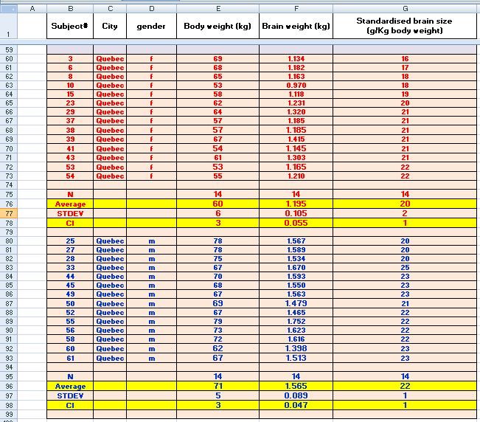
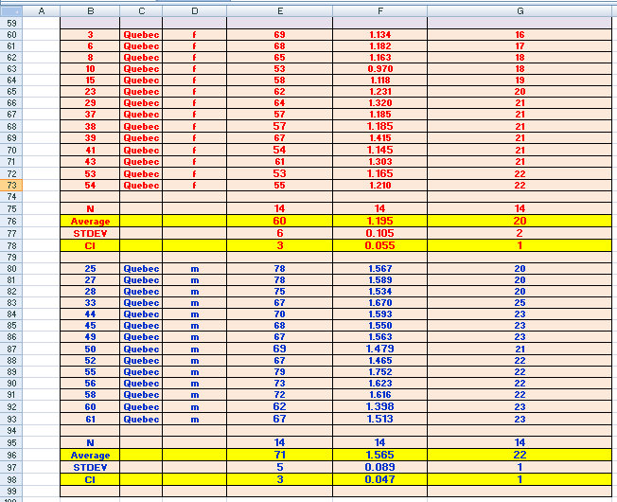
splitting the spreadsheet
Titles of columns
If your table is very big (many columns and/or many rows), when you scroll down or right, the titles of your columns and of your rows disappear. If you want to check the titles, you have to scroll all the way back where the titles are.
Scrolling down
the spreadsheet to see
However, if you split your spreadsheet, you can keep the titles of your columns and rows visible at all time no matter how far you scroll down and sideway!
NO SPLIT:
titles of columns not on screen
SPLIT:
titles of columns stay on screen
Titles of
columns
SPLIT

Slide 7
SPLITTING THE SPREADSHEET
4-
Titles of columns
If your table is very big (many columns and/or many rows), when you scroll down or right, the titles of your columns and of your rows disappear. If you want to check the titles, you have to scroll all the way back where the titles are.
Scrolling down
the spreadsheet to see
However, if you split your spreadsheet, you can keep the titles of your columns and rows visible at all time no matter how far you scroll down and sideway!
SPLIT:
titles of columns stay on screen
NO SPLIT:
titles of columns not on screen
Titles of
columns
SPLIT

Slide 8
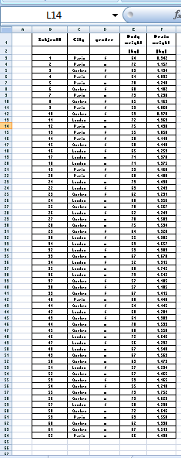
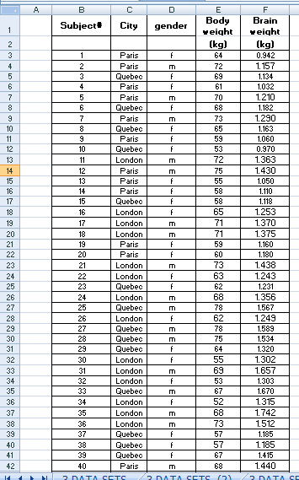
OK: Lets do it. This is our new set of data.
This table contains the brain weight & body weights of 62 subjects (males & females) originating from 3 cities (London, Paris & Quebec)

Slide 9
OK: Lets do it. This is our new set of data.
The genders are all mixed up
The provenances are all mixed up

Slide 10

OK: Lets do it. This is our new set of data.
The genders are all mixed up
The provenances are all mixed up
I need to separate our subjects neatly by their gender and provenance.
I want to make 6 small tables:
1 All the females from London
2 All the males from London
3 All the females from Paris
4 All the males from Paris
5 All the females from Quebec
6 All the males from Quebec

Slide 11
5-
OK: Lets do it. This is our table of data.
The genders are all mixed up
The provenances are all mixed up
This table contains the brain weight & body weights of 62 subjects (males & females) originating from 3 cities (London, Paris & Quebec)
BUT
the subjects are all mixed up.
We need to separate them neatly by their gender and provenance and we want to make 6 small tables:
1 All the females from London
2 All the males from London
3 All the females from Paris
4 All the males from Paris
5 All the females from Quebec
6 All the males from Quebec

Slide 12

Lets’ sort our data by city and gender! (in less than 20 sec.)
Do NOT
move the rows around!
or cut and paste;
or copy and paste...
It is too time consuming. Do not do it!
INSTEAD USE EXCEL’S SORT FUNCTION:
Select the range of cells to be sorted;
Go in the Ribbon and click on Data;
Click on “Sort”;
If you selected the first row containing the title of your columns, tick “my data has headers” and watch the first row getting “unselected”;
Go to “Sort by” and chose the criteria for your 1st sorting – I will choose “city”. If I click OK now I will split my data into 3 groups: London, Paris and Quebec;
Do NOT click OK and Go to “Add Level” ;
Another sorting choice “Then by” appears. Chose the criteria for your 2nd sorting – I will choose “gender”;
Now click on OK and your data will be sorted 1st in 3 groups (London, Paris and Quebec) and 2nd in 2 subgroups (Females and males) inside each group).

Slide 13
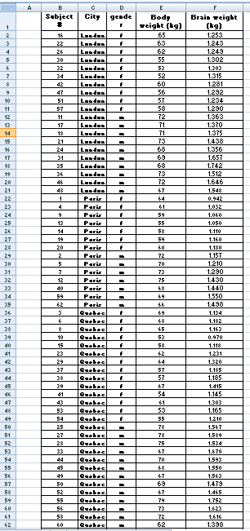
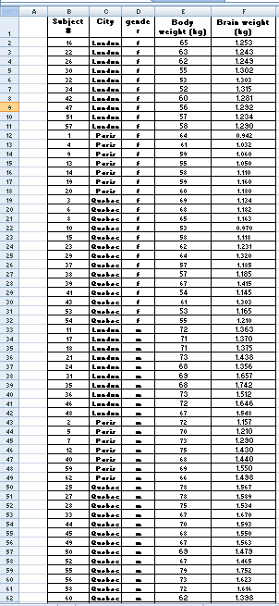
Lets’ sort our data by city and gender! (in less than 20 sec.) (con’t)
Data are sorted
1st by city
and
2nd by gender
This is what would happen if data were sorted
1st by gender
and
2nd by city
Female
London
London
Female
Paris
Male
Female
Quebec
Paris
Male
London
Female
Male
Paris
Quebec
Male
Quebec

Slide 14
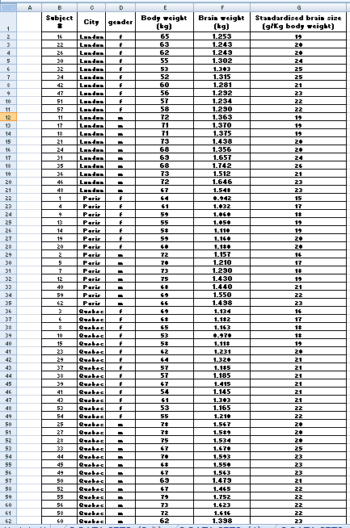
Calculate the standardised brain size using Excel’s arithmetic equation
Standardised brain size in g per kg _{body weight} =
(Brain weight in kg * 1000) / Body weight in kg
Female
London
Male
Female
Paris
What is “Excel’s arithmetic equation”? See Excel 3!
Male
Female
Quebec
Male

Slide 15
SPLITTING THE SPREADSHEET
4-
Titles of columns
If your table is very big (many columns and/or many rows), when you scroll down or right, the titles of your columns and of your rows disappear. If you want to check the titles, you have to scroll all the way back where the titles are.
Scrolling down
the spreadsheet to see
However, if you split your spreadsheet, you can keep the titles of your columns and rows visible at all time no matter how far you scroll down and sideway!
SPLIT:
titles of columns stay on screen
NO SPLIT:
titles of columns not on screen
Titles of
columns
SPLIT

Slide 16
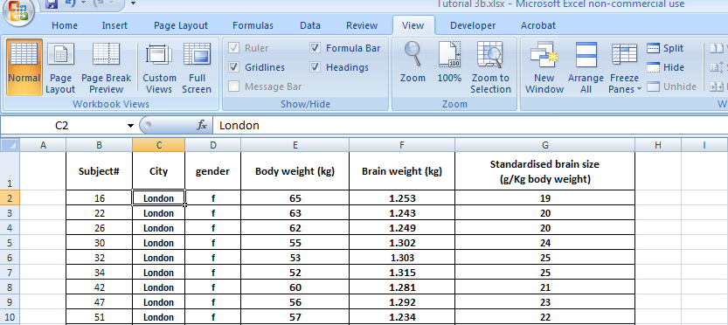

Split the table so that no matter how “down” we scroll we can still see the titles of our rows & columns.
2
3
Titles of columns
1
Titles of rows
1- Select the location of the “split” by clicking inside the cell;
2- Go to “View” in the ribbon;
3- Click on “Split”.
Click here
and go to the next slide

Slide 17
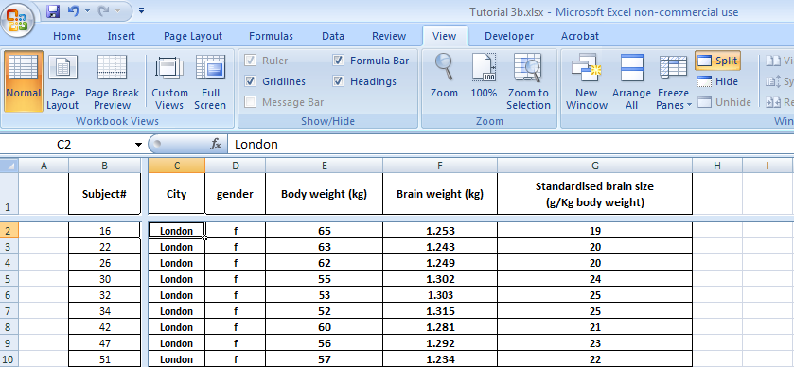
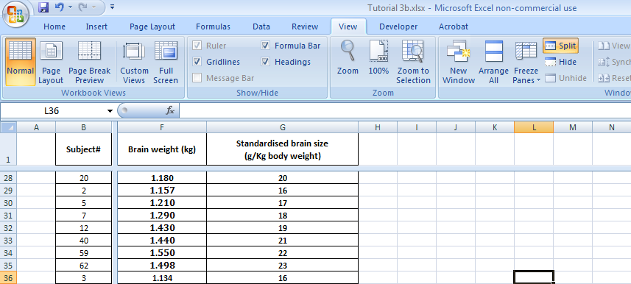
Split the table so that no matter how “down” we scroll we can still see the heading of our rows & columns. (con’t)
You have your splits
If you scroll down or right, you can still see the titles beside the rows and above the columns

Slide 18
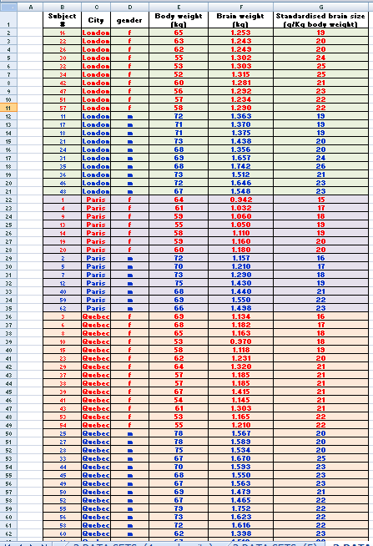
Color coding
Female
London
Male
Female
Paris
Male
How do I change the colors in my cells? See Excel 1&2!
Female
Quebec
Male

Slide 19
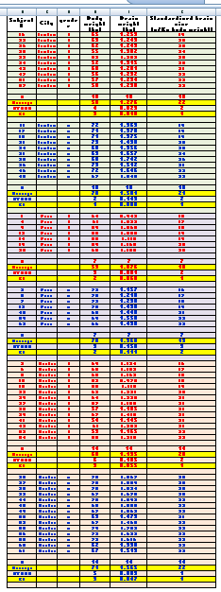
Calculate averages and confidence intervals of the body size, brain weight and standardised brain weight of our 6 groups of subjects.
1 All the females from London
Insert & Label rows for stats
Calculate Averages & confidence intervals
2 All the males from London
How do I do that?
See Excel 1&2!
3 All the females from Paris
4 All the males from Paris
5 All the females from Quebec
Go to the next slide
6 All the males from Quebec

Slide 20
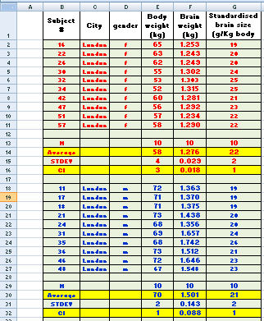
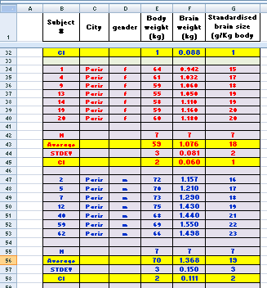
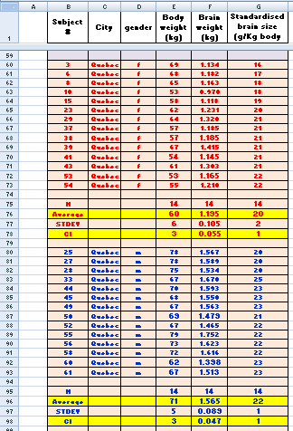

Calculate averages and confidence intervals of the body size, brain weight and standardised brain weight of our 6 groups of subjects. (con’t)
1 All the females from London
2 All the males from London
3 All the females from Paris
4 All the males from Paris
5 All the females from Quebec
6 All the males from Quebec
Now, we have to plot these data and
we will do it in
Click on Excel 5
Excel 5

Slide 21

Excel 4
For a demo on how to insert and label rows click here ->
For a demo on how to calculate Averages and
Confidence Intervals quickly & efficiently click here ->
85% no ribbon

