Slide 1
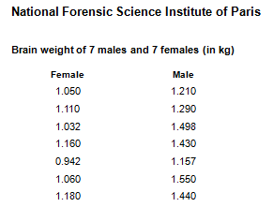
Simple Table & Simple Bar Graph
BASIC KNOWLEDGE
In this tutorial you will learn how to go from
THIS

Slide 2
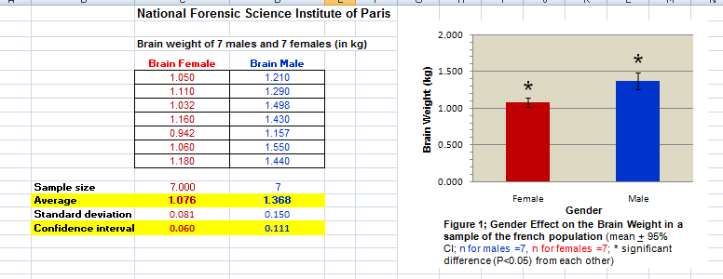
Learn how to border & change the color of your cells
to
Learn how to make bar graph
THAT
Learn how to use the statistical functions

Slide 3
Simple Table & Simple Bar Graph
BASIC KNOWLEDGE
In this tutorial you will learn how to go from
THIS
to
THAT
Learn how to border & change the color of your cells
Learn how to make bar graph
Learn how to use the statistical functions

Slide 4
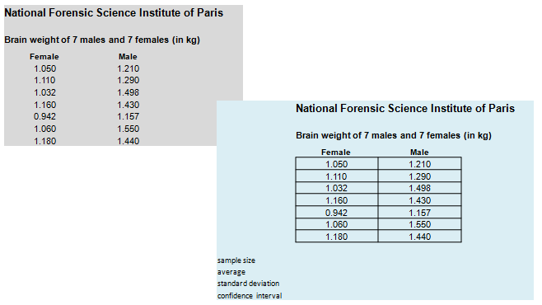

Simple Table
How to draw Borders around the cells
How to label your rows
How to increase the width of a column
TO
For a demo click here ->

Slide 5
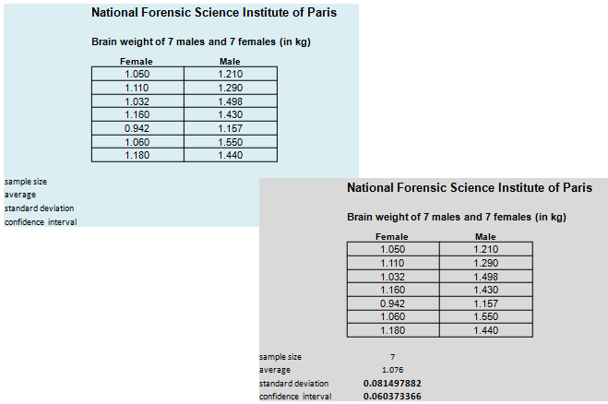
Simple Table
How to find the stats functions to calculate
Sample size, Average, Standard deviation and Confidence interval
TO

Slide 6
Simple Table
How to find the stats functions to calculate
Sample size, Average, Standard deviation and Confidence interval (con’t)
1- Go to function (fx)
2- Select “All”
3- Scroll to find the function you want
3- Scroll to find the function you want
4- Click on it
5- Select your dataset
Sample size → find “COUNT”
Average → find “AVERAGE”
Standard deviation → find “STDEV”
Confidence interval → find “CONFIDENCE”
6- Click on “OK”
For a demo click here ->

Slide 7
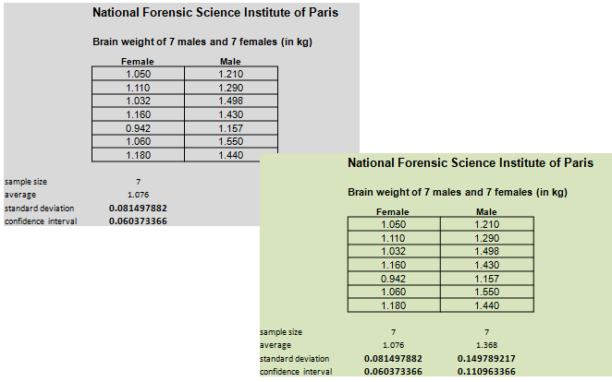
Simple Table
Calculate Sample size, Average, Standard deviation and Confidence interval for the Male dataset!
TO
Just Use “Copy” & “Paste”
For a demo click here ->

Slide 8
Simple Table
Calculate Sample size, Average, Standard deviation and Confidence interval for the Male dataset!
TO
Just Use “Copy” & “Paste”

Slide 9
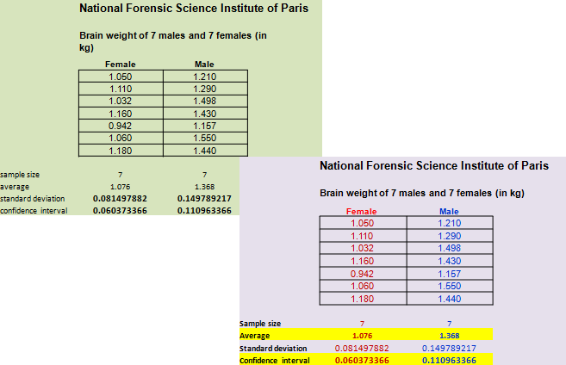
Simple Table
Color code, bold & highlight data in the table
Just Select the cells and then do your changes
TO
For a demo click here ->

Slide 10
Simple Table
Color code data & cells - bold data
Just Select the cells and then do your changes
TO
For a demo click here ->

Slide 11
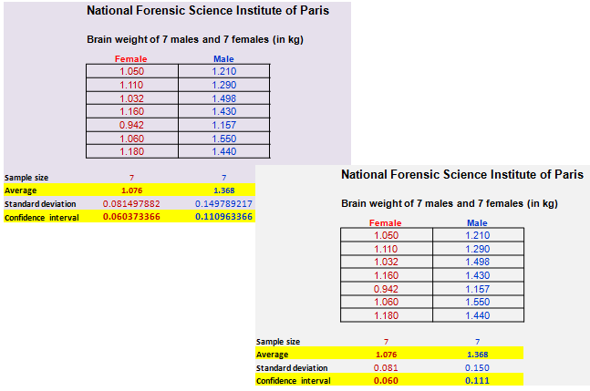
Simple Table
Change the decimal place
TO
For a demo click here ->

Slide 12
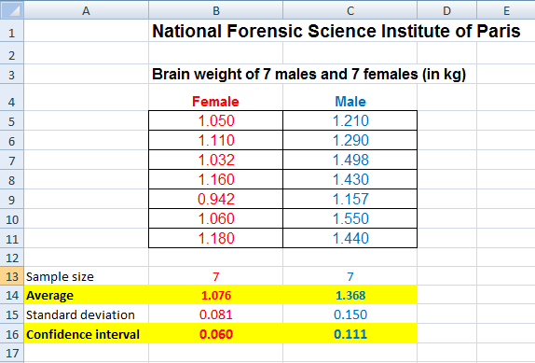
Simple Table
IMPORTANT: DOUBLE CHECK QUICKLY FOR ERRORS!
We copied the formulae of the female dataset and pasted them under the dataset of the male. Let’s make sure that the data selected for the males are the proper dataset.
Dataset that has to be selected for the males goes from C5 to C11
For a demo click here ->

Slide 13
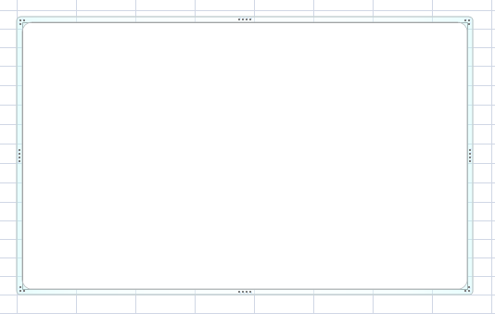
Simple Bar graph
Selecting “bar graph”
For a demo click here ->

Slide 14
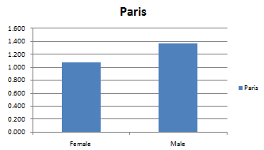
Simple Bar graph
Plotting the average brain weights of the males and females
Labelling the bars of your graph
TO
For a demo click here ->

Slide 15
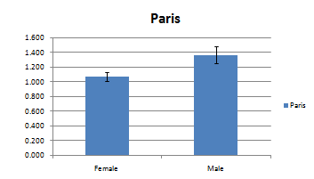
Simple Bar graph
Plotting the confidence intervals
TO
For a demo click here ->

Slide 16
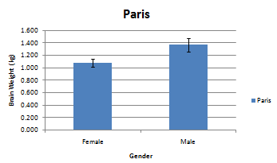
Simple Bar graph
Writing the axis titles (horizontal & vertical axis)
TO
For a demo click here ->

Slide 17
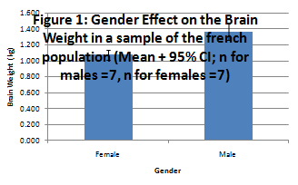
Simple Bar graph
Writing the graph title
TO
For a demo click here ->

Slide 18
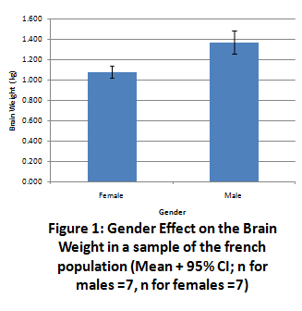
Simple Bar graph
Re-sizing & Dragging graph and titles
TO
Just Click on it & drag / resize
For a demo click here ->

Slide 19
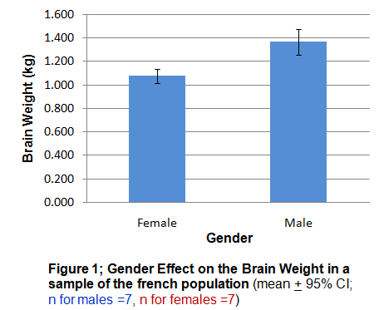
Simple Bar graph
Modifying the titles & Changing font size, type, color
TO
Just Click, select and then do your changes
For a demo click here ->

Slide 20

Simple Bar graph
Modifying the titles & Changing font size, type, color (con’t)
Oups!
I forgot to show you how to do “ + “.
Click on the demo!
Actually, you don’t need the demo – Just type the + sign and underline it!

Slide 21

17- Simple Bar graph
Modifying the titles & Changing font size, type, color (con’t)
Oups!
I forgot to show you how to do “ + “.
Click on the demo!
Actually, you don’t need the demo – Just type the + sign and underline it!

Slide 22
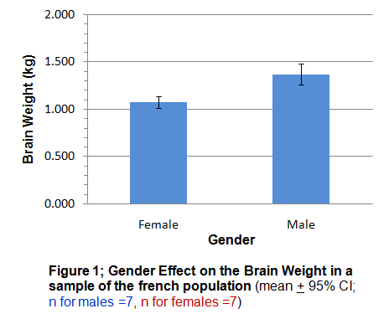
Simple Bar graph
Changing the scale of the Y-axis
TO
For a demo click here ->

Slide 23
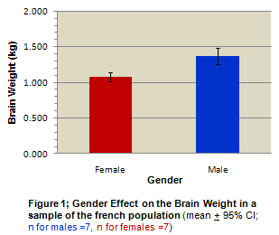
Simple Bar graph
Changing the colors of the bars
Changing the color of the background
(+ quick overview on how to format the chart and plot areas)
TO
For a demo click here ->

Slide 24
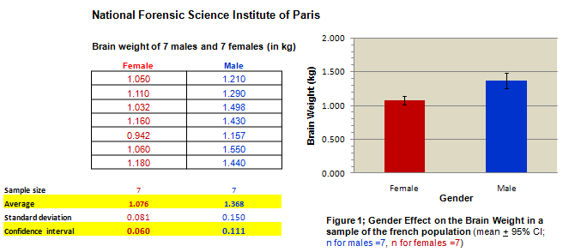
Simple Bar Graph
IMPORTANT:
QUICKLY DOUBLE CHECK FOR ERRORS!
Let’s make sure we didn’t make mistakes when we plotted our data. The graph should match the table (sometime it does not and students hand-in erroneous figures...)
For a demo click here ->

Slide 25
OH NO! The brains of French Women are significantly smaller (*) than their male counterparts
(*) In Biol 363 we will assume that means are significantly different from each other if their confidence intervals do not overlap - (in “real life” you should be doing proper statistical analysis!)
For a demo on how to add the * on the bars, click here ->

