Slide 1
INTRODUCTION to EXCEL
  TERMINOLOGY
  BRIEF INTRO ON MAKING A TABLE
  HOW TO FIND TOOLS YOU NEED
  BRIEF INTRO ON MAKING A GRAPH
  A GOOD ADVICE: double check your work!

Slide 2
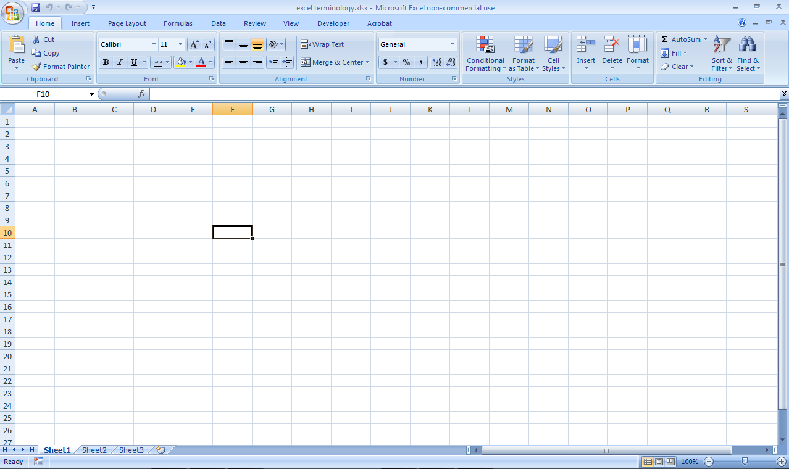
What is an “Excel spreadsheet document”?
Terminology
Excel spreadsheet document:
it is the whole thing

Slide 3
What are “Ribbon” & “Spreadsheets”?
Terminology
Ribbon: it contains all the tools. (to switch between them, click on the tabs; then click on the tool you need)
File name
3 “pages” called Spreadsheets. (to switch between them, click on the tabs; to access their tools, right-click on the tabs)
Click there to create a new spreadsheet
Zoom

Slide 4
What are “Cell”, “Columns & Rows”, “Cell identification”, “Formula bar”?
Terminology
Display the identification of the cell(s) you selected
Columns (Excel identifies them with letters )
Formula bar (displays what is in the cell – it can be a number, words, or a formula)
Cell (one block of information inside the spreadsheet. In it you will type either, number, formula or text) – Excel identifies each cell by its unique column and row heading (this cell is identified as F10).
Rows (Excel identifies them with numbers)

Slide 5
What are “Columns & Rows”?
Terminology
Column
Rows (Excel identifies them with numbers)
Columns (Excel identifies them with letters )
Row

Slide 6
What are “Cell” and “Cell identification”?
Terminology
Display the identification of the cell(s) you selected
Cell (one block of information inside the spreadsheet. In it you will type either, number, formula or text) – Excel identifies each cell by its unique column and row heading (this cell is identified as F10).

Slide 7
What is “Formula bar”?
Terminology
Formula bar (displays the content of the cell you selected – it can be a number, words, or a formula)

Slide 8
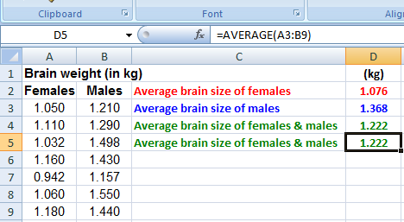
What is a Range of cells? What is it used for?
Terminology
A range of cells is a group of cells that you will select in order to perform a task on them all together.
The task can be anything from “changing their color” (see example #1) to “calculating the average of their numbers” (see example #2)
A range of cells is referred by the identification of the cell in the upper-left corner of the range, a colon (:), and then the identification of the cell in the lower-right corner of the range.
Formula bar shows what is in the cell D5.
D2 calculate the average of all the values that are in the Range of cells A3 to B9

Slide 9
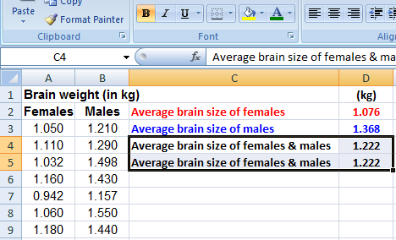
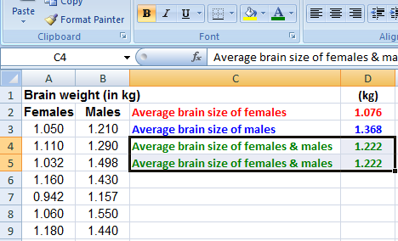
Range of cells (con’t) – Example #1: Changing color
Terminology
How to change the color of the font in the cell range C4:D5 from BLACK to GREEN
1- Select the range
(we will show you how to do that later)
2- Click on the “Font color tool” and choose your color
3- DONE! It’s green.

Slide 10
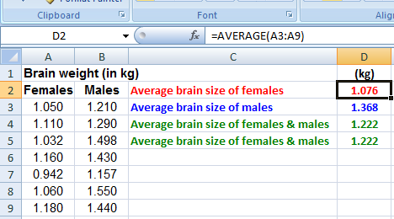

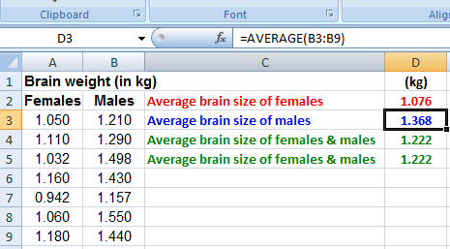

Range of cells (con’t) – Example #2: Calculating averages
Terminology
To calculate the average of the brain size of females, we selected the range of cells A3:A9
We will show you how to find the formula for average and how to select the range later
To calculate the average of the brain size of males, we selected the range of B3:B9
MORE ON RANGE!
CLICK HERE!

Slide 11
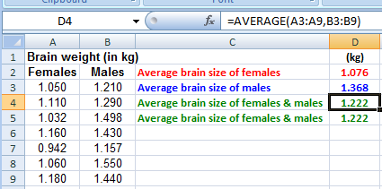
Range of cells (con’t) – Example #2: Calculating averages (more)
Terminology
To calculate the average of the brain size of female & males, we either select the range of cells A3:B9
We will show you how to find the formula for average and how to select the range later
or we select the 2 ranges of cells A3:A9 & B3:B9

Slide 12
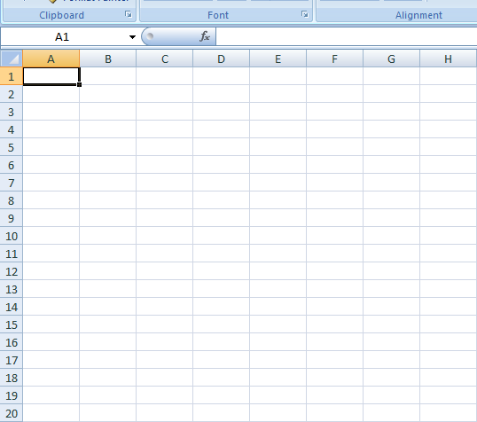
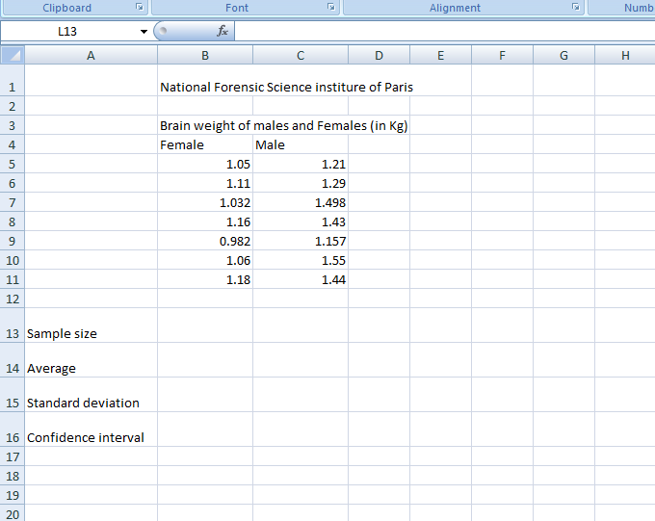
Entering and correcting information (numbers & text) in your spreadsheet
Just Click on a cell and type!
Do you know how to change column width and row height?

Slide 13
Brief Intro – Table See it!
Going from here
to there!

Slide 14
Brief Intro – Table How to type and correct information in cells

Slide 15

Brief Intro – Making a Table
Just Click on a cell and type
For a demo on how to type and correct information in cells click here ->
For a demo on how to insert, delete & change column width and row height, click here ->

Slide 16
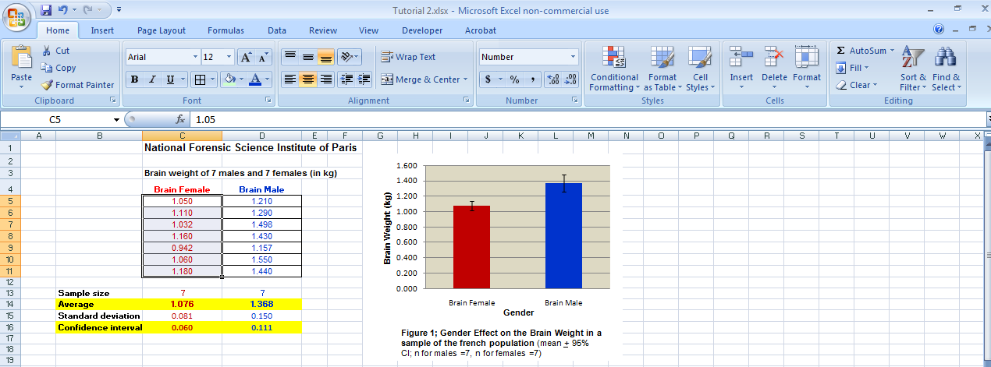
9- FIRST USEFUL TIP: The general rule to find the tool you need!
To modify any component of a Table or a graph you can follow either method A) or method B)
Method A) Good Mostly for Excel 2007
1- Select a component
(for example a range of cells)
2- Browse through the ribbon at the top of Excel to find the tool you need to do the change
In Excel, if you click there , a window will appear with more tools

Slide 17
The general rule to find the tool you need!
To modify any component of a Table or a graph you can follow either method A) or method B)
Method A) Good Mostly for Excel 2007
1- Select a component
(for example a range of cells)
2- Browse through the ribbon at the top of Excel to find the tool you need to do the change
In Excel, if you click there , a window will appear with more tools

Slide 18
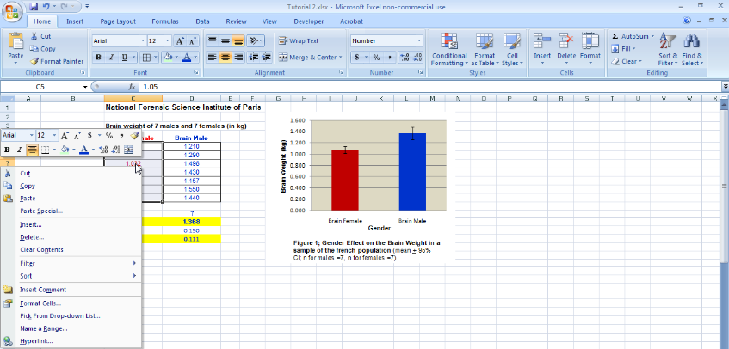
10- FIRST USEFUL TIP: The general rule to find the tool you need!
To modify any component of a Table or a graph you can follow either method A) or method B)
Method B) Good for Excel 2004 & 2007
1- Select a component
(for example a range of cells)
2- Right click with your mouse on the top of the component selected. A window opens offering the tools available.

Slide 19
The general rule to find the tool you need!
To modify any component of a Table or a graph you can follow either method A) or method B)
Method B) Good for Excel 2004 & 2007
1- Select a component
(for example a range of cells)
2- Right click with your mouse on the top of the component selected. A window opens offering the tools available.

Slide 20
The general rule to find the tool you need!
Watch a demo

Slide 21
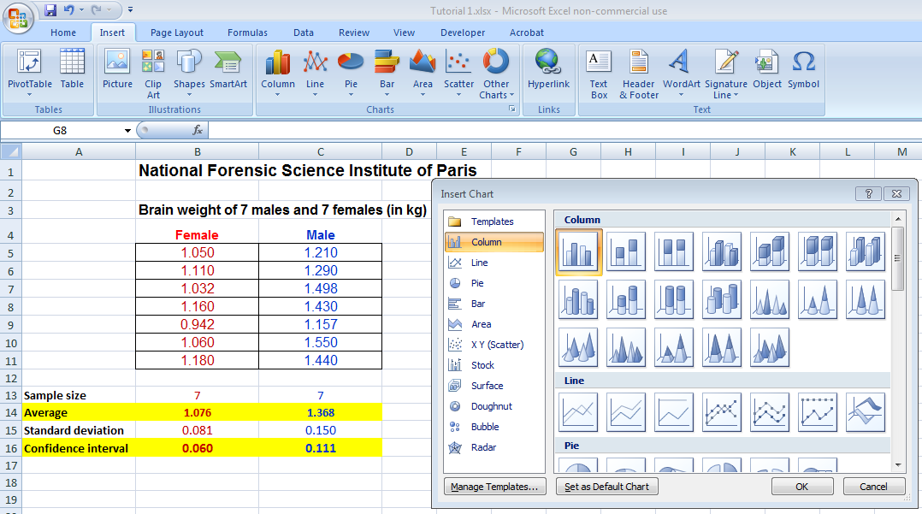
BRIEF INTRO - GRAPHS: How to insert a graph in your spreadsheet
Graph is called chart by Excel!
1- Click on “Insert”
2- Click on your choices (type and subtype of graph)

Slide 22
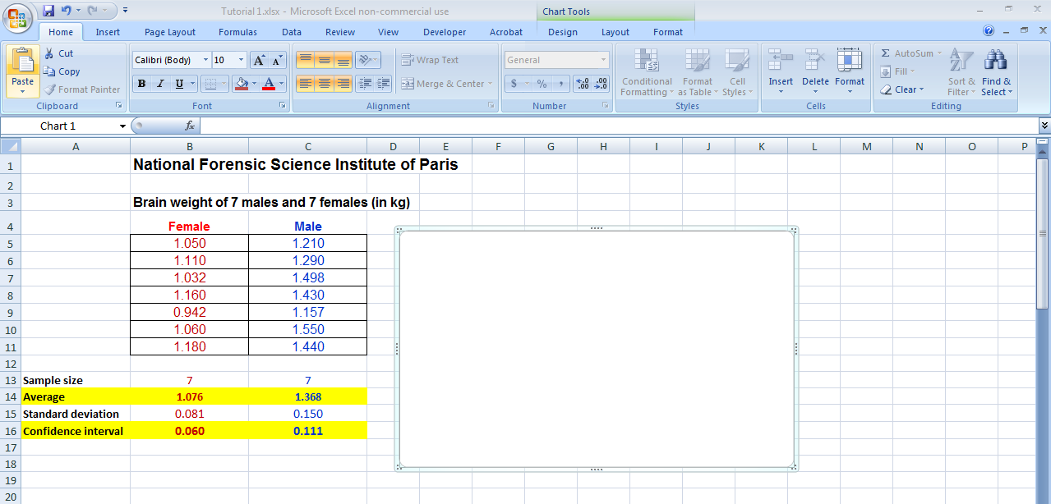
BRIEF INTRO - GRAPHS: How to insert a graph in your spreadsheet
Graph is called chart by Excel!
1- Click on “Insert”
2- Click on your choices (type and subtype of graph)
3- A box appears. This is where you will make your graph
We will learn how to make an actual graph later

Slide 23
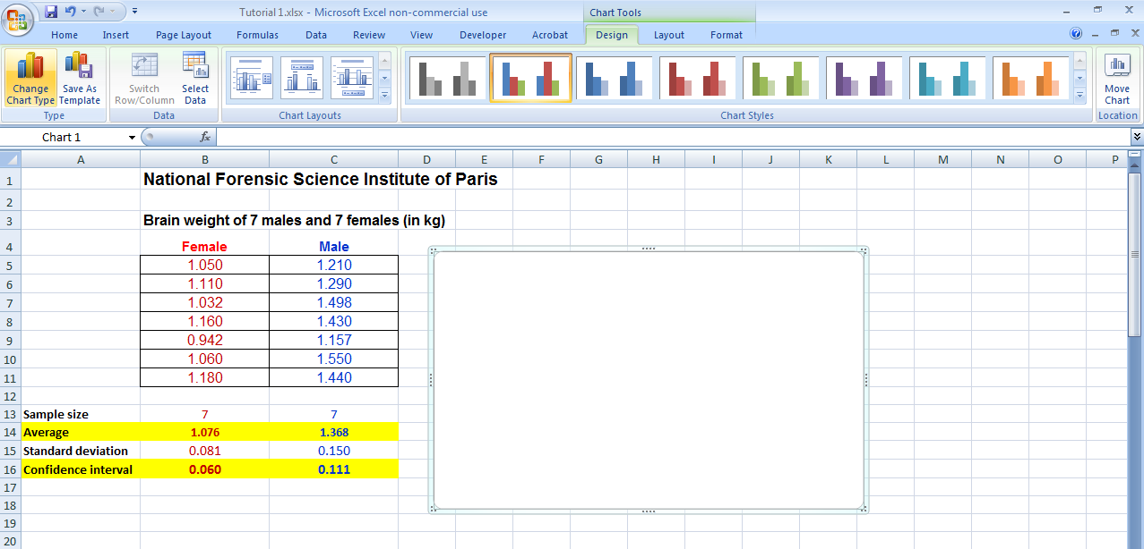
BRIEF INTRO - GRAPHS: How to find tools to make/modify graphs!
How to find tools to make/modify your graph?
1- Click inside the box!
2- see the 3 tabs giving you access to tools
3- click on the tabs
4- see all the choices
“ Click “

Slide 24
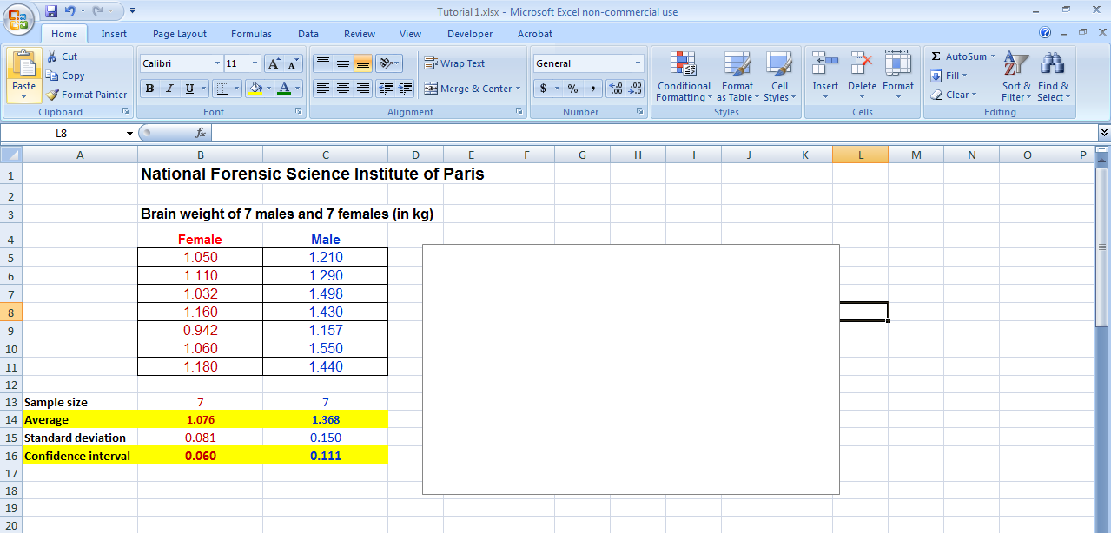
BRIEF INTRO - GRAPHS: I cannot find the tools!
Make sure that you click inside the box!
If you do not click inside the box: the tools to make the graph cannot be seen
“ Click “

Slide 25
BRIEF INTRO - GRAPHS: Demo
Make sure that you click inside the box!
If you do not click inside the box: the tools to make the graph cannot be seen
“ Click “
For a demo click here ->

Slide 26
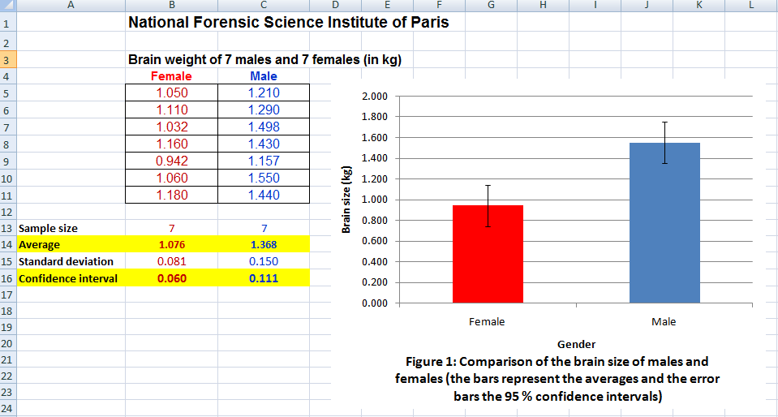
A GOOD ADVICE: DOUBLE CHECK your work QUICKLY FOR ERRORS!
Double check that you didn’t make mistakes.
If you rush to deadline, it is easy to make mistake when selecting the range of cells to calculate statistical variables or when selecting the values you need to plot in your graph
It is easy to double check quickly if there is a mismatch. For example ....
Can you find the 2 mistakes in the graph below?

Slide 27
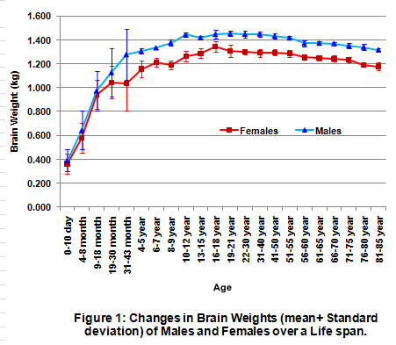
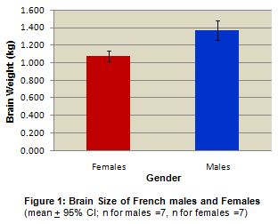
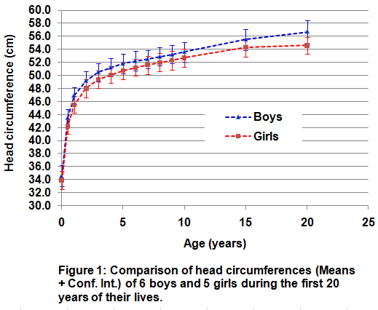
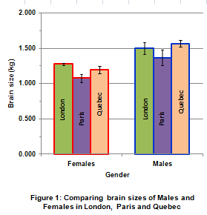
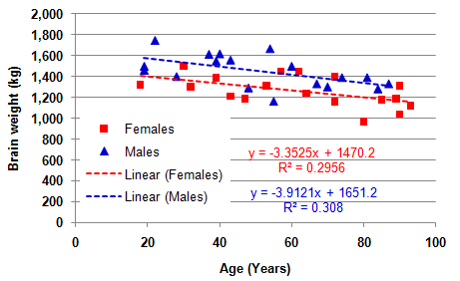
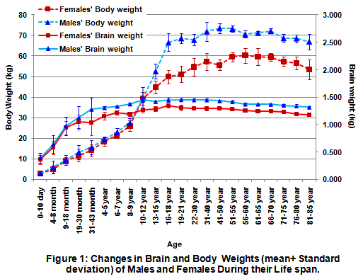
Graphs - Terminology - Types
Bar graphs
Scatter (or XY) graphs
Line graphs

Slide 28
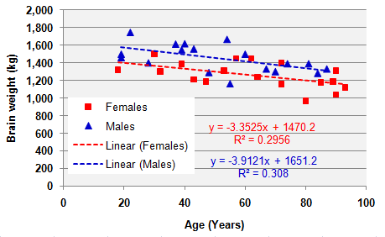
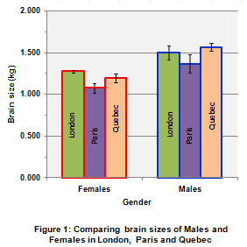
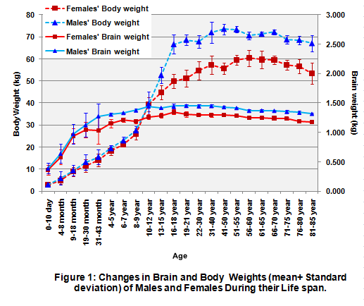
17- Graphs - Terminology
Understand the difference between:
Chart Area & Plot Area
X axis & Y axis
Chart Area
Plot Area
Y axis
X axis
Chart Area
Plot Area
Chart Area
Plot Area

Slide 29
Graphs - Terminology
Understand the difference between:
Chart Area
Plot Area
Chart Area & Plot Area
Chart Area
Plot Area
Chart Area
Plot Area

Slide 30
Graphs - Terminology
Understand the difference between:
X axis & Y axis
Y axis
X axis

Slide 31

Graphs – Terminology – Data series
Data series refers to the set of values (X,Y) that are going to be plotted on the graph
OK! So Data series are just plots on a graph!
1 series
2 series
2 series
3 series
2 series
4 series

