Slide 1
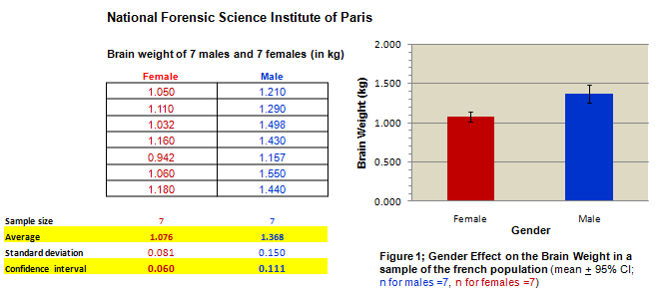
In Excel 2 we saw that the brains of French Women are significantly smaller (*) than their male counterparts
*
*
It may just be because Females are smaller than Males and therefore we should standardise our data to correct for the difference in Body size.
In this tutorial we will utilise the “arithmetic equations” feature of Excel to standardise our data. We will divide each brain weight by the body weight of its owner.

Slide 2
EXCEL’S ARITHMETIC EQUATIONS
In Excel 2 we saw that the brains of French Women are significantly smaller (*) than their male counterparts
*
*
It may just be because Females are smaller than Males and therefore we should standardise our data to correct for the difference in Body size.
In this tutorial we will utilise the “arithmetic equations” feature of Excel to standardise our data. We will divide each brain weight by the body weight of its owner.

Slide 3
Arithmetic Equations
BASIC KNOWLEDGE
I will assume that you possess basic knowledge of Excel (see Tutorials 1&2)
In this tutorial you will learn how to go from
THIS

Slide 4
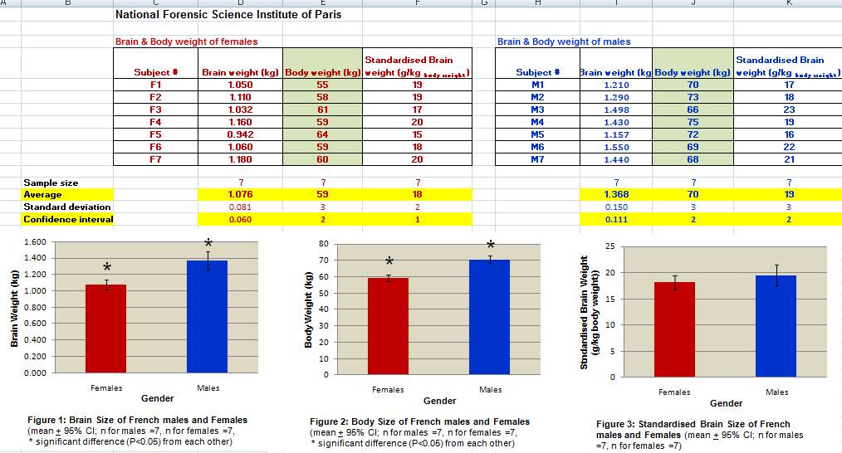
3-
To
Learn how to use Arithmetic Equations
Insert an extra column
Wrap text inside a cell
THAT
Learn how to make 2 graphs in less than 30 sec.

Slide 5

Arithmetic Equations
I will assume that you possess basic knowledge of Excel (see Tutorials 1&2)
In this tutorial you will learn how to go from
THIS
Click on the arrow!
Click here!
to

Slide 6
Arithmetic Equations
THAT
Learn how to insert an extra column
Learn how to wrap text inside a cell
Learn how to use Arithmetic Equations
Learn how to make 2 graphs in less than 30 sec.

Slide 7
FIRST – SOME BACKGROUND INFORMATION ON ARITHMETIC EQUATIONS IN EXCEL!
4-

Slide 8
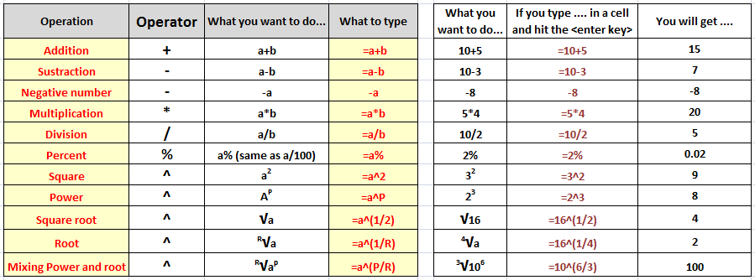
Excel can do Arithmetic Equations
and this is the list of Arithmetic operators it uses.
IMPORTANT:
The sign = tells Excel that the succeeding characters constitute a formula.
Excel can also use parentheses () to control the order of calculation.
Excel can perform calculations on numbers or on cells (we will see how to perform calculations on cells next).

Slide 9

Wait a minute!
BIG DEAL?
What’s the
I can use a calculator and do it faster. I do not need Excel spreadsheet to add, subtract or multiply a few numbers!
Well my rotund yellow friend, the BIG DEAL is ... an excel equation can also refer to other cells within the worksheet and this enables you to do a great number of calculations very fast just with a few click of your mouse.
Excel is much more than a fancy calculator! Go to the next slides.

Slide 10


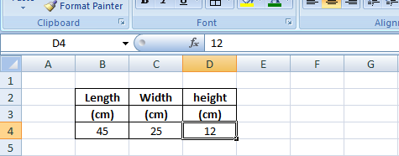
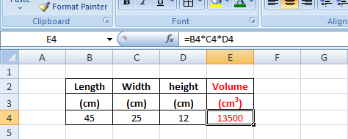
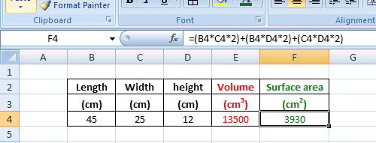
Just an quick example to illustrate. Let’s calculate the volume and surface area of a box using the arithmetic equations
I type the Length, Width and Height of a box in this table ->
Look in the formula bar, you see “12” the height of the box.
I type in red the formula to calculate the volume of the box ->
Look at the formula bar. You do not see “45” or “25” or “12” see inside the formula. You see the “identification” of the cells that carry the Length, Width and Height .
Same here. In green I type the formula to calculate the surface area of the box.
(By the way, double-check quickly the formula in the formula bar! Is it the correct formula and did I refer to the proper cells?
Nice, but I can use my calculator and do it faster!

Slide 11

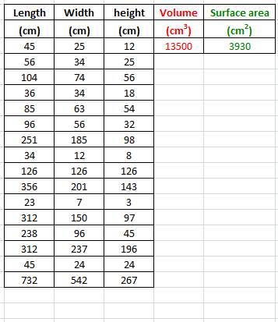
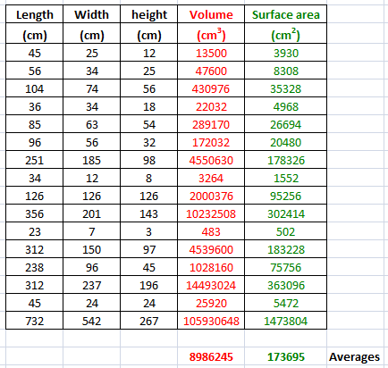


You are right! If you have to do these calculations for ONE box only, using your calculator will be faster
But what if you need to calculate the volume and surface area of 16 boxes?
Let’s race! I will use the Arithmetical equations (and refer to the appropriate cells) to calculate volume and surface area of the 1st box. THEN I will use the copy/paste tool to do the same 2 calculations for my 15 other boxes.
You will do the same calculations using your calculator!
Me: Less than 30 sec.
You?
16 minutes! Pfff...

Slide 12
NOW – LETS GO BACK TO OUR BRAIN STORY AND LEARN HOW TO DO IT!
9-

Slide 13
In Excel 2 we saw that the brains of French Women are significantly smaller (*) than their male counterparts
*
*
It may just be because Females are smaller than Males and therefore we should standardise our data to correct for the difference in Body size.
In this tutorial we will utilise the “arithmetic equations” feature of Excel to standardise our data. We will divide each brain weight by the body weight of its owner.

Slide 14
Learn how to insert an extra column
Learn how to wrap text inside a cell
Learn how to use Arithmetic Equations
Learn how to make 2 graphs in less than 30 sec.

Slide 15
10- Remember the brain story? The brains of French Women seems to be significantly smaller (*) than their male counterparts...
It may just be because Females are smaller than Males. Let’s standardise our data by dividing each brain weight by the body weight of its subject and see if we still get the same trend between genders.
And we will use Excel arithmetic equations to do just that!

Slide 16
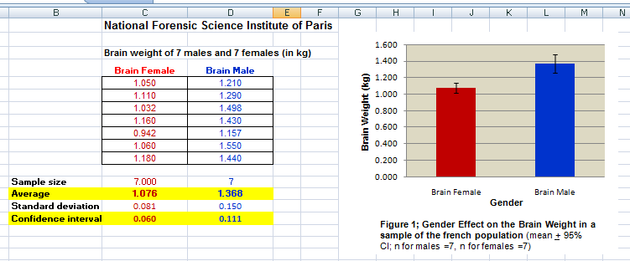
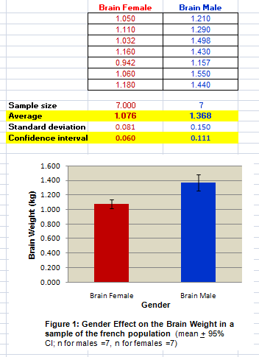
Moving the graph below the table
TO
Just click on the graph & drag it!

Slide 17

11- Moving the graph below the table
Just click on the graph & drag it!
TO
For a demo click here ->

Slide 18
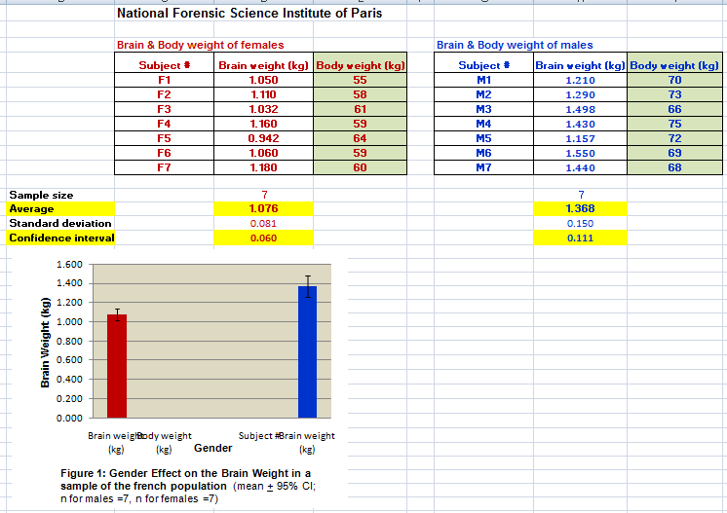
Table
Inserting columns in the table to type the subjects’ Identification numbers and body weight
TO
The graph becomes all weird
Do NOT PANIC!
DO NOT DESPAIR!

Slide 19
12- Table
Inserting subjects’ Identification numbers and their body weight in the table
TO
The graph becomes all weird
Do NOT PANIC!
DO NOT DESPAIR!
For a demo click here ->

Slide 20
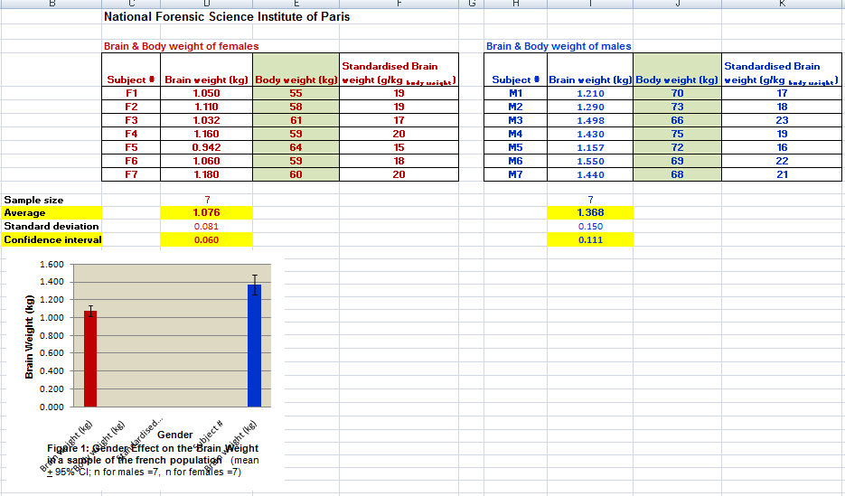
13- Using Arithmetic equations to standardise the brain weight
For each subject, we will divide the brain weight by the body weight using the arithmetic formulae:
Standardised brain size in g per kg _{body weight} = (Brain weight in kg * 1000) / Body weight in kg
... and learn how to wrap text inside a cell
TO
Type the arithmetic equation in one cell
then Copy & Paste it in the other cells!
The graph becomes weirder
Keep steady!

Slide 21
Table
Inserting columns in the table to calculate their standardised brain weights & learning how to wrap text in cells
Insert these two columns ... and learn how to wrap text inside a cell
TO
Type the arithmetic equation in one cell
then Copy & Paste it in the other cells!
The graph becomes weirder
Keep steady!

Slide 22
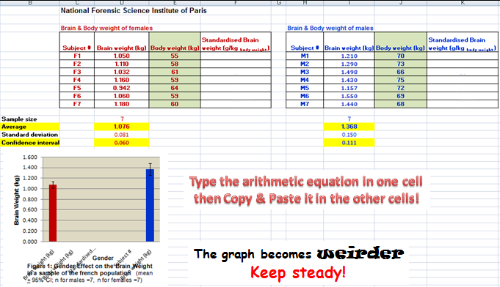
Table
Inserting columns in the table to calculate their standardised brain weights & learning how to wrap text in cells
Insert these two columns ... and learn how to wrap text inside a cell
Type the arithmetic equation in one cell
then Copy & Paste it in the other cells!
The graph becomes weirder
Keep steady!

Slide 23
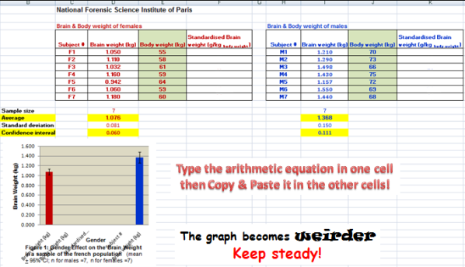
Table
Using Arithmetic equations to standardise the brain weight
For each subject, we will divide the brain weight by the body weight using the arithmetic formulae:
Standardised brain size in g per kg _{body weight} = (Brain weight in kg * 1000) / Body weight in kg
TO
Type the arithmetic equation in one cell
then Copy & Paste it in the other cells!
The graph becomes weirder
Keep steady!

Slide 24
For a demo on how to wrap text inside a cell click here ->
(if you just want to see the demo of the wrap,
speed up right to the second half of the clip)
For a demo on how to do arithmetic function click here ->

Slide 25
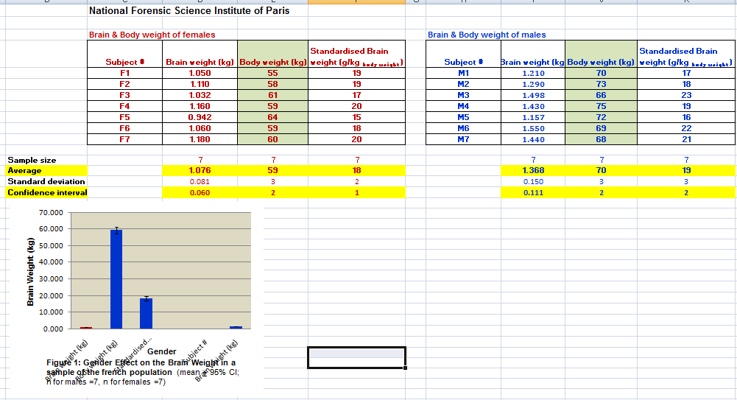
Table
Calculating averages and confidence intervals of the body sizes and standardised brain weights of males and females
Just Copy & Paste!
TO
Weirder & Weirder!

Slide 26
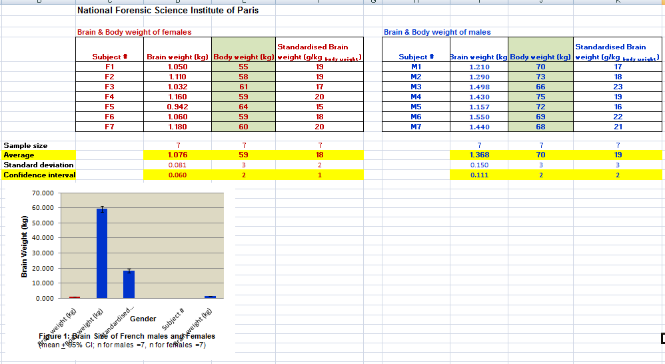
14- We calculate averages and confidence intervals of the body size and the standardised brain weight of our males and females
Just Copy & Paste!
TO
Weirder & Weirder!
For a demo click here ->

Slide 27
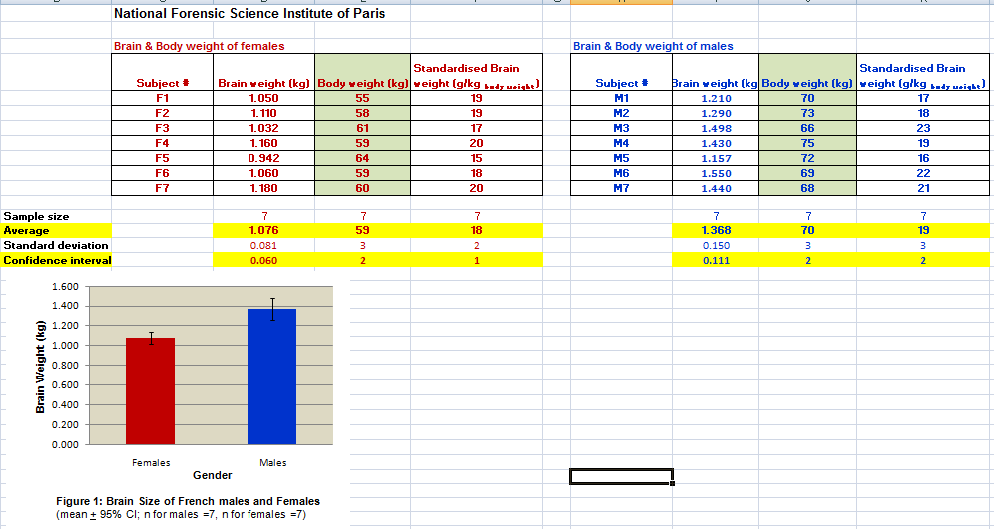
Fixing the “weird graph” -> we have 2 choices:
Either we delete it & make a new one from scratch (how? see Excel 2)
or we fix it (how? Select what you want to change in your old graph by clicking on it and just change it)
TO

Slide 28
15- Graphing data-> we have 2 choices:
Either we delete the old graph & make a new one from scratch (how? see Excel 2 to show how) or we fix the old graph (how? See demo on this slide)
Just select what you want to change in your old graph (click on it) and change it!
TO
For a demo click here ->

Slide 29
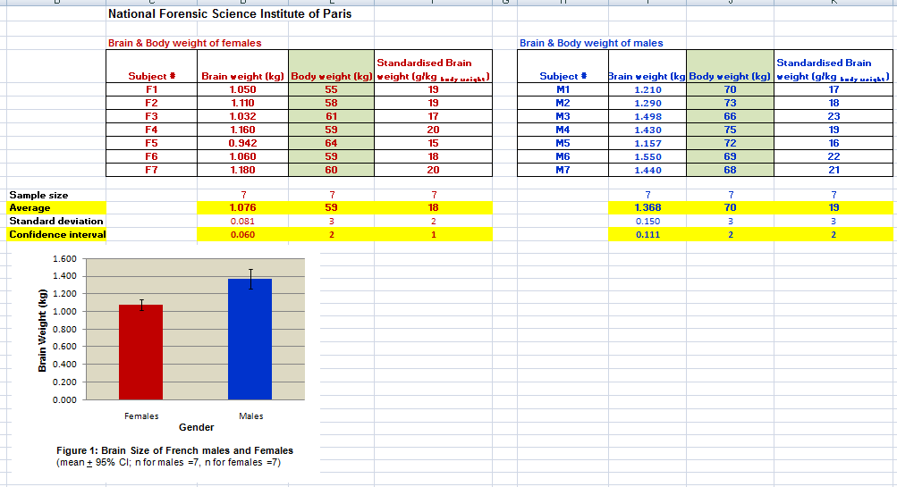
Making 2 new graphs in less than 30 sec!
Copy & Paste Twice.
Then click in these 2 graphs
and make your changes!
TO

Slide 30
Hey! If we standardise brain size relatively to body weight, there is no significant difference between genders.
(*) In Biol 363 we will assume that means are significantly different from each other if their confidence intervals do not overlap - (in “real life” you should be doing proper statistical analysis!)

