Slide 1

SARS-CoV-2
An evolving pandemic
Sarah (Sally) Otto
Department of Zoology
University of British Columbia
Notes:
https://nextstrain.org/ncov?l=radial

Slide 2
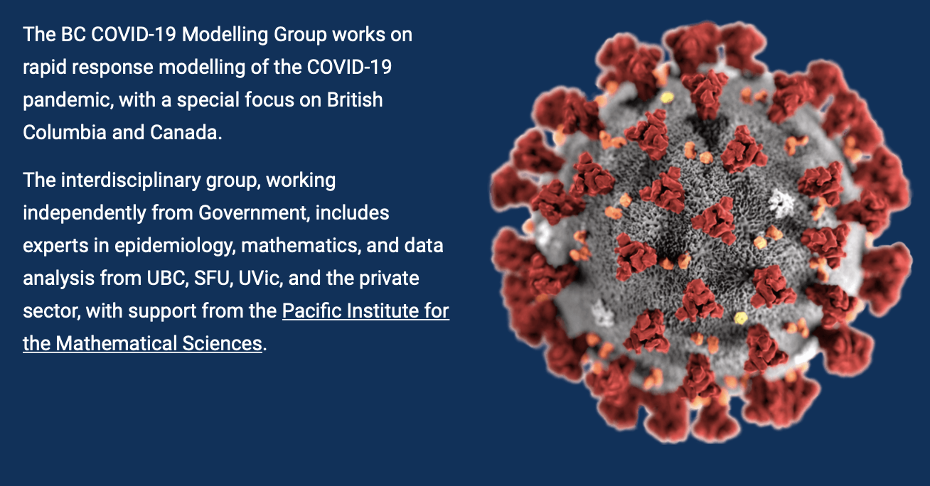
BC COVID-19 Modelling Group
Weekly meetings
Review relevant articles
Expert presentations
Present new models for feedback
Request help with projects
Provide advice
Slack channel
News updates
Communications channel
Community building
Public reports
https://bccovid-19group.ca
https://bccovid-19group.ca
Independent and freely offered advice,
using a diversity of modelling approaches.

Slide 3
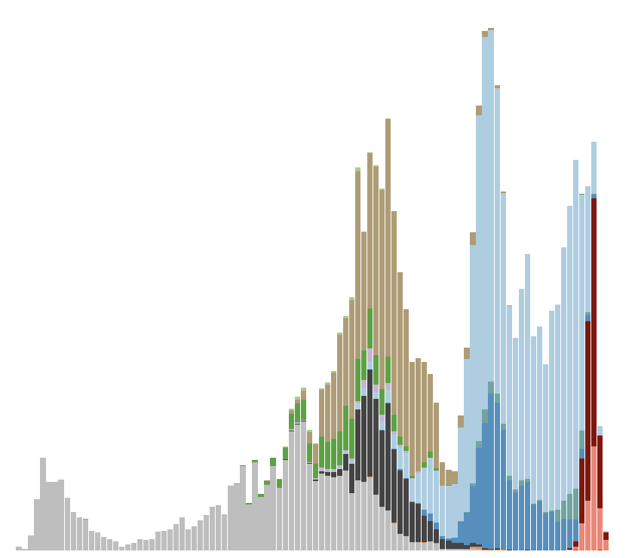

A year later, a broader network of Canadian scientists launched CoVaRR-Net (Coronavirus Variants Rapid Response Network, https://covarrnet.ca) with the goal of tracking and assessing the impact of variants.
Network brings together immunologists, bioinformaticians, molecular & cellular biologists, public health experts, and evolutionary biologists.
https://bccovid-19group.ca

Slide 4
A year later, a broader network of Canadian scientists launched CoVaRR-Net (Coronavirus Variants Rapid Response Network, https://covarrnet.ca) with the goal of tracking and assessing the impact of variants.
Network brings together immunologists, bioinformaticians, molecular & cellular biologists, public health experts, and evolutionary biologists.
https://bccovid-19group.ca
Evolution…of how we conduct science to aid action

Slide 5
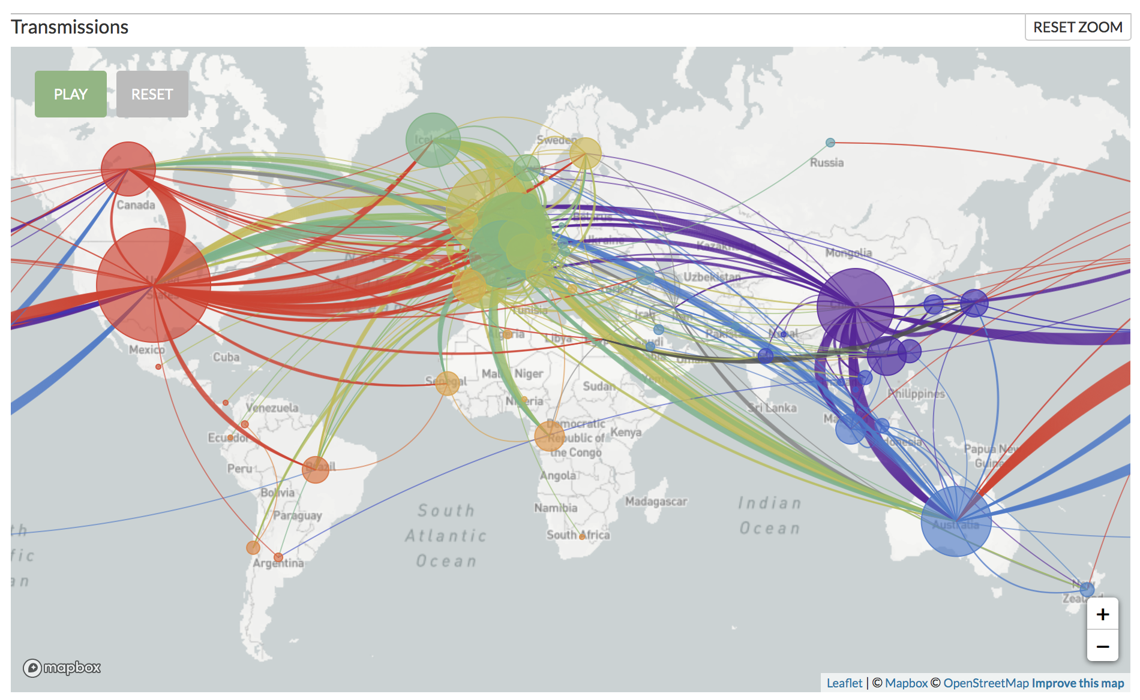
Nextstrain.org
Within weeks after the initial reports emerging from Wuhan, China, of a new respiratory illness in December 2019, scientists had already started searching for signatures of adaptation to humans within the genomes of SARS-CoV-2.
https://nextstrain.org/ncov?l=radial
Notes:
https://nextstrain.org/ncov?l=radial

Slide 6
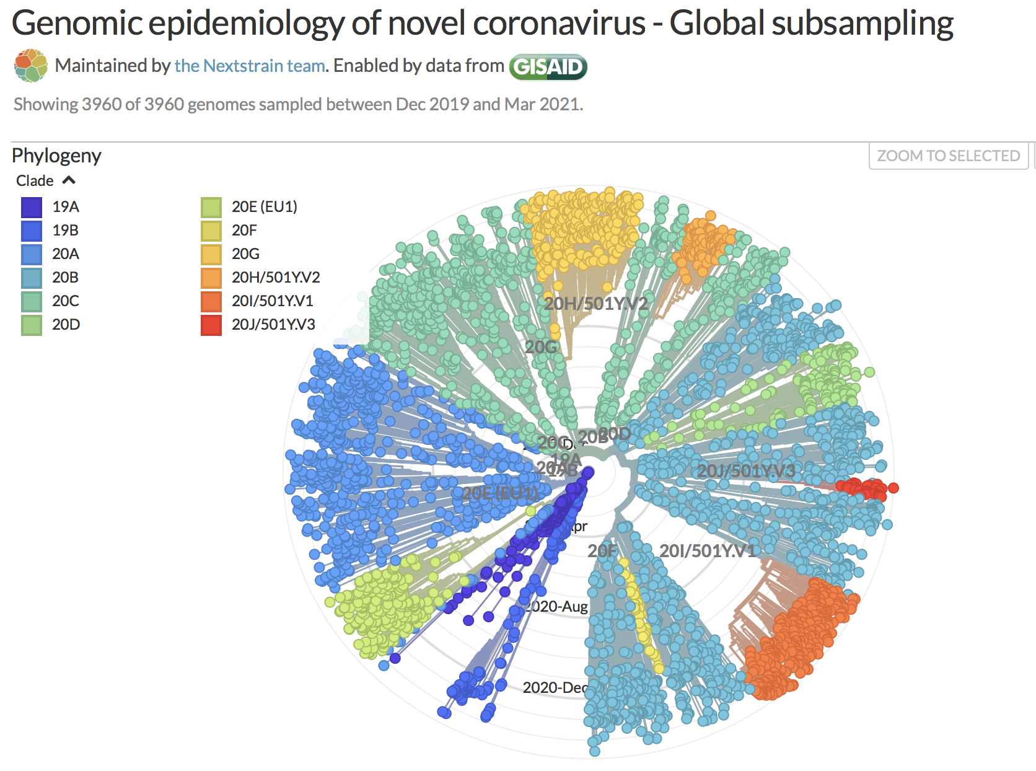
~11,000,000 genomes!!
Sequences coalesce
in Nov/Dec 2019
Rate of substitution:
= 0.0008/bp/year
(about once per genome every two weeks)
First year did not show strong signs of selective sweeps
(star-shaped tree)
https://nextstrain.org/ncov?l=radial
Notes:
~2–6 times lower than the seasonal flu
Alpha – 20I, Beta – 20H, Gamma – 20J

Slide 7
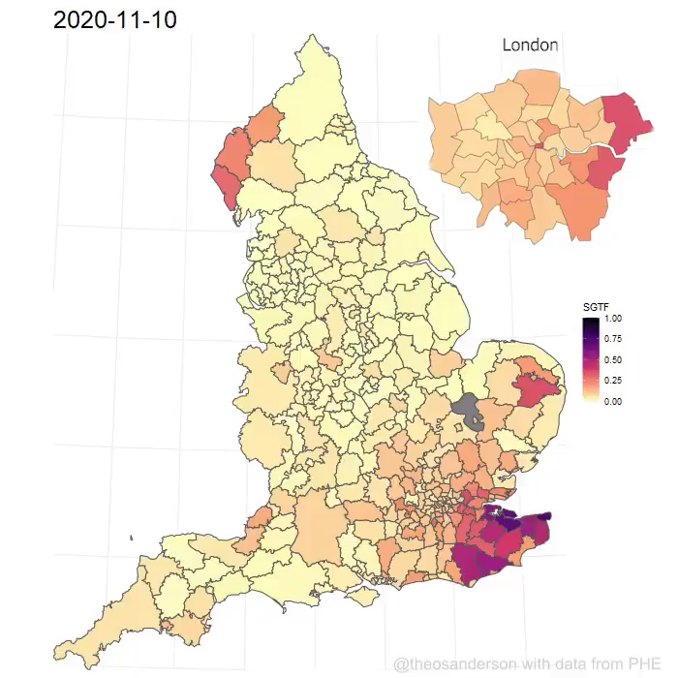
Variants of Concern
Public Health England (Dec. 21, 2020) reported a Variant of Concern (VOC) B.1.1.7 that had increased in frequency across multiple weeks and across multiple health authorities.
Data from Public Health England
(visual from Theo Sanderson)

Slide 8
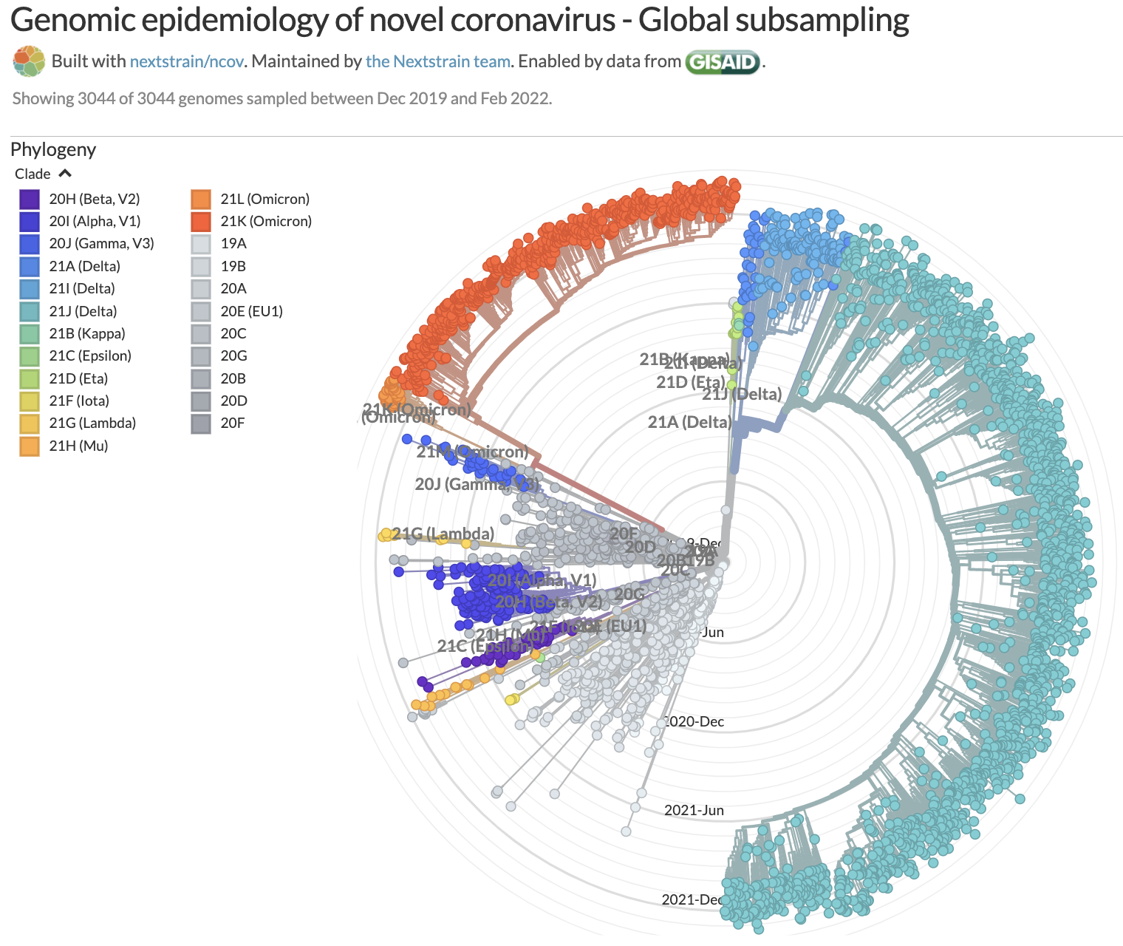
Second year characterized by waves of variants of concern (VoCs)
https://nextstrain.org/ncov?l=radial
Notes:
~2–6 times lower than the seasonal flu

Slide 9

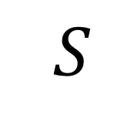
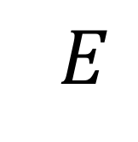
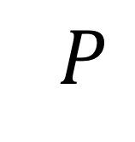
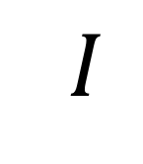
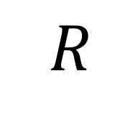
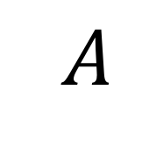

Modelling selection on SARS-CoV-2
Mutations added and tracked
⚡️
susceptible
exposed
presymptomatic
symptomatic
recovered
asymptomatic
Vaccinations & waning over time
Day et al. (2020)
Otto et al. (2022)

Slide 10
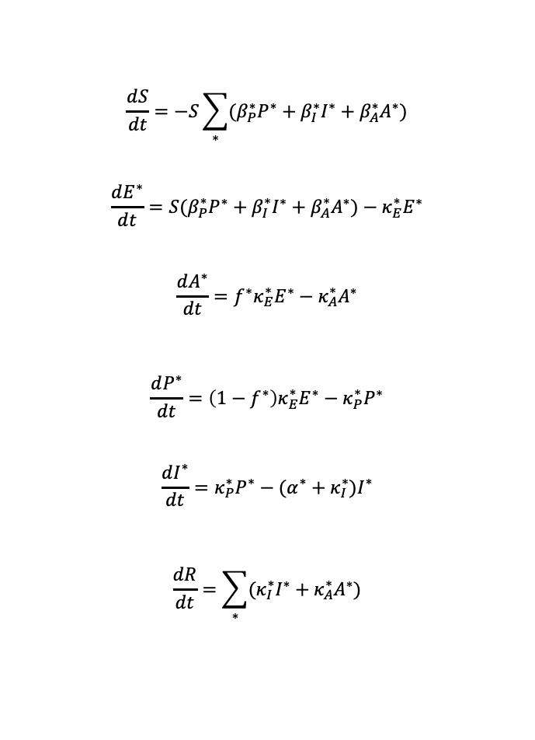
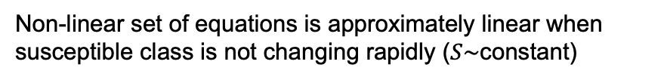
$$\frac{dS}{dt}=−S\sum_{∗}{(β_{P}^{∗}P^{∗}+β_{I}^{∗}I^{∗}+β_{A}^{∗}A^{∗})}$$
$$\frac{dE^{∗}}{dt}=S(β_{P}^{∗}P^{∗}+β_{I}^{∗}I^{∗}+β_{A}^{∗}A^{∗})−κ_{E}^{∗}E^{∗}$$
$$\frac{dA^{∗}}{dt}=f^{∗}κ_{E}^{∗}E^{∗}−κ_{A}^{∗}A^{∗}$$
$$\frac{dP^{∗}}{dt}=\left(1−f^{∗}\right)κ_{E}^{∗}E^{∗}−κ_{P}^{∗}P^{∗}$$
$$\frac{dI^{∗}}{dt}=κ_{P}^{∗}P^{∗}−(α^{∗}+κ_{I}^{∗})I^{∗}$$
$$\frac{dR}{dt}=\sum_{∗}{(κ_{I}^{∗}I^{∗}+κ_{A}^{∗}A^{∗})}$$
SEAPIR Model
Non-linear set of equations is approximately linear when susceptible class is not changing rapidly ($S\sim$constant)
susceptible
exposed
presymptomatic
symptomatic
recovered
asymptomatic
Notes:
Choose parameters to constrain R0 initially to around 2.5
Parameters from Caroline’s G&M study:
D = 5 = 1/${ κ}_{I}$, R0=2.56 = (1+D${ κ}_{P}$) $β$/$κ_{P}$ if $β_{P}=β_{I}=β$ and $β_{A}=0$, $κ_{E}$ = 1/4, $κ_{P}$ = 1
[D is likely longer? And $κ_{P}$ might be smaller, 1/2 or 1/3 for a 2-3 days presymptomatic based on He et al.?]
$β_{P}$ may be higher than the average value of $β_{I}$ based on viral trajectories. Set default $β_{P}$ = $β_{I}.$
$β_{A}$ is the big unknown. Set default to zero
Default f ~ 20% (Mizumoto et al.)
Quarantine can be treated by altering $β_{P}$ and $β_{I}$. Social distancing would lower both (${cβ}_{P}$ and ${cβ}_{I}$), while self-isolating cases would lower primarily those with symptoms (${c q β}_{I}$).
Set ${1/ κ}_{A}=$(${1/ κ}_{P}$)+$({1/ κ}_{I}$) to have the same expected time through the infectious and asymptomatic routes.
R0= ((1-f) ($β_{P}$ (α+$κ_{I}$ )+$β_{I}$ $κ_{P}$ ))/((α+$κ_{I}$) $κ_{P}$) +($β_{A}$ f)/$κ_{A}$
bA=0;
f=0.2;
κI=0.2;
κE=0.25;
κP=1;
bP=0.7;
bI=0.7;
α=0.05;
R0=2.8

Slide 11
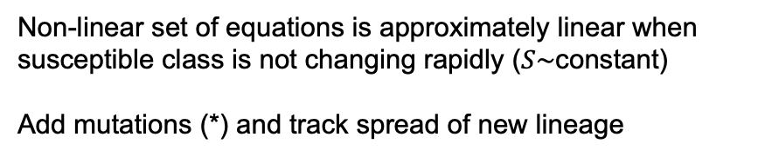
$$\frac{dS}{dt}=−S\sum_{∗}{(β_{P}^{∗}P^{∗}+β_{I}^{∗}I^{∗}+β_{A}^{∗}A^{∗})}$$
$$\frac{dE^{∗}}{dt}=S(β_{P}^{∗}P^{∗}+β_{I}^{∗}I^{∗}+β_{A}^{∗}A^{∗})−κ_{E}^{∗}E^{∗}$$
$$\frac{dA^{∗}}{dt}=f^{∗}κ_{E}^{∗}E^{∗}−κ_{A}^{∗}A^{∗}$$
$$\frac{dP^{∗}}{dt}=\left(1−f^{∗}\right)κ_{E}^{∗}E^{∗}−κ_{P}^{∗}P^{∗}$$
$$\frac{dI^{∗}}{dt}=κ_{P}^{∗}P^{∗}−(α^{∗}+κ_{I}^{∗})I^{∗}$$
$$\frac{dR}{dt}=\sum_{∗}{(κ_{I}^{∗}I^{∗}+κ_{A}^{∗}A^{∗})}$$
SEAPIR Model
Non-linear set of equations is approximately linear when susceptible class is not changing rapidly ($S\sim$constant)
Add mutations (*) and track spread of new lineage
⚡️
susceptible
exposed
presymptomatic
symptomatic
recovered
asymptomatic
Notes:
Choose parameters to constrain R0 initially to around 2.5
Parameters from Caroline’s G&M study:
D = 5 = 1/${ κ}_{I}$, R0=2.56 = (1+D${ κ}_{P}$) $β$/$κ_{P}$ if $β_{P}=β_{I}=β$ and $β_{A}=0$, $κ_{E}$ = 1/4, $κ_{P}$ = 1
[D is likely longer? And $κ_{P}$ might be smaller, 1/2 or 1/3 for a 2-3 days presymptomatic based on He et al.?]
$β_{P}$ may be higher than the average value of $β_{I}$ based on viral trajectories. Set default $β_{P}$ = $β_{I}.$
$β_{A}$ is the big unknown. Set default to zero
Default f ~ 20% (Mizumoto et al.)
Quarantine can be treated by altering $β_{P}$ and $β_{I}$. Social distancing would lower both (${cβ}_{P}$ and ${cβ}_{I}$), while self-isolating cases would lower primarily those with symptoms (${c q β}_{I}$).
Set ${1/ κ}_{A}=$(${1/ κ}_{P}$)+$({1/ κ}_{I}$) to have the same expected time through the infectious and asymptomatic routes.
R0= ((1-f) ($β_{P}$ (α+$κ_{I}$ )+$β_{I}$ $κ_{P}$ ))/((α+$κ_{I}$) $κ_{P}$) +($β_{A}$ f)/$κ_{A}$
bA=0;
f=0.2;
κI=0.2;
κE=0.25;
κP=1;
bP=0.7;
bI=0.7;
α=0.05;
R0=2.8

Slide 12
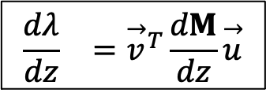
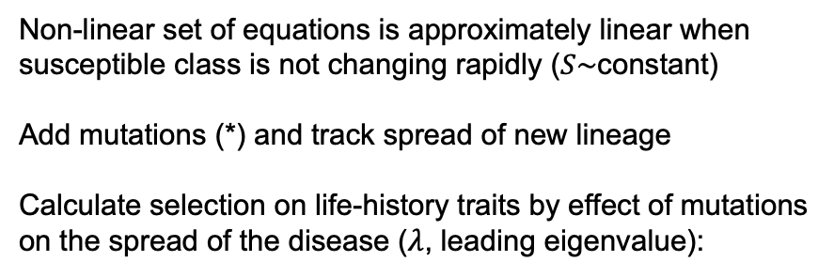
$$\frac{dS}{dt}=−S\sum_{∗}{(β_{P}^{∗}P^{∗}+β_{I}^{∗}I^{∗}+β_{A}^{∗}A^{∗})}$$
$$\frac{dE^{∗}}{dt}=S(β_{P}^{∗}P^{∗}+β_{I}^{∗}I^{∗}+β_{A}^{∗}A^{∗})−κ_{E}^{∗}E^{∗}$$
$$\frac{dA^{∗}}{dt}=f^{∗}κ_{E}^{∗}E^{∗}−κ_{A}^{∗}A^{∗}$$
$$\frac{dP^{∗}}{dt}=\left(1−f^{∗}\right)κ_{E}^{∗}E^{∗}−κ_{P}^{∗}P^{∗}$$
$$\frac{dI^{∗}}{dt}=κ_{P}^{∗}P^{∗}−(α^{∗}+κ_{I}^{∗})I^{∗}$$
$$\frac{dR}{dt}=\sum_{∗}{(κ_{I}^{∗}I^{∗}+κ_{A}^{∗}A^{∗})}$$
SEAPIR Model
Non-linear set of equations is approximately linear when susceptible class is not changing rapidly ($S\sim$constant)
Add mutations (*) and track spread of new lineage
Calculate selection on life-history traits by effect of mutations on the spread of the disease ($λ$, leading eigenvalue):
⚡️
$$\begin{matrix}\frac{dλ}{dz} & ={\overset{→}{v}}^{T}\frac{dM}{dz}\overset{→}{u}\end{matrix}$$
susceptible
exposed
presymptomatic
symptomatic
recovered
asymptomatic
Notes:
Choose parameters to constrain R0 initially to around 2.5
Parameters from Caroline’s G&M study:
D = 5 = 1/${ κ}_{I}$, R0=2.56 = (1+D${ κ}_{P}$) $β$/$κ_{P}$ if $β_{P}=β_{I}=β$ and $β_{A}=0$, $κ_{E}$ = 1/4, $κ_{P}$ = 1
[D is likely longer? And $κ_{P}$ might be smaller, 1/2 or 1/3 for a 2-3 days presymptomatic based on He et al.?]
$β_{P}$ may be higher than the average value of $β_{I}$ based on viral trajectories. Set default $β_{P}$ = $β_{I}.$
$β_{A}$ is the big unknown. Set default to zero
Default f ~ 20% (Mizumoto et al.)
Quarantine can be treated by altering $β_{P}$ and $β_{I}$. Social distancing would lower both (${cβ}_{P}$ and ${cβ}_{I}$), while self-isolating cases would lower primarily those with symptoms (${c q β}_{I}$).
Set ${1/ κ}_{A}=$(${1/ κ}_{P}$)+$({1/ κ}_{I}$) to have the same expected time through the infectious and asymptomatic routes.
R0= ((1-f) ($β_{P}$ (α+$κ_{I}$ )+$β_{I}$ $κ_{P}$ ))/((α+$κ_{I}$) $κ_{P}$) +($β_{A}$ f)/$κ_{A}$
bA=0;
f=0.2;
κI=0.2;
κE=0.25;
κP=1;
bP=0.7;
bI=0.7;
α=0.05;
R0=2.8

Slide 13
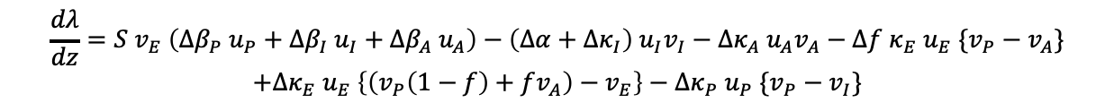
SEAPIR Model
What selection pressures are acting on SARS-CoV-2?
$$\frac{dλ}{dz}=S v_{E} \left(Δβ_{P} u_{P}+Δβ_{I} u_{I}+Δβ_{A}{ u}_{A}\right)−\left(Δα+Δκ_{I}\right){ u}_{I}v_{I}−Δκ_{A} u_{A}v_{A}−Δf κ_{E} u_{E} \{v_{P}−v_{A}\}$$
$$+Δκ_{E} u_{E} \left\{\left(v_{P}\left(1−f\right)+fv_{A}\right)−v_{E}\right\}−Δκ_{P} u_{P} \{v_{P}−v_{I}\}$$
susceptible
exposed
presymptomatic
symptomatic
recovered
asymptomatic
Notes:
Choose parameters to constrain R0 initially to around 2.5
Parameters from Caroline’s G&M study:
D = 5 = 1/${ κ}_{I}$, R0=2.56 = (1+D${ κ}_{P}$) $β$/$κ_{P}$ if $β_{P}=β_{I}=β$ and $β_{A}=0$, $κ_{E}$ = 1/4, $κ_{P}$ = 1
[D is likely longer? And $κ_{P}$ might be smaller, 1/2 or 1/3 for a 2-3 days presymptomatic based on He et al.?]
$β_{P}$ may be higher than the average value of $β_{I}$ based on viral trajectories. Set default $β_{P}$ = $β_{I}.$
$β_{A}$ is the big unknown. Set default to zero
Default f ~ 20% (Mizumoto et al.)
Quarantine can be treated by altering $β_{P}$ and $β_{I}$. Social distancing would lower both (${cβ}_{P}$ and ${cβ}_{I}$), while self-isolating cases would lower primarily those with symptoms (${c q β}_{I}$).
Set ${1/ κ}_{A}=$(${1/ κ}_{P}$)+$({1/ κ}_{I}$) to have the same expected time through the infectious and asymptomatic routes.
R0= ((1-f) ($β_{P}$ (α+$κ_{I}$ )+$β_{I}$ $κ_{P}$ ))/((α+$κ_{I}$) $κ_{P}$) +($β_{A}$ f)/$κ_{A}$
bA=0;
f=0.2;
κI=0.2;
κE=0.25;
κP=1;
bP=0.7;
bI=0.7;
α=0.05;
R0=2.8

Slide 14
SEAPIR Model
What selection pressures are acting on SARS-CoV-2?
$$\frac{dλ}{dz}=S v_{E} \left(Δβ_{P} u_{P}+Δβ_{I} u_{I}+Δβ_{A}{ u}_{A}\right)−\left(Δα+Δκ_{I}\right){ u}_{I}v_{I}−Δκ_{A} u_{A}v_{A}−Δf κ_{E} u_{E} \{v_{P}−v_{A}\}$$
$$+Δκ_{E} u_{E} \left\{\left(v_{P}\left(1−f\right)+fv_{A}\right)−v_{E}\right\}−Δκ_{P} u_{P} \{v_{P}−v_{I}\}$$
Right eigenvector
(strictly positive)
Differences in left eigenvectors
Compares “reproductive values”
Mutant effects
susceptible
exposed
presymptomatic
symptomatic
recovered
asymptomatic
Notes:
Choose parameters to constrain R0 initially to around 2.5
Parameters from Caroline’s G&M study:
D = 5 = 1/${ κ}_{I}$, R0=2.56 = (1+D${ κ}_{P}$) $β$/$κ_{P}$ if $β_{P}=β_{I}=β$ and $β_{A}=0$, $κ_{E}$ = 1/4, $κ_{P}$ = 1
[D is likely longer? And $κ_{P}$ might be smaller, 1/2 or 1/3 for a 2-3 days presymptomatic based on He et al.?]
$β_{P}$ may be higher than the average value of $β_{I}$ based on viral trajectories. Set default $β_{P}$ = $β_{I}.$
$β_{A}$ is the big unknown. Set default to zero
Default f ~ 20% (Mizumoto et al.)
Quarantine can be treated by altering $β_{P}$ and $β_{I}$. Social distancing would lower both (${cβ}_{P}$ and ${cβ}_{I}$), while self-isolating cases would lower primarily those with symptoms (${c q β}_{I}$).
Set ${1/ κ}_{A}=$(${1/ κ}_{P}$)+$({1/ κ}_{I}$) to have the same expected time through the infectious and asymptomatic routes.
R0= ((1-f) ($β_{P}$ (α+$κ_{I}$ )+$β_{I}$ $κ_{P}$ ))/((α+$κ_{I}$) $κ_{P}$) +($β_{A}$ f)/$κ_{A}$
bA=0;
f=0.2;
κI=0.2;
κE=0.25;
κP=1;
bP=0.7;
bI=0.7;
α=0.05;
R0=2.8

Slide 15
What selection pressures act on SARS-CoV-2
in a largely susceptible population?
Higher transmission
Intrinsic transmissibility
Immune evasion
Negligible direct selection on severity and mortality
susceptible
exposed
presymptomatic
symptomatic
recovered
asymptomatic
Prolonged infectivity:
Earlier infectivity favoured if cases rising
Later infectivity favoured if cases declining
Day et al. (2020)

Slide 16
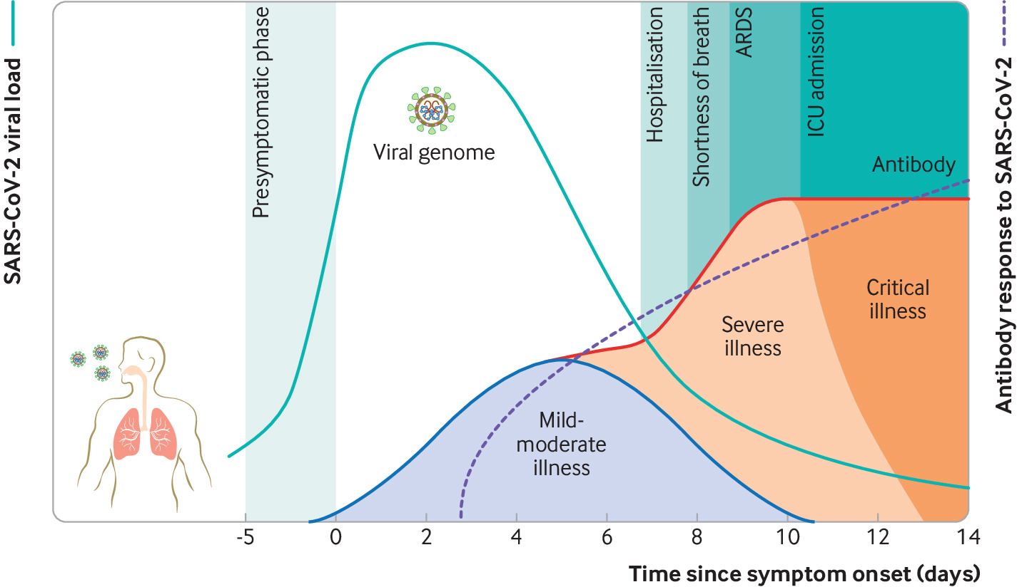
What selection pressures act on SARS-CoV-2
in a largely susceptible population?
Higher transmission
Intrinsic transmissibility
Immune evasion
Negligible direct selection on severity and mortality
Cevik et al. BMJ (2020)
Prolonged infectivity:
Earlier infectivity favoured if cases rising
Later infectivity favoured if cases declining
Day et al. (2020)

Slide 17
What selection pressures act on SARS-CoV-2
in a largely susceptible population?
“Virulence evolution will be driven largely by the indirect effects of pleiotropy…”
Mutations might “couple a higher transmission rate with higher mortality (positive pleiotropy)…if mutations increase viral replication rates.”
Alternatively, mutations might alter “tissue tropism such that the disease tends to preferentially infect cells of the upper respiratory tract, rather than the lower respiratory tract. Such infections could lead to a higher transmission rate but be less virulent (negative pleiotropy)”
Cevik et al. BMJ (2020)
Day et al. (2020)

Slide 18
What selection pressures act on SARS-CoV-2
in a largely susceptible population?
“Virulence evolution will be driven largely by the indirect effects of pleiotropy…”
Mutations might “couple a higher transmission rate with higher mortality (positive pleiotropy)…if mutations increase viral replication rates.”
Alternatively, mutations might alter “tissue tropism such that the disease tends to preferentially infect cells of the upper respiratory tract, rather than the lower respiratory tract. Such infections could lead to a higher transmission rate but be less virulent (negative pleiotropy)”
Hospitalization
Death
Hazard Ratio
Day et al. (2020)
Based on:
Lin et al. (2022) for Alpha, Beta, Gamma, Delta vs wildtype
Nyberg et al. (2022) for Omicron vs Delta (rescaled using above to wildtype)

Slide 19
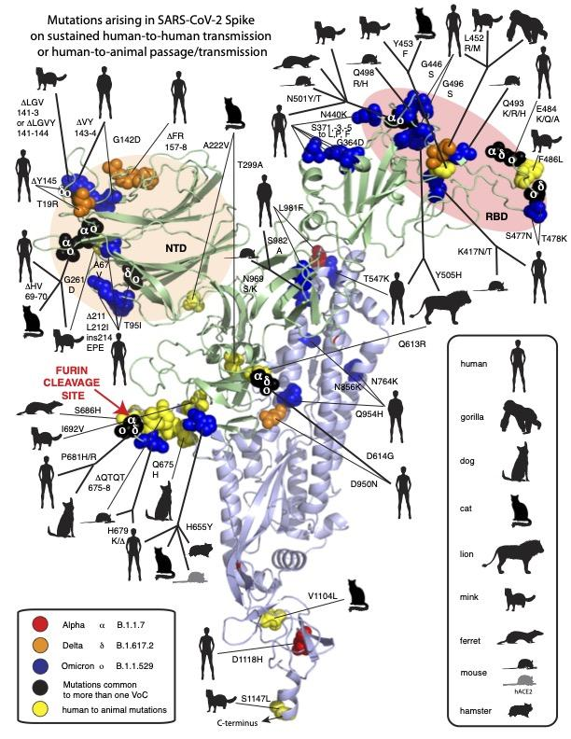
Unusual evolutionary features of VOC
Black box: Passage through immunocompromised individual(s) with persistent infections may account for these aspects
Human → animal → human repeat zoonoses may similarly introduce multiple mutations, occasionally generating new more transmissible variants.
Dr. Robert Garry
Notes:
Mink and hamster reinfections observed

Slide 20


Evolution in action
We can estimate selection using classical population genetics models for the change in frequency (p) of a variant due to selection (s):
$$\frac{dp}{dt}=s p (1−p)$$
which can be solved:
$$p_{t}=\frac{e^{st}{ p}_{0}}{1−{ p}_{0}+e^{st}{ p}_{0}}$$
Proportion of sequences
2022

Slide 21
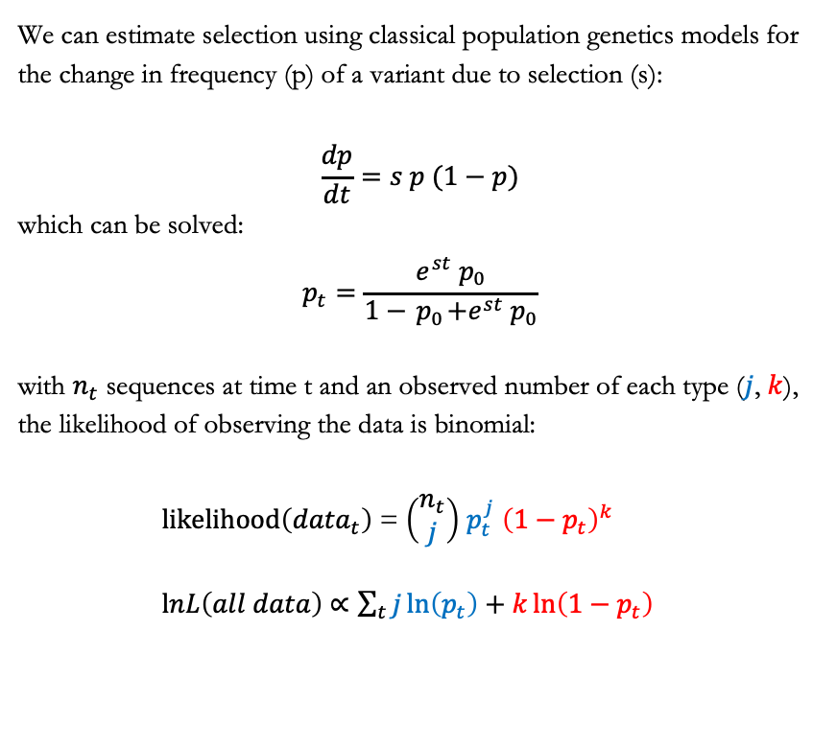
Evolution in action
We can estimate selection using classical population genetics models for the change in frequency (p) of a variant due to selection (s):
$$\frac{dp}{dt}=s p (1−p)$$
which can be solved:
$$p_{t}=\frac{e^{st}{ p}_{0}}{1−{ p}_{0}+e^{st}{ p}_{0}}$$
with $n_{t}$ sequences at time t and an observed number of each type ($j$, $k$), the likelihood of observing the data is binomial:
$\text{likelihood}\left({data}_{t}\right)$ = $\left(\begin{matrix}n_{t} \\ j\end{matrix}\right)$ $p_{t}^{j}$ ${\left(1−p_{t}\right)}^{k}$
$\text{l}nL\left(all data\right)$ $∝\sum_{t}{j\ln\left(p_{t}\right)+k\ln\left({1−p}_{t}\right)}$
Proportion of sequences
2022

Slide 22

Evolution in action
We can estimate selection using classical population genetics models for the change in frequency (p) of a variant due to selection (s):
$$\frac{dp}{dt}=s p (1−p)$$
which can be solved:
$$p_{t}=\frac{e^{st}{ p}_{0}}{1−{ p}_{0}+e^{st}{ p}_{0}}$$
with $n_{t}$ sequences at time t and an observed number of each type ($j$, $k$), the likelihood of observing the data is binomial:
$\text{likelihood}\left({data}_{t}\right)$ = $\left(\begin{matrix}n_{t} \\ j\end{matrix}\right)$ $p_{t}^{j}$ ${\left(1−p_{t}\right)}^{k}$
$\text{l}nL\left(all data\right)$ $∝\sum_{t}{j\ln\left(p_{t}\right)+k\ln\left({1−p}_{t}\right)}$
Proportion of sequences
2022
Estimate selection by maximizing the likelihood
Plus: get CI & allow for multiple variants

Slide 23

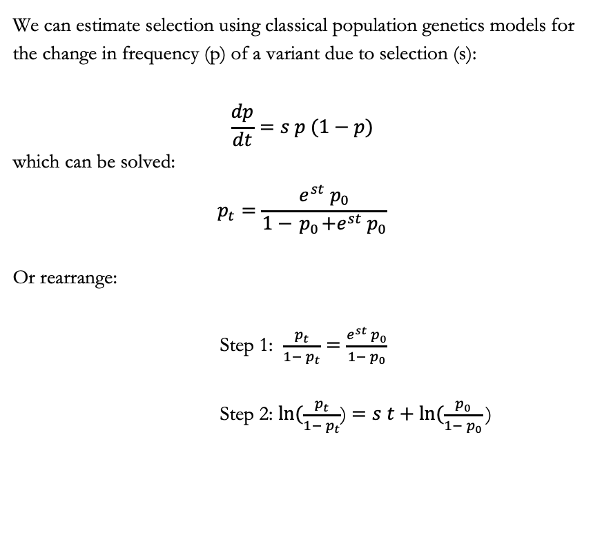
Evolution in action
We can estimate selection using classical population genetics models for the change in frequency (p) of a variant due to selection (s):
$$\frac{dp}{dt}=s p (1−p)$$
which can be solved:
$$p_{t}=\frac{e^{st}{ p}_{0}}{1−{ p}_{0}+e^{st}{ p}_{0}}$$
Or rearrange:
Step 1: $\frac{p_{t}}{1−{ p}_{t}}$ $=\frac{e^{st}{ p}_{0}}{1−{ p}_{0}}$
Step 2: $ln⁡(\frac{p_{t}}{1−{ p}_{t}}$) $=s t+ln⁡(\frac{p_{0}}{1−{ p}_{0}}\text{)}$
$⁡(\frac{p_{t}}{1−{ p}_{t}}$)
2022
Predicts a linear relationship with constant slope s if selection is constant

Slide 24
SEAPIR Model
What selection pressures are acting on SARS-CoV-2?
$$\frac{dλ}{dz}=S v_{E} \left(Δβ_{P} u_{P}+Δβ_{I} u_{I}+Δβ_{A}{ u}_{A}\right)−\left(Δα+Δκ_{I}\right){ u}_{I}v_{I}−Δκ_{A} u_{A}v_{A}−Δf κ_{E} u_{E} \{v_{P}−v_{A}\}$$
$$+Δκ_{E} u_{E} \left\{\left(v_{P}\left(1−f\right)+fv_{A}\right)−v_{E}\right\}−Δκ_{P} u_{P} \{v_{P}−v_{I}\}$$
Selection should weaken for a variant that increases transmission if susceptibles are protected and/or transmission is limited.
susceptible
exposed
presymptomatic
symptomatic
recovered
asymptomatic
Notes:
Choose parameters to constrain R0 initially to around 2.5
Parameters from Caroline’s G&M study:
D = 5 = 1/${ κ}_{I}$, R0=2.56 = (1+D${ κ}_{P}$) $β$/$κ_{P}$ if $β_{P}=β_{I}=β$ and $β_{A}=0$, $κ_{E}$ = 1/4, $κ_{P}$ = 1
[D is likely longer? And $κ_{P}$ might be smaller, 1/2 or 1/3 for a 2-3 days presymptomatic based on He et al.?]
$β_{P}$ may be higher than the average value of $β_{I}$ based on viral trajectories. Set default $β_{P}$ = $β_{I}.$
$β_{A}$ is the big unknown. Set default to zero
Default f ~ 20% (Mizumoto et al.)
Quarantine can be treated by altering $β_{P}$ and $β_{I}$. Social distancing would lower both (${cβ}_{P}$ and ${cβ}_{I}$), while self-isolating cases would lower primarily those with symptoms (${c q β}_{I}$).
Set ${1/ κ}_{A}=$(${1/ κ}_{P}$)+$({1/ κ}_{I}$) to have the same expected time through the infectious and asymptomatic routes.
R0= ((1-f) ($β_{P}$ (α+$κ_{I}$ )+$β_{I}$ $κ_{P}$ ))/((α+$κ_{I}$) $κ_{P}$) +($β_{A}$ f)/$κ_{A}$
bA=0;
f=0.2;
κI=0.2;
κE=0.25;
κP=1;
bP=0.7;
bI=0.7;
α=0.05;
R0=2.8

Slide 25


SEAPIR Model
What selection pressures are acting on SARS-CoV-2?
$$\frac{dλ}{dz}=S v_{E} \left(Δβ_{P} u_{P}+Δβ_{I} u_{I}+Δβ_{A}{ u}_{A}\right)−\left(Δα+Δκ_{I}\right){ u}_{I}v_{I}−Δκ_{A} u_{A}v_{A}−Δf κ_{E} u_{E} \{v_{P}−v_{A}\}$$
$$+Δκ_{E} u_{E} \left\{\left(v_{P}\left(1−f\right)+fv_{A}\right)−v_{E}\right\}−Δκ_{P} u_{P} \{v_{P}−v_{I}\}$$
$⁡(\frac{p_{t}}{1−{ p}_{t}}$)
Alpha/Gamma wave
Selection should weaken for a variant that increases transmission if susceptibles are protected and/or transmission is limited.
susceptible
exposed
presymptomatic
symptomatic
recovered
2021
BC’s ‘circuit breaker’ on 30 March 2021
(vertical line: closing indoor dining, gym closures, travel within the province restricted;
See Otto et al. 2022 Current Biology)
asymptomatic
Notes:
Choose parameters to constrain R0 initially to around 2.5
Parameters from Caroline’s G&M study:
D = 5 = 1/${ κ}_{I}$, R0=2.56 = (1+D${ κ}_{P}$) $β$/$κ_{P}$ if $β_{P}=β_{I}=β$ and $β_{A}=0$, $κ_{E}$ = 1/4, $κ_{P}$ = 1
[D is likely longer? And $κ_{P}$ might be smaller, 1/2 or 1/3 for a 2-3 days presymptomatic based on He et al.?]
$β_{P}$ may be higher than the average value of $β_{I}$ based on viral trajectories. Set default $β_{P}$ = $β_{I}.$
$β_{A}$ is the big unknown. Set default to zero
Default f ~ 20% (Mizumoto et al.)
Quarantine can be treated by altering $β_{P}$ and $β_{I}$. Social distancing would lower both (${cβ}_{P}$ and ${cβ}_{I}$), while self-isolating cases would lower primarily those with symptoms (${c q β}_{I}$).
Set ${1/ κ}_{A}=$(${1/ κ}_{P}$)+$({1/ κ}_{I}$) to have the same expected time through the infectious and asymptomatic routes.
R0= ((1-f) ($β_{P}$ (α+$κ_{I}$ )+$β_{I}$ $κ_{P}$ ))/((α+$κ_{I}$) $κ_{P}$) +($β_{A}$ f)/$κ_{A}$
bA=0;
f=0.2;
κI=0.2;
κE=0.25;
κP=1;
bP=0.7;
bI=0.7;
α=0.05;
R0=2.8

Slide 26

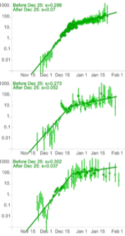

SEAPIR Model
$⁡(\frac{p_{t}}{1−{ p}_{t}}$)
What selection pressures are acting on SARS-CoV-2?
BC
$$\frac{dλ}{dz}=S v_{E} \left(Δβ_{P} u_{P}+Δβ_{I} u_{I}+Δβ_{A}{ u}_{A}\right)−\left(Δα+Δκ_{I}\right){ u}_{I}v_{I}−Δκ_{A} u_{A}v_{A}−Δf κ_{E} u_{E} \{v_{P}−v_{A}\}$$
$$+Δκ_{E} u_{E} \left\{\left(v_{P}\left(1−f\right)+fv_{A}\right)−v_{E}\right\}−Δκ_{P} u_{P} \{v_{P}−v_{I}\}$$
Selection should weaken for a variant that increases transmission if susceptibles are protected and/or transmission is limited.
AB
Collective concern
susceptible
exposed
presymptomatic
symptomatic
recovered
ON
Omicron
asymptomatic
2022
BC COVID-19 Modelling Report (Feb 17, 2022)
Notes:
Choose parameters to constrain R0 initially to around 2.5
Parameters from Caroline’s G&M study:
D = 5 = 1/${ κ}_{I}$, R0=2.56 = (1+D${ κ}_{P}$) $β$/$κ_{P}$ if $β_{P}=β_{I}=β$ and $β_{A}=0$, $κ_{E}$ = 1/4, $κ_{P}$ = 1
[D is likely longer? And $κ_{P}$ might be smaller, 1/2 or 1/3 for a 2-3 days presymptomatic based on He et al.?]
$β_{P}$ may be higher than the average value of $β_{I}$ based on viral trajectories. Set default $β_{P}$ = $β_{I}.$
$β_{A}$ is the big unknown. Set default to zero
Default f ~ 20% (Mizumoto et al.)
Quarantine can be treated by altering $β_{P}$ and $β_{I}$. Social distancing would lower both (${cβ}_{P}$ and ${cβ}_{I}$), while self-isolating cases would lower primarily those with symptoms (${c q β}_{I}$).
Set ${1/ κ}_{A}=$(${1/ κ}_{P}$)+$({1/ κ}_{I}$) to have the same expected time through the infectious and asymptomatic routes.
R0= ((1-f) ($β_{P}$ (α+$κ_{I}$ )+$β_{I}$ $κ_{P}$ ))/((α+$κ_{I}$) $κ_{P}$) +($β_{A}$ f)/$κ_{A}$
bA=0;
f=0.2;
κI=0.2;
κE=0.25;
κP=1;
bP=0.7;
bI=0.7;
α=0.05;
R0=2.8

Slide 27
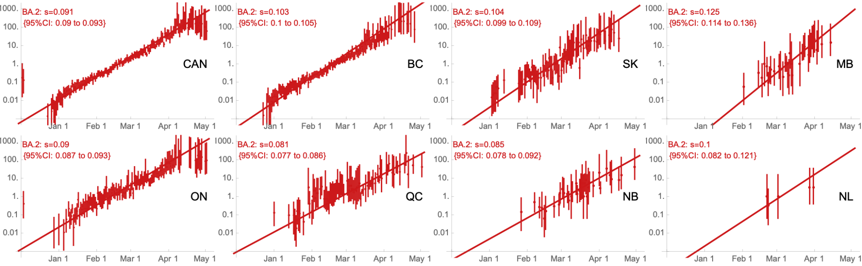
Evolution in action
Omicron’s BA.2 vs BA.1
Freq(BA.2)/Freq(BA.1)
2022
BC COVID-19 Modelling Report (May 18, 2022)
Notes:
Choose parameters to constrain R0 initially to around 2.5
Parameters from Caroline’s G&M study:
D = 5 = 1/${ κ}_{I}$, R0=2.56 = (1+D${ κ}_{P}$) $β$/$κ_{P}$ if $β_{P}=β_{I}=β$ and $β_{A}=0$, $κ_{E}$ = 1/4, $κ_{P}$ = 1
[D is likely longer? And $κ_{P}$ might be smaller, 1/2 or 1/3 for a 2-3 days presymptomatic based on He et al.?]
$β_{P}$ may be higher than the average value of $β_{I}$ based on viral trajectories. Set default $β_{P}$ = $β_{I}.$
$β_{A}$ is the big unknown. Set default to zero
Default f ~ 20% (Mizumoto et al.)
Quarantine can be treated by altering $β_{P}$ and $β_{I}$. Social distancing would lower both (${cβ}_{P}$ and ${cβ}_{I}$), while self-isolating cases would lower primarily those with symptoms (${c q β}_{I}$).
Set ${1/ κ}_{A}=$(${1/ κ}_{P}$)+$({1/ κ}_{I}$) to have the same expected time through the infectious and asymptomatic routes.
R0= ((1-f) ($β_{P}$ (α+$κ_{I}$ )+$β_{I}$ $κ_{P}$ ))/((α+$κ_{I}$) $κ_{P}$) +($β_{A}$ f)/$κ_{A}$
bA=0;
f=0.2;
κI=0.2;
κE=0.25;
κP=1;
bP=0.7;
bI=0.7;
α=0.05;
R0=2.8

Slide 28
Evolution in action
Omicron
Selection coefficients per day, s
vs wildtype
BC COVID-19 Modelling Report
(2June2021, 6August2021, 17Feb2022, 18May2022, next one)

Slide 29
Evolution in action
Omicron
SELECTION PER DAY!!!
Selection coefficients per day, s
vs wildtype
BC COVID-19 Modelling Report
(2June2021, 6August2021, 17Feb2022, 18May2022, next one)

Slide 30
Evolution in action
Days to double in frequency relative to reference strain
Omicron
s = 25% → 2.7 days
s = 15% → 4.6 days
Selection coefficients per day, s
s = 10% → 7 days
s = 5% → 14 days
s = 1% → 70 days
vs wildtype
BC COVID-19 Modelling Report
(2June2021, 6August2021, 17Feb2022, 18May2022, next one)

Slide 31

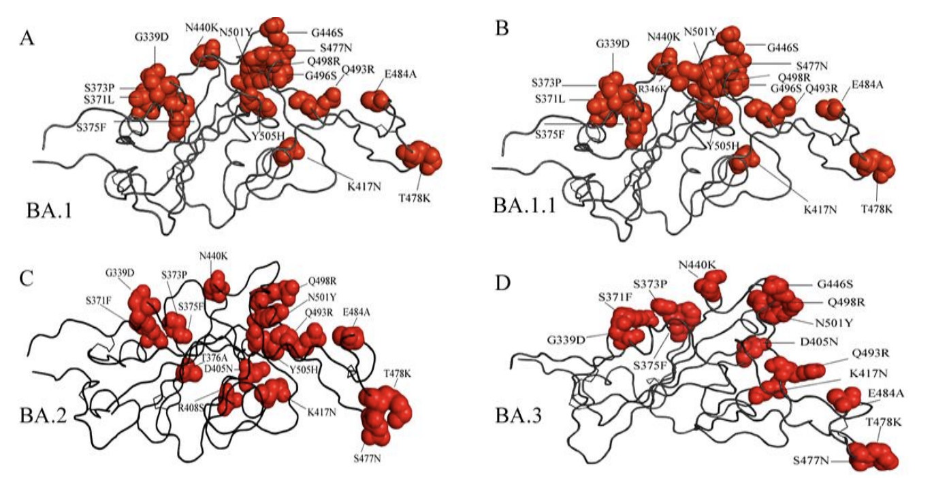
Omicron: First major VOC to evade immunity
Three times more spike mutations than all other VOC had when they arose.
Many mutations are known or predicted to reduce efficacy of neutralizing antibodies and increase ACE2 binding.
Receptor Binding Domain
with residue mutated relative to the wild-type
Financial Times
Kumar et al. (2022) J Med Vir
Notes:
These count only independent mutations (a deleted stretch counts as one). Here Delta is 21J.

Slide 32
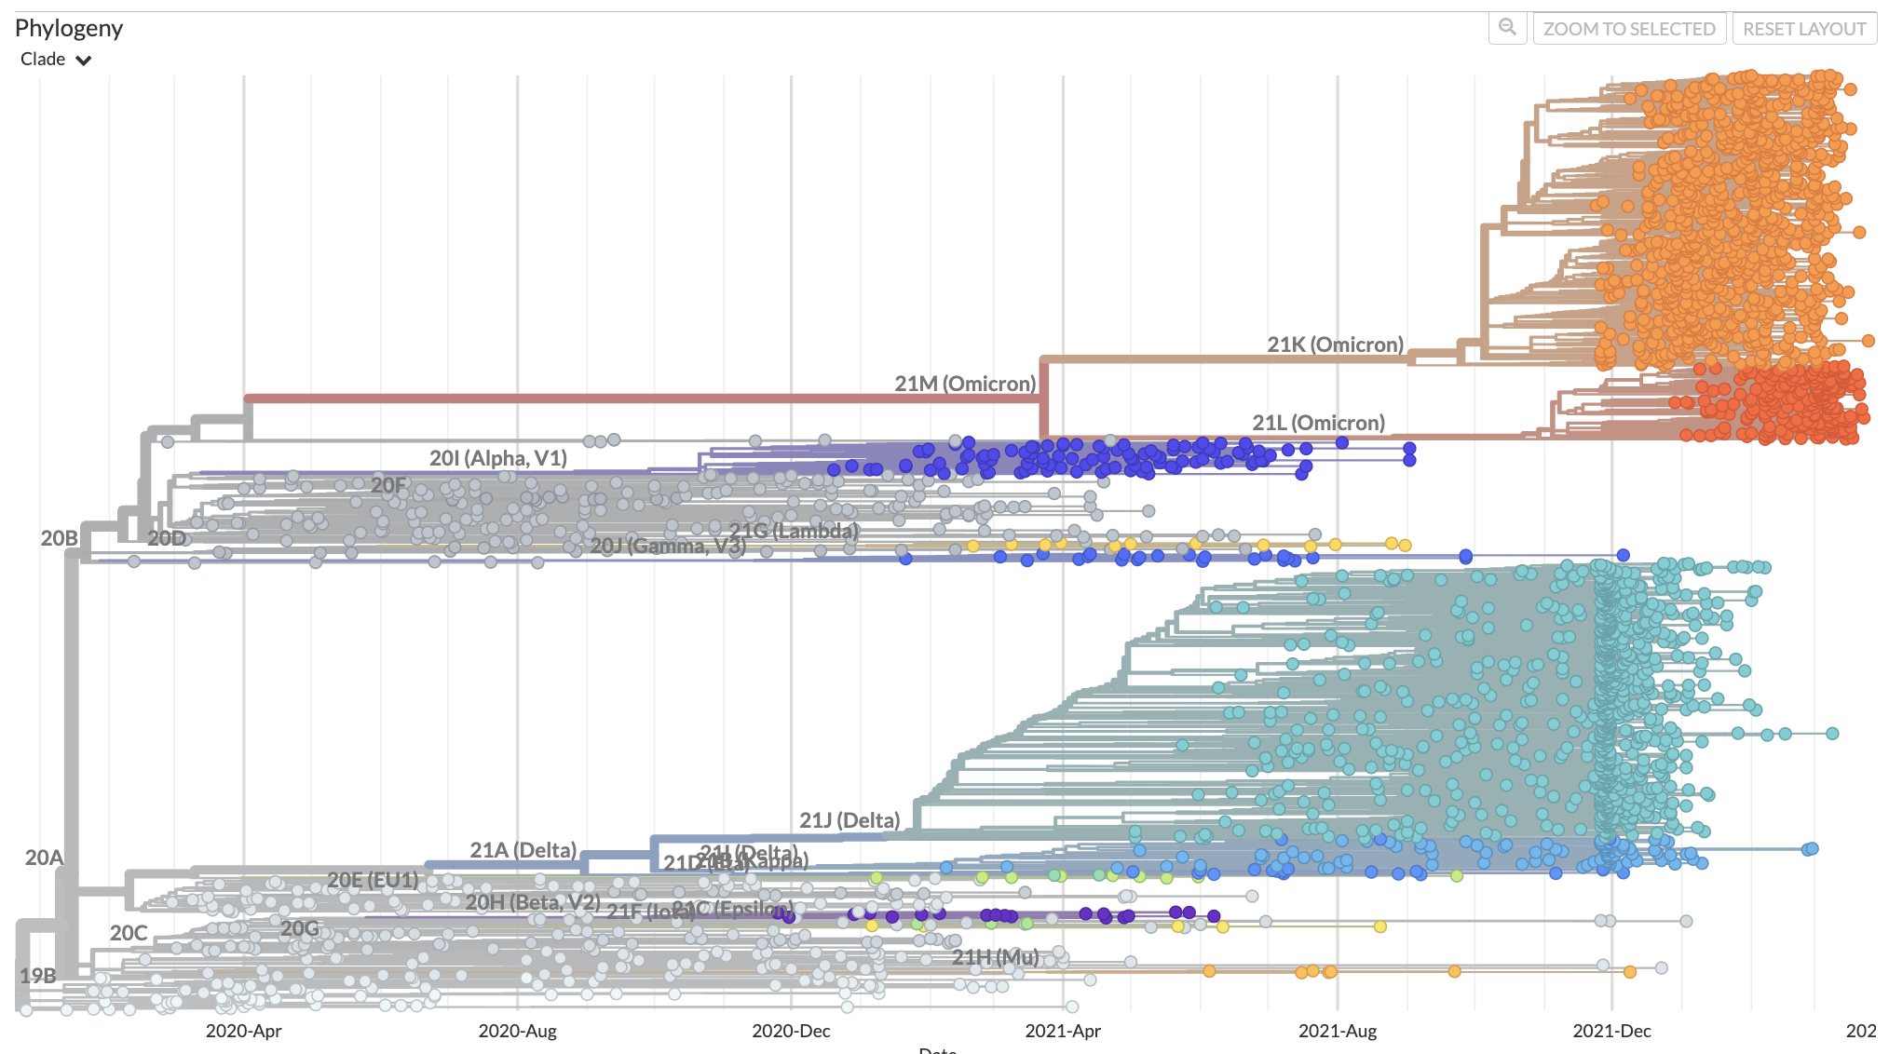

Omicron
Divergence of BA.4 & BA.5 (~October 2021)²
Divergence of BA.1 & BA.2 (~April 2021)
Divergence of Omicron (~April 2020)
BA.1
First detected in mid-November 2021¹, Omicron shows a substantially older evolutionary history, diverging from other VOC near the beginning of the pandemic.
BA.2
¹ Viana et al. (2022)
² Tegally et al. (2022)
32

Slide 33

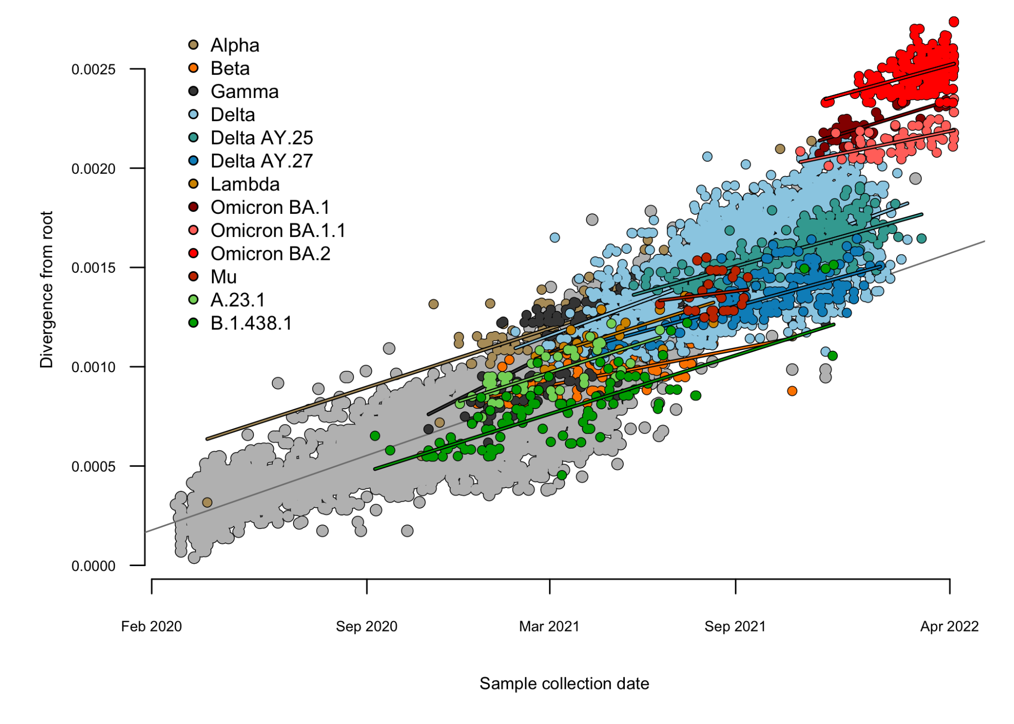
Omicron Sub-Lineages
The mutation rates per unit time (slopes) are similar, but Omicron appears to have had a history of elevated mutation (a pulse raising the intercept).
Unusual evolutionary features of Omicron:
more than expected number of mutations
disproportionate number of changes in spike
a long period of evolutionary divergence “out of sight” of global surveillance
evidence that recombination was involved^{1,2} in the generation of at least one of BA.1-BA.5
[Source: Art Poon]
¹ Viana et al. (2022)
² Tegally et al. (2022)

Slide 34
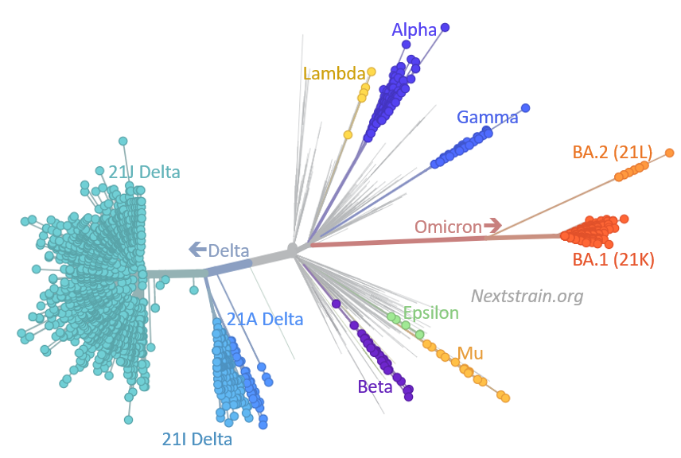
Unusual evolutionary features of VOC
Black box: Passage through immunocompromised individual(s) with persistent infections¹ may account for these unusual features:
High and prolonged viral replication (more mutations)
Relaxed and/or altered immune environment, allowing mutations to accumulate in antigenic regions
Hidden from surveillance efforts
Higher potential for recombination²
¹ e.g., 335 days in a lymphoma patient; >9 months in an HIV patient
² Recombination detected in a lymphoma patient infected for 14 months, initially infected with B.1.160 then with Alpha (Burel et al.)

Slide 35
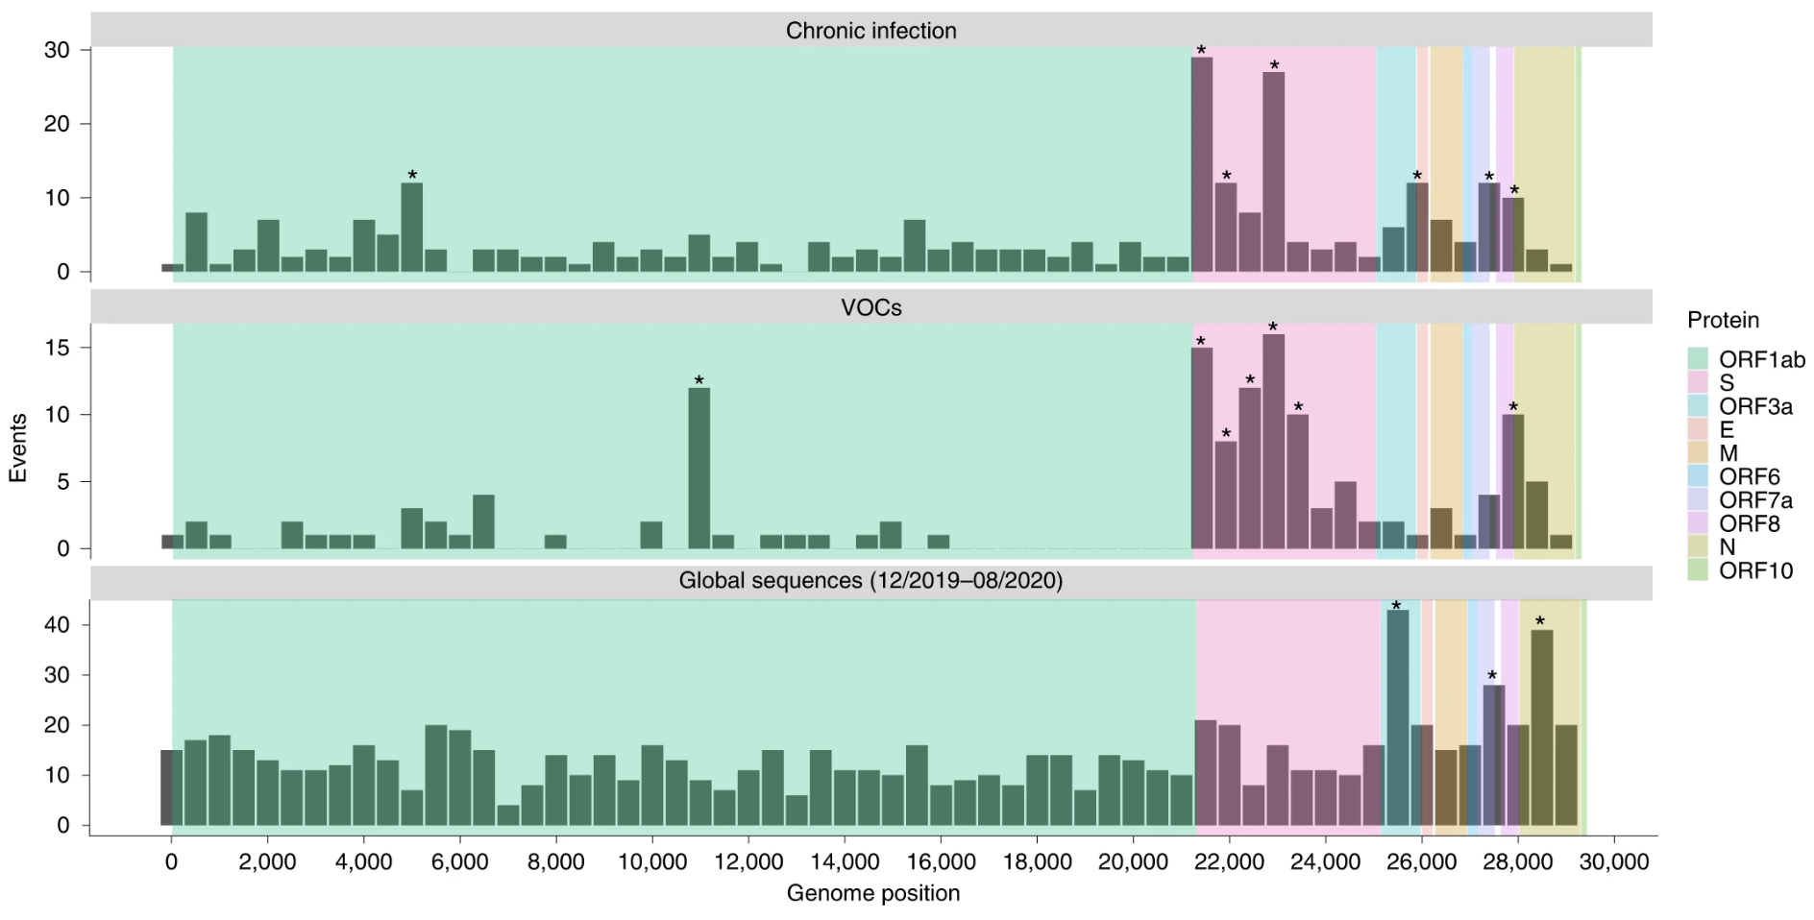
Unusual evolutionary features of VOC
Harari et al. (2022)

Slide 36
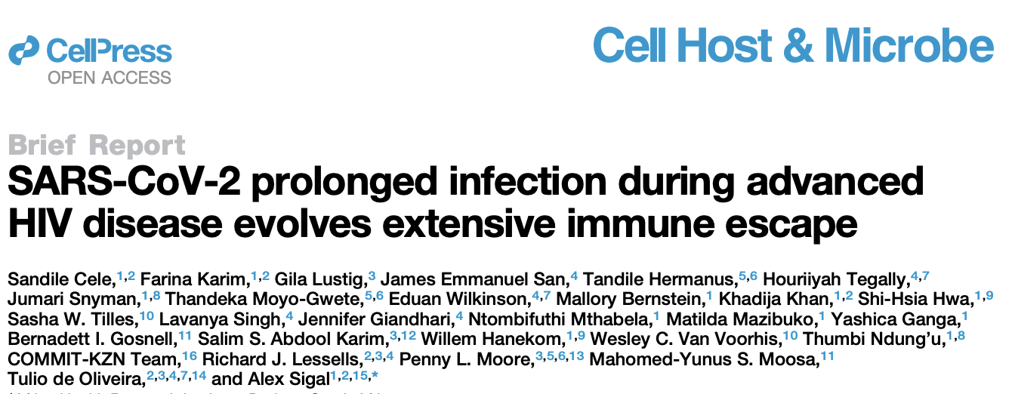
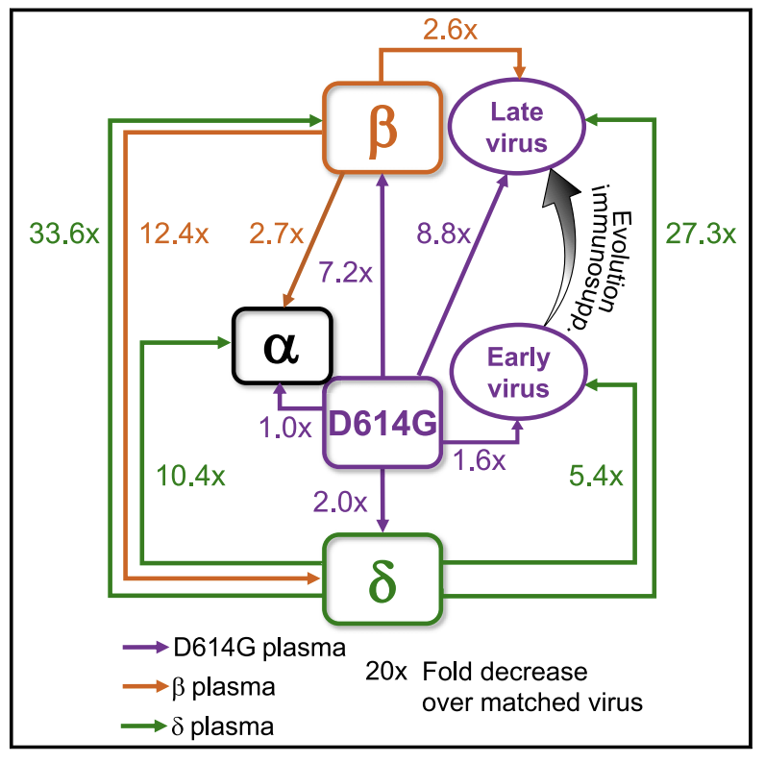
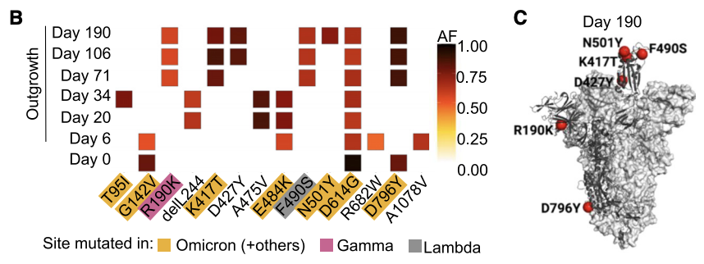
Unusual evolutionary features of VOC
Example of an immunocompromised patient with persistent (190 day) COVID infection, which evolved substantial escape from neutralization.
Notes:
Pfizer BNT162b2-vaccinated participants: plasma neutralization capacity was decreased 5-fold against D190 relative to ancestral virus with the D614G mutation

Slide 37
Evolution: Emergence of new variants
Most mutations will arise in prevailing lineages:
Increases in transmissibility & immune escape (e.g., BA.4 & BA.)
Major shifts may well arise outside of these lineages (less likely to elicit an immune response)
Immunosuppressed individuals
Human -> animal -> human zoonoses
New variants may be more (e.g., Alpha and Delta) or less (e.g., Omicron) severe.
Globally: Since May 1, 2022, Delta (37), Alpha (2), and a variety of other non-VOC lineages remain in circulation (0.2%).

Slide 38
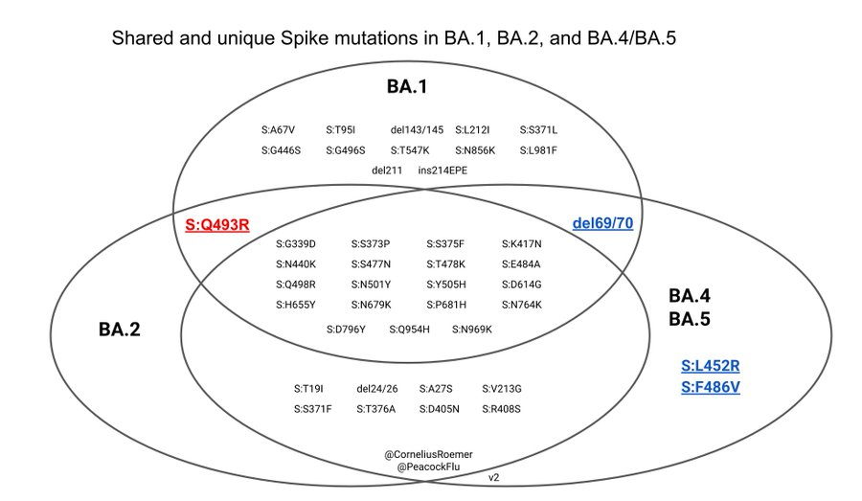
Sub-variants BA.4 & BA.5
→ Very similar to BA.2, but called BA.4 and BA.5 because they lack some of the mutations characteristic of BA.2 (like S:Q493, NSP4 L438 and Orf6 D61). Diverged earlier?
S:L452R - increased ACE2 binding and infectivity; reduced antibody recognition
S:F486R - a key site for evasion of antibodies
Tegally et al. (2022)
Notes:
Check ven diagram for update with 493

Slide 39

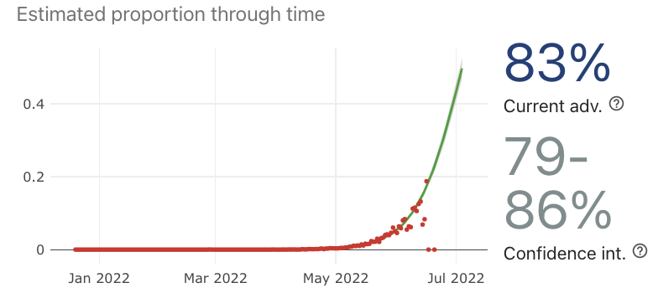
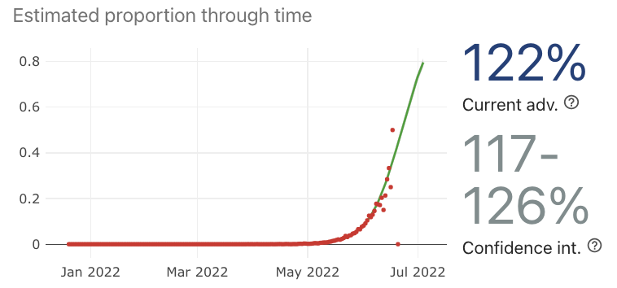
Omicron Sub-Lineages
Global proportion
s = 9% per day
Early data from South Africa suggests an 8% per day selective advantage for BA.4 and 12% for BA.5 (Tegally et al. 2022), relative to BA.2.
Spread may result from a combination of higher inherent transmissibility and immune evasion (Khan et al. 2022; Hachmann et al.).
BA.4
per week
s = 12% per day
per week
Together, BA.4 & BA.5 are estimated to comprise >70% of global sequences by today
BA.5

Slide 40
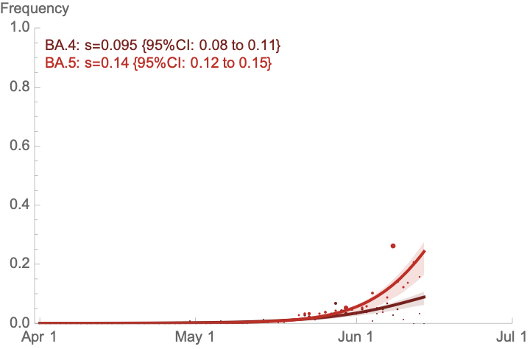
Omicron sub-lineages in Canada
July 1, 2022 projection
GISAID data shared by Public Health labs across Canada allow us to track the spread of Omicron sublineages over time.
freq(BA.4): 13%
freq(BA.5): 69%
→ BA.4 is spreading rapidly at a rate of s=9.5% per day relative to BA.2#
→ BA.5 is spreading slightly faster with s=14% per day relative to BA.2#
Proportion of sequences
These lineages should now (or soon) dominate the COVID-19 picture in Canada.
Source (S. Otto) Canadian metadata was downloaded from GISAID for the Omicron GRA clades (Alberta sequences were removed as AB first identifies variants and preferentially sequences some subtypes). A model of selection was fit to the numbers of each type using maximum likelihood based on a trinomial distribution given the expected frequencies on each day. Hessian matrix used to obtain confidence intervals.

Slide 41
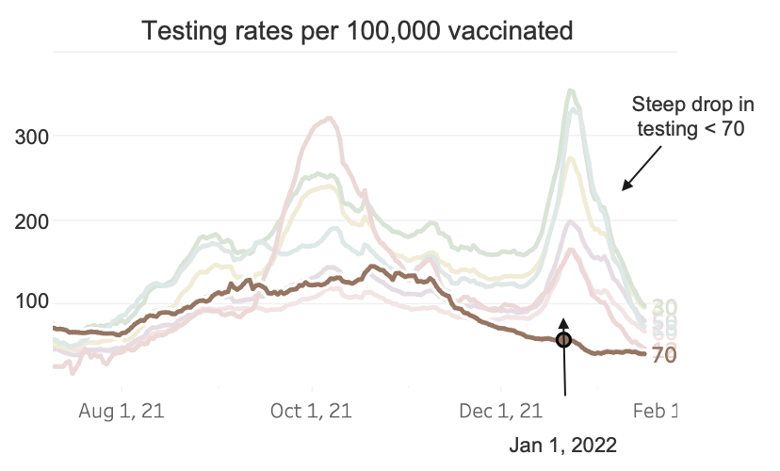
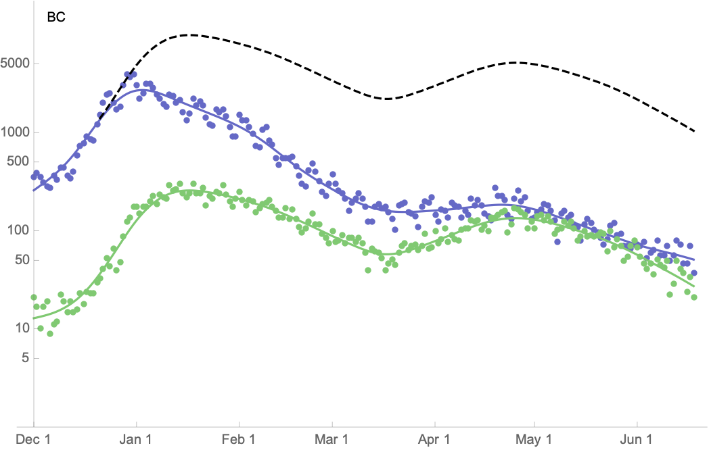
What does this imply for case numbers?
British Columbia
We’ll use case numbers observed in individuals aged 70+ to assess trends, as they have been more consistently tested.
Corrected case # (black)
<70 (blue)
Cases among the 70+ age group are significantly decreasing*.
70+ (green)
Source (S. Otto) New cases per day in 10-year age groups were downloaded from the BCCDC COVID-19 data portal. Cubic spline fits to log-case data were obtained (curves) for those 70+ (green) or <70 (blue). *Linear regression through log case counts among 70+ from last 14 days of data.
Notes:
~25% of the population is over 70, but almost all reported cases are in that group.

Slide 42
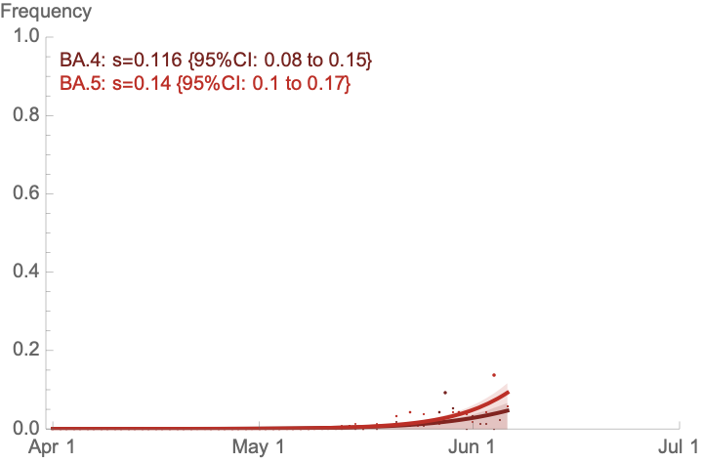
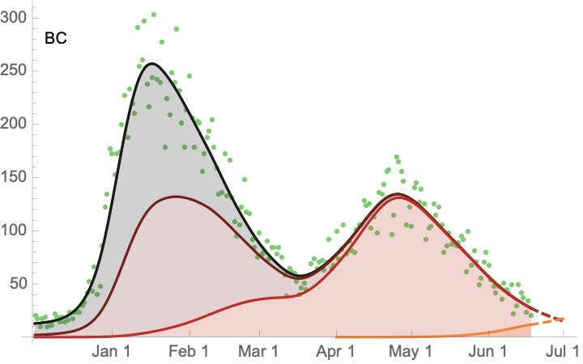
What does this imply for case numbers?
Fitting models of selection allows us to estimate frequency changes among variants.
Multiplying by the # of cases in those over 70 allows us to estimate growth in numbers of each Omicron sublineage.
BA.1
BA.1.1
BA.2
BA.4/5
→ While numbers of BA.1 and BA.2 are declining, estimated numbers of BA.4 & BA.5 (grouped together) are rising (r = +3.1%) in British Columbia.
Source (S. Otto) Canadian metadata was downloaded from GISAID for the Omicron GRA clades. A model of selection was fit to the numbers of each type using maximum likelihood based on a trinomial distribution given the expected frequencies on each day. Hessian matrix used to obtain confidence intervals.
Notes:
19 day doubling time

Slide 43
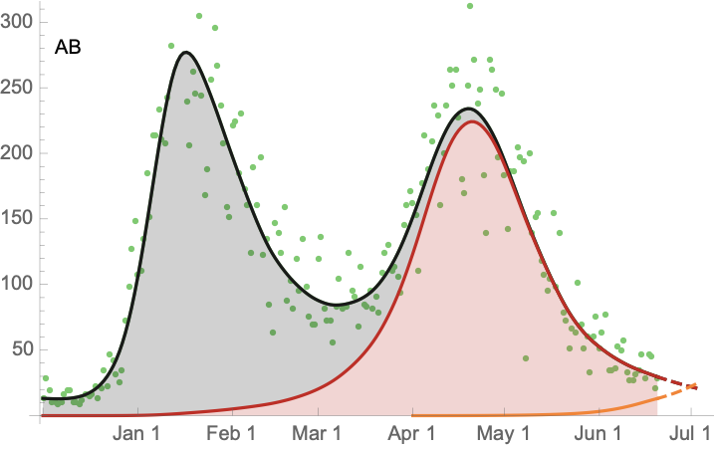
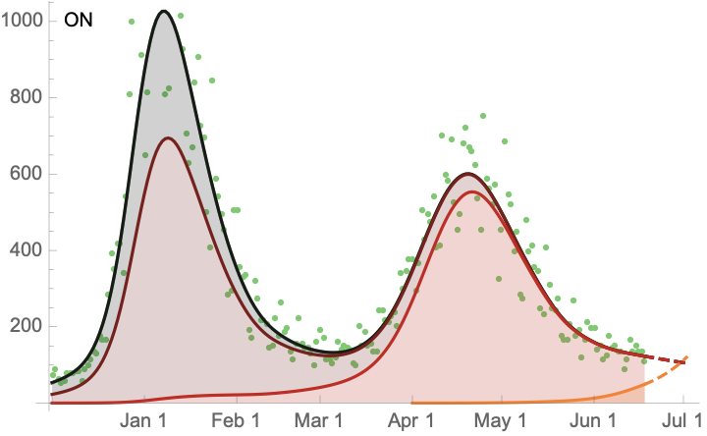
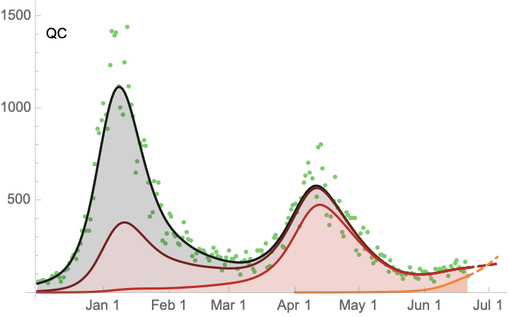
Daily growth rates
BC r = 3.1%
(23 day doubling)
Alberta r = 4.9%
(14 day doubling)
BA.1
BA.1
& BA.1.1
BA.1.1
BA.2
BA.2
BA.4/5
BA.4/5
Ontario r = 6.3%
(11 day doubling)
Quebec r = 5.5%
(12.5 day doubling)
BA.1
BA.1
BA.1.1
BA.2
BA.2
BA.4/5
BA.1.1
BA.4/5
Notes:
19 day doubling time

Slide 44
The Third Omicron Wave
The above projections indicate that case numbers should start rising
around July 1, driven by a BA.4 & BA.5 wave.
This third Omicron wave should peak about 4-8 weeks afterwards.
Fairly high confidence

Slide 45
The Third Omicron Wave
The above projections indicate that case numbers should start rising
around July 1, driven by a BA.4 & BA.5 wave.
This third Omicron wave should peak about 4-8 weeks afterwards.
The height & impact of this peak is challenging to predict, depending on the interplay of many factors:
Antibody levels
Efficacy of neutralizing antibodies
Virulence of BA.4 & BA.5
Public health measures
Fairly high confidence
No confidence

Slide 46
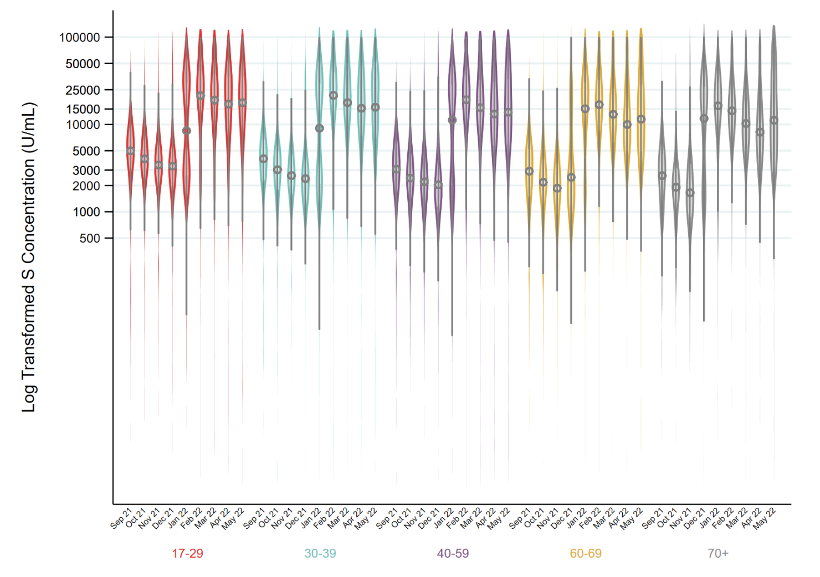
Factors determining the height of the BA.4/BA.5 wave
1. Antibody levels
The COVID-19 Immunity Task Force & Canadian Blood Services data suggests high standing levels of spike antibodies in all age groups (blood donations through mid-May 2022).
Good news

Slide 47
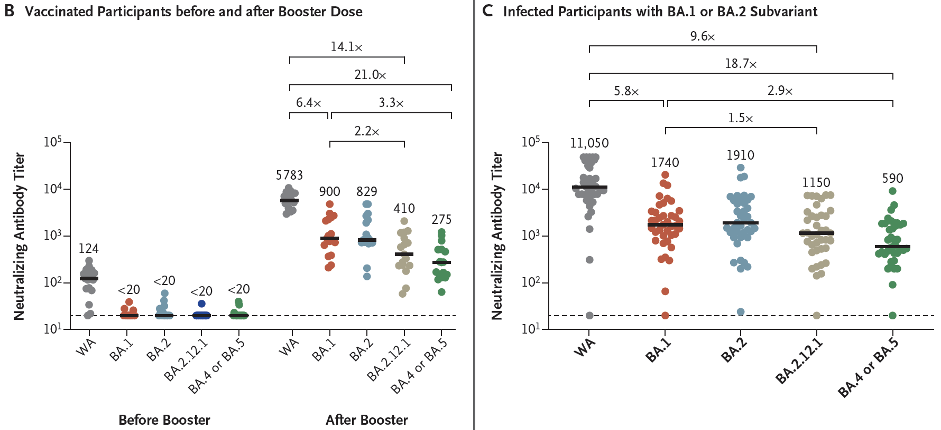
Factors determining the height of the BA.4/BA.5 wave
2. Efficacy of neutralizing antibodies: The ability of these antibodies to neutralize SARS-CoV-2 and prevent infection is substantially compromised for BA.4 & BA.5.
Booster
(two weeks ago)
Omicron infection & vaccination (26/27)
Bad news
Hachmann et al, (2022) NEJM

Slide 48
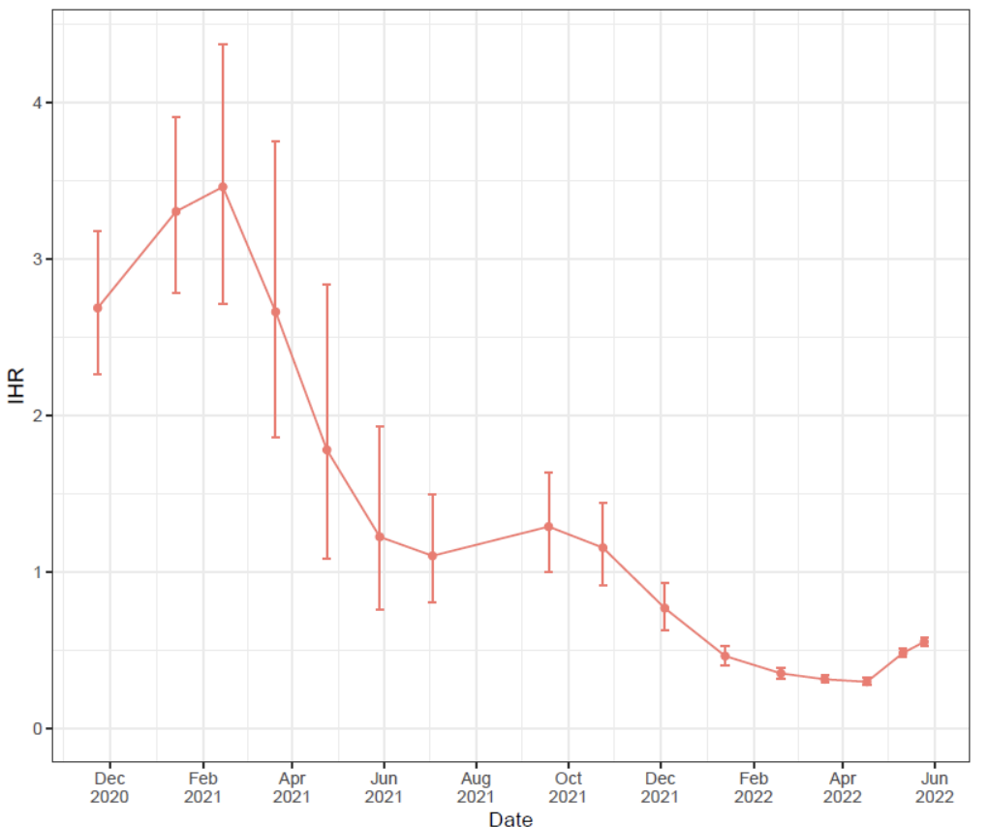
Factors determining the height of the BA.4/BA.5 wave
3. Virulence: Currently have no clear indication of the relative virulence of BA.1-BA.5
Alpha
In its 43 technical briefing, the UK Health Security Agency reported model estimates of hospitalization rate per infection (IHR) over time.
Recent data shows an uptick: BA.4 & BA.5 or waning immunity?
Delta
???
Vaccine rollout
Omicron
Uncertain news

Slide 49

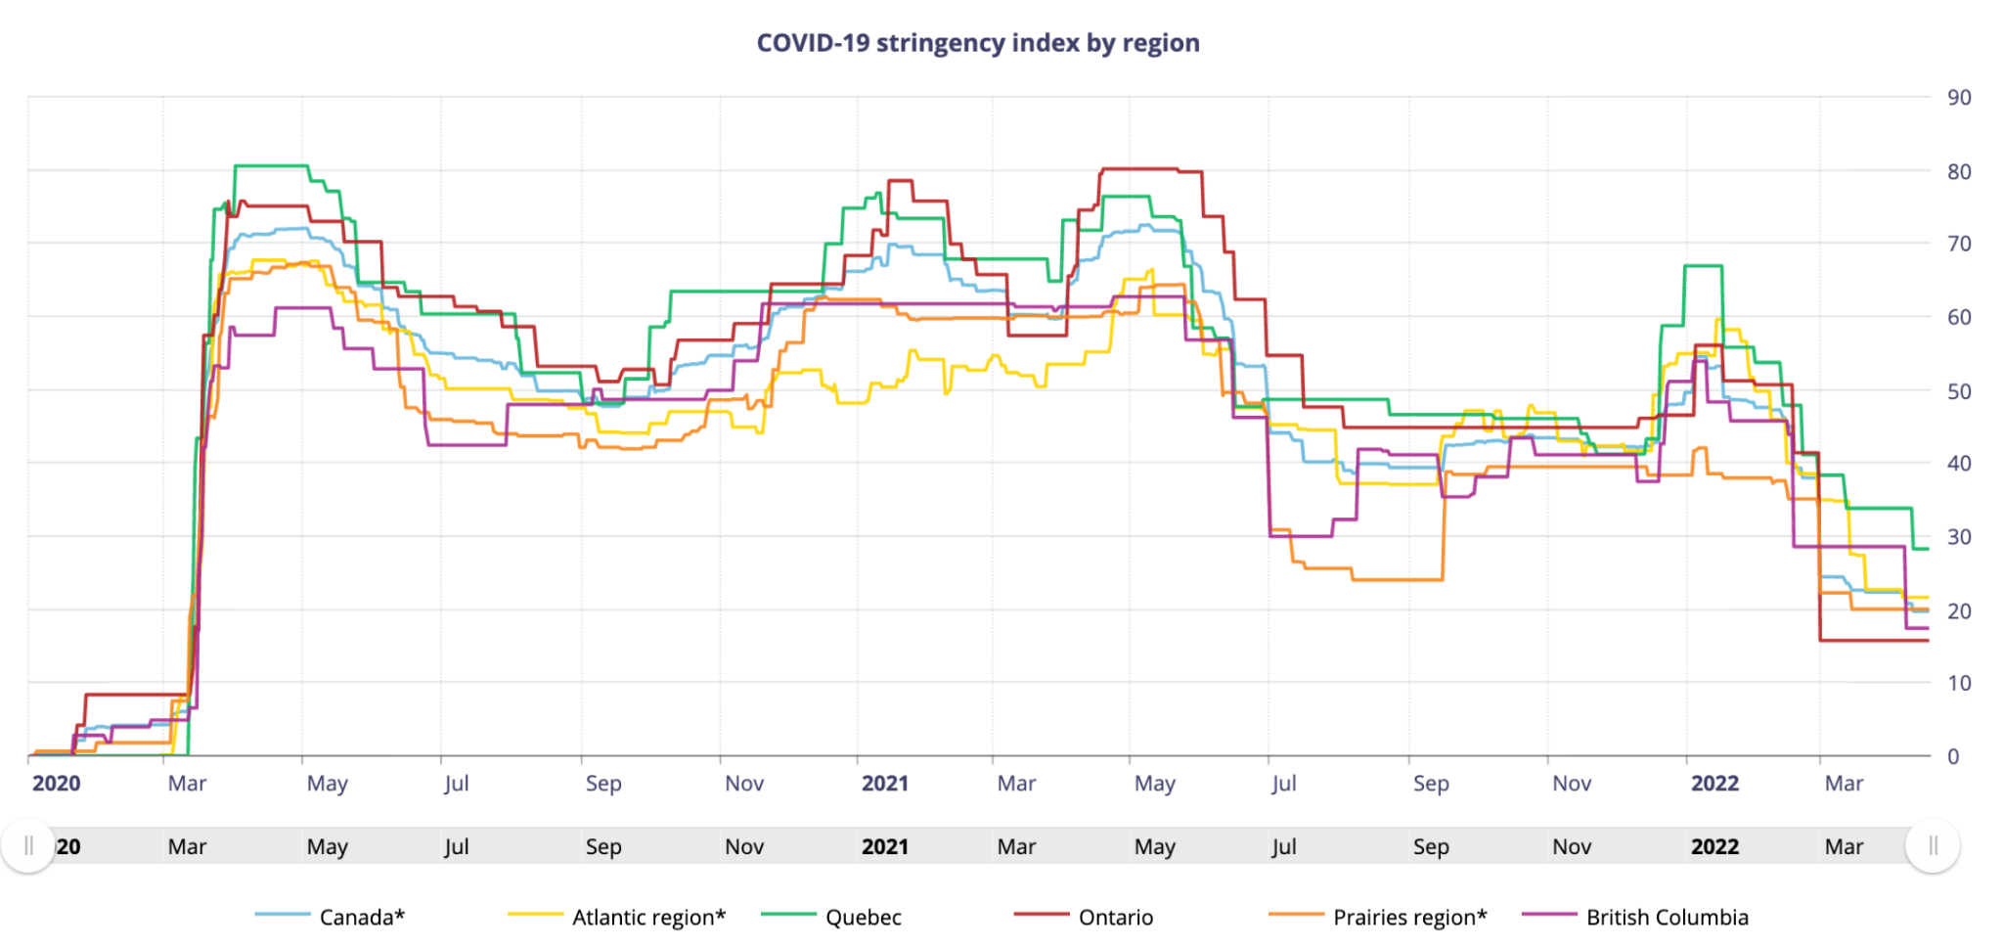
Factors determining the height of the BA.4/BA.5 wave
4. Public health measures: Lowest since the pandemic began and little appetite
Not great news

Slide 50

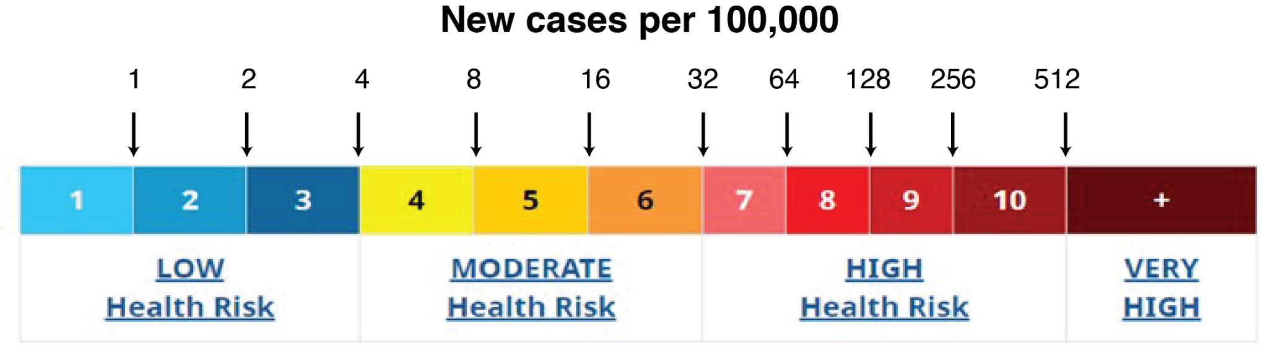
Prepare the public: We are at the start of the BA.4/BA.5 wave
Encourage boosters: Don’t wait for the bivalent vaccines (Wuhan & Omicron)
Omicron-specific booster from Moderna shows just a slight difference relative to prototype booster, which may have little real-world relevance to vaccine effectiveness (e.g., only 1.75 difference in neutralizing geometric mean titer ratio between boosting with mRNA-1273.214 vs mRNA-1273 [Moderna June 8 2022 press release].
Prioritize bivalent vaccine for immunologically naive individual
Globally prioritize treatment of those suffering persistent infections
2-3% of population immunosuppressed
40M+ living with HIV/AIDS

Slide 51

Thank you
https://bccovid-19group.ca

