Slide 1
Why are you here (University – Science program)?
Engineering
Medicine-dentistry
Teaching
Other
Research
Don’t know
Raise your hand if you are in your
4th year
3rdyear
2nd year
1st year

Slide 2
Math - High school: 90% → UBC Y1: 66%
Physic - High school: 88% → UBC Y1: 72%
92%
High school average
Biol 121 midterm
Biol 121 final
50-55%
65-70%
Student population
>90%
45-50%
0
20
40
60
80
100
Grades

Slide 3
Math - High school: 90% → UBC Y1: 66%
Physic - High school: 88% → UBC Y1: 72%
BAD MARKS = temporary set back
92%
High school average
Biol 121 midterm
Biol 121 final
50-55%
NOT failure!
65-70%
Student population
>90%
45-50%
0
20
40
60
80
100
Grades

Slide 4
Don’t lose heart!
Do something about it!
DO NOT THINK THAT YOU ARE NOT SMART ENOUGH!

Slide 5
Alumni, 3rd 4th year students & Profs
- Academics: Studying and Learning Styles
- Take ownership of your life and find a balance
- Social & Extracurricular
FUN!
EXPLORE!
ENJOY!

Slide 6
University is different than high school!
Lots of THINGS TO DO: CONCEPTS to understand ; CONTENT to memorize; Assignments, Midterms, Finals, Essays, Papers, Reports
MANY SOURCES of info: Online notes, Textbooks, Own class notes, Papers to read, Exercises; Lectures, Labs, Tutorials, …
Parents & teachers are not here to look out for you anymore!
Your organizational skills … not great!
Strategy for studying: inappropriate, rigid!
Time management: poor
All the cramming that was successful in the past won’t cut it at UBC!
Don’t wait until the last minute to start your work

Slide 7
ADVICE #1
Look at the big picture!

Slide 8
Advice #1: Big picture
First & second years -> what’s the point of the stuff I am learning in my courses?

Slide 9
Advice #1: Big picture (cont’)
If you cannot see the BIG picture in your first & second years, trust your teachers!
You will figure it out in your 4th year.

Slide 10
Advice #1: Big picture (cont’)
BIOL 454
Dive response
in the
Weddell Seal

Slide 11
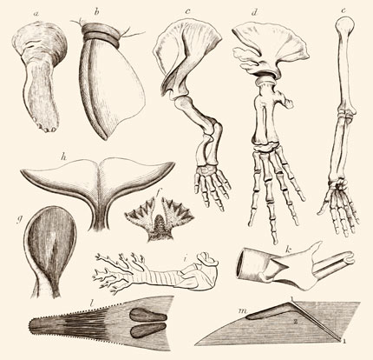
Advice #1: Big picture (cont’)
BIOL 204
Anatomy

Slide 12
Advice #1: Big picture (cont’)
BIOL 204

Slide 13
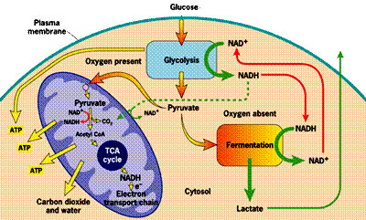
Advice #1: Big picture (cont’)
BIOL 201
Cellular Biology

Slide 14
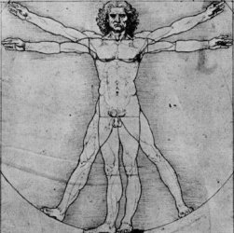
Advice #1: Big picture (cont’)
BIOL 204
BIOL 201

Slide 15
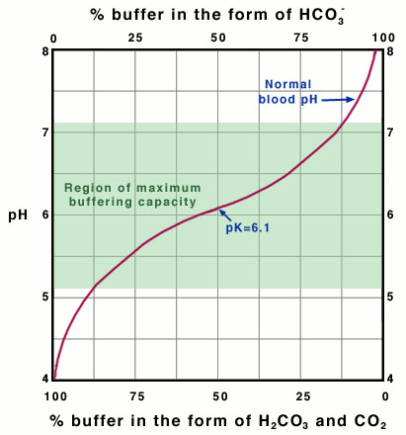
Advice #1: Big picture (cont’)
CHEM 205
Physical Chemistry

Slide 16
Advice #1: Big picture (cont’)
BIOL 204
BIOL 204
BIOL 201
BIOL 201
CHEM 205

Slide 17
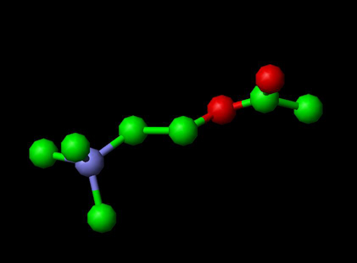
Advice #1: Big picture (cont’)
CHEM 233
Organic Chemistry

Slide 18
Advice #1: Big picture (cont’)
BIOL 204
BIOL 204
BIOL 201
BIOL 201
BIOL 334
CHEM 205

Slide 19
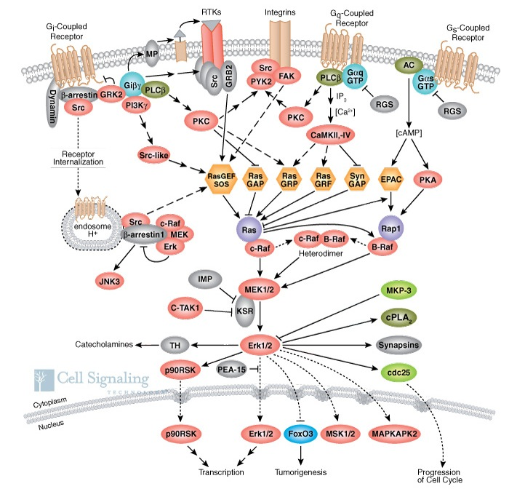
Advice #1: Big picture (cont’)
BIOC 302
Biochemistry

Slide 20
Advice #1: Big picture (cont’)
BIOL 204
BIOL 204
BIOL 201
BIOL 201
BIOL 334
BIOC 302
CHEM 205

Slide 21
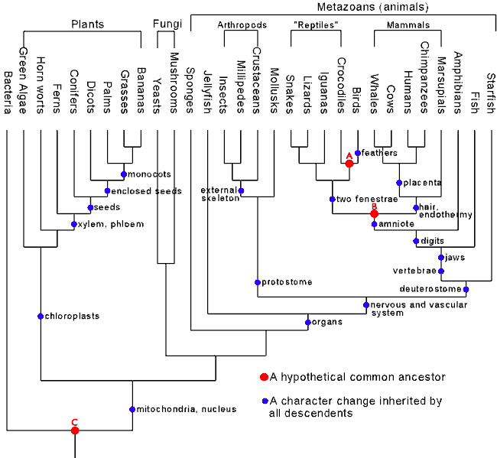
Advice #1: Big picture (cont’)
BIOL 321
Evolutionary Biology

Slide 22
Advice #1: Big picture (cont’)
BIOL 204
BIOL 204
BIOL 201
BIOL 201
BIOL 321
BIOL 334
BIOC 302
CHEM 205

Slide 23
Advice #1: Big picture (cont’)
BIOL 334
Genetics

Slide 24
Advice #1: Big picture (cont’)
BIOL 204
BIOL 204
BIOL 201
BIOL 201
BIOL 334
BIOL 321
BIOL 334
BIOC 302
CHEM 205

Slide 25
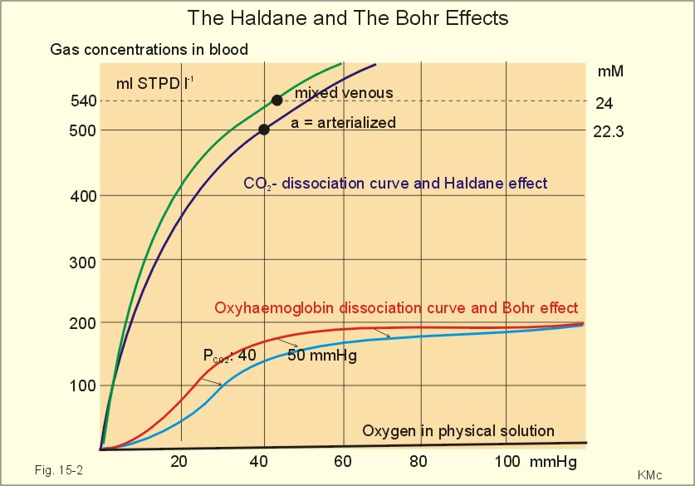
Advice #1: Big picture (cont’)
BIOL 364
Comparative Physiology

Slide 26
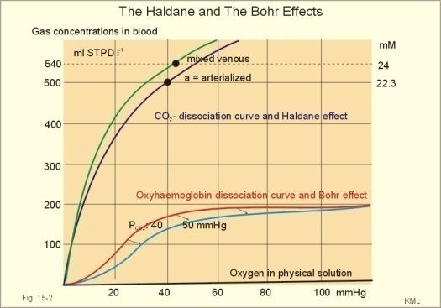
Advice #1: Big picture (cont’)
BIOL 364
BIOL 204
BIOL 204
BIOL 201
BIOL 201
BIOL 334
BIOL 321
BIOL 334
BIOC 302
CHEM 205

Slide 27
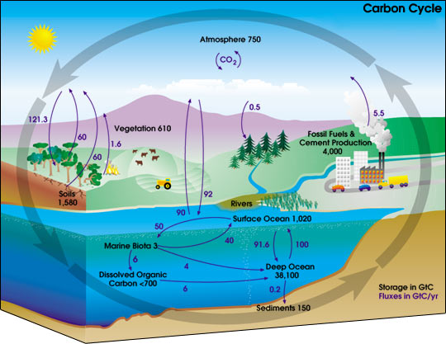
Advice #1: Big picture (cont’)
BIOL 304
Ecology

Slide 28
Advice #1: Big picture (cont’)
BIOL 364
BIOL 304
BIOL 204
BIOL 204
BIOL 201
BIOL 201
BIOL 334
BIOL 321
BIOL 334
BIOC 302
CHEM 205

Slide 29
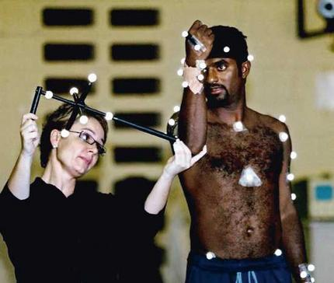
Advice #1: Big picture (cont’)
BIOL 325
Biomechanics

Slide 30
Advice #1: Big picture (cont’)
BIOL 364
BIOL 304
BIOL 204
BIOL 204
BIOL 201
BIOL 201
BIOL 334
BIOL 321
BIOL 334
BIOC 302
BIOL 325
CHEM 205

Slide 31
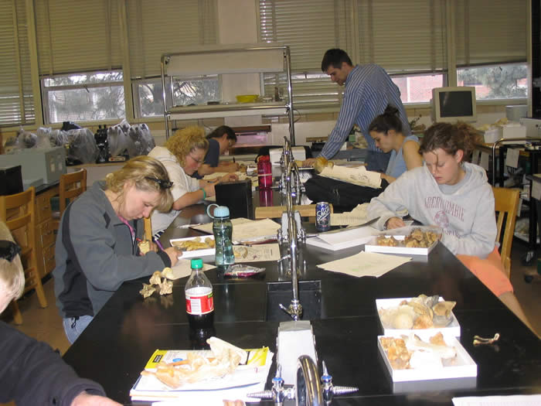
Advice #1: Big picture
BIOL 140
Laboratory Investigations
in Life Science

Slide 32
Advice #1: Big picture (cont’)
BIOL 364
BIOL 304
BIOL 204
BIOL 204
BIOL 201
BIOL 201
BIOL 334
BIOL 140
BIOL 321
BIOL 334
BIOC 302
BIOL 325
CHEM 205

Slide 33
Advice #1: Big picture (cont’)
Big picture of EACH OF YOUR COURSE!
Preview
Scan-read
Have a sniff
BEFORE the teacher covers the material

Slide 34
ADVICE #2
Find a successful learning strategy!
Don't work harder,
Work SMARTER!

Slide 35
Advice #2: Learning strategies
Lots of THINGS TO DO
MANY SOURCES of info
What are the Foundation of all SUCCESSFUL
LEARNING STRATEGIES?

Slide 36
Advice #2: Learning strategies – Preview
Before starting a new chapter, PREVIEW IT
to get the “BIG picture”
Online teacher notes or Book?
Choose what is easier, faster & most enjoyable!
Scan-read
Have a sniff

Slide 37
Advice #2: Learning strategies – Strategies
At the end of the day, re-read & check your lecture notes.
 Cornell notes
If any holes -> see your Prof / office hours
As soon as the teacher finishes a chapter, learn it!
SYNTHESIZE Book + online notes + notes taken in class into YOUR FINAL PRODUCT
FINAL PRODUCT -> If any holes -> see your prof / office hours
-> what you use for your exam.
-> keep it FOR MCAT OR DAT
-> own learning style
3 TASKS:
1. MEMORIZATION
2. CONCEPTS – UNDERSTANDING
3. PROBLEMS
 Flash/Cue cards – Q & A
Different
strategies
 Visual maps or summary
 Summary sheets
 Practice problems
 Last minute cram sheets

Slide 38
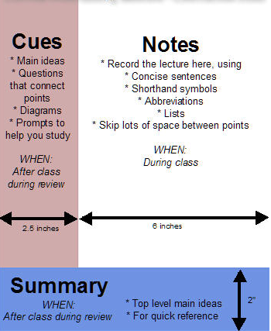
Advice #2: Learning strategies – Strategies (con’t)
At the end of the day, re-read & check your lecture notes.
 Cornell notes

Slide 39
Memorization
Advice #2: Learning strategies – Strategies (con’t)
What for: Definitions, structures, identification, pathways, lists
Example of Courses: BIOL 200, 201, CHEM 233
Strategies: Flashcards (identification and drawing/writing them out); Acronyms; For pathways: flashcard for each part of the pathway; put in order
Where to use them : on the bus, in line, with your roommate

Slide 40
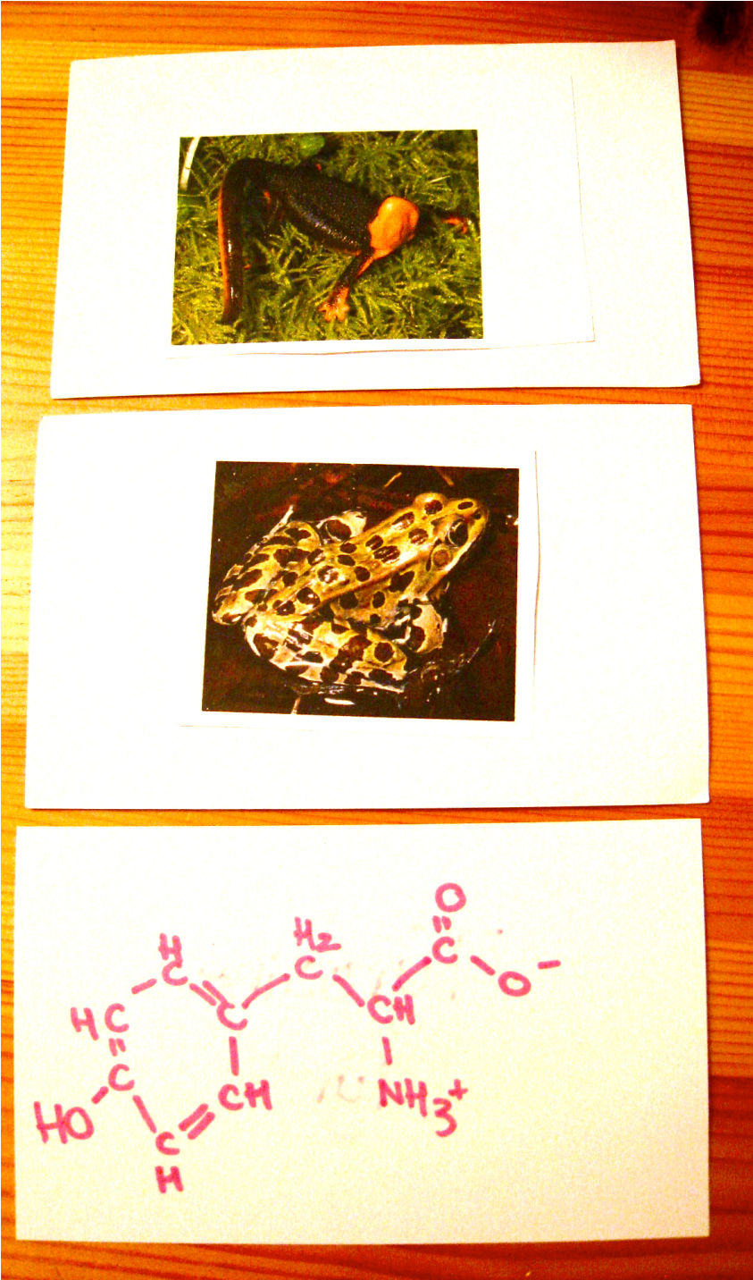
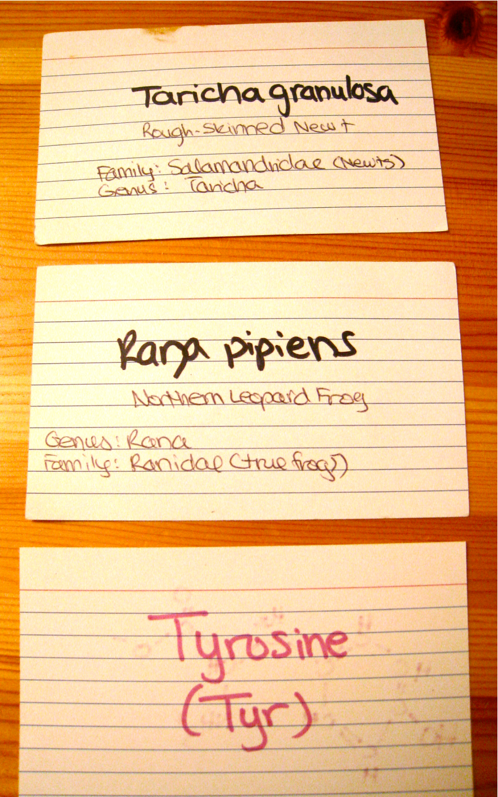

Slide 41
Concepts and Ideas: 1- Visual mapping
Advice #2: Learning strategies – Strategies (con’t)
What for: Overall concepts; when a course or lecture has many different topics
Example of Courses: All upper level, especially biology
Strategies:
Concept maps,
Flow charts
Pictures
Where to use: anywhere – one piece of paper vs. all of your lecture notes.

Slide 42
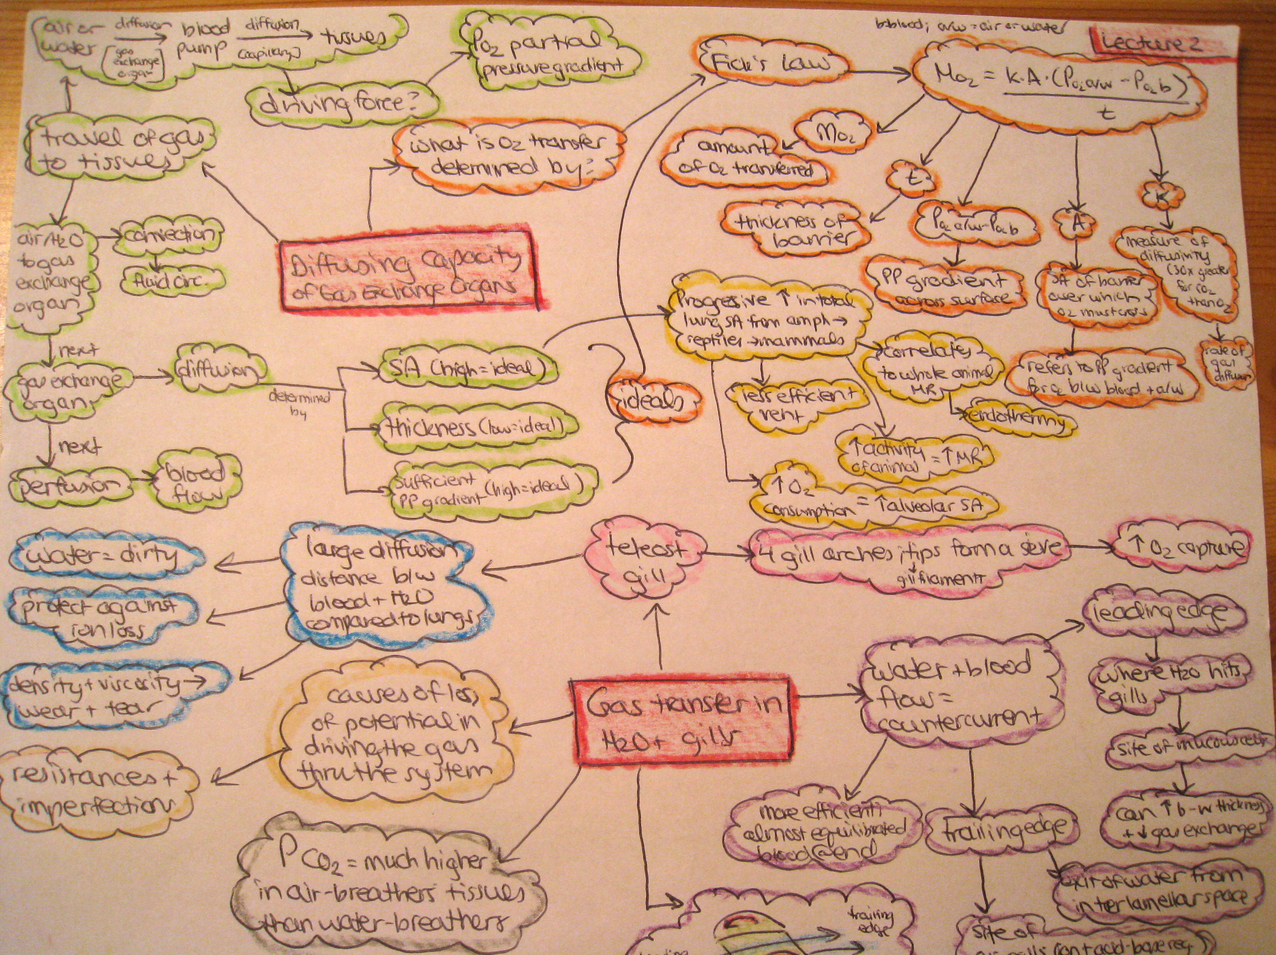

Slide 43
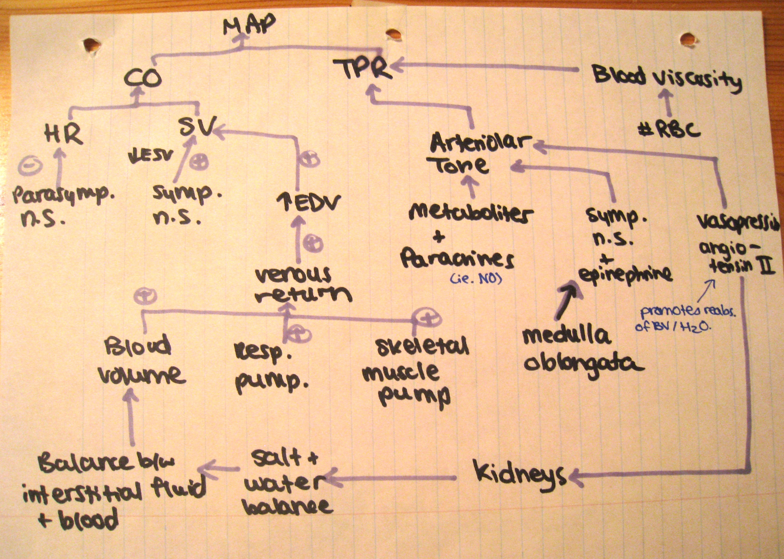

Slide 44
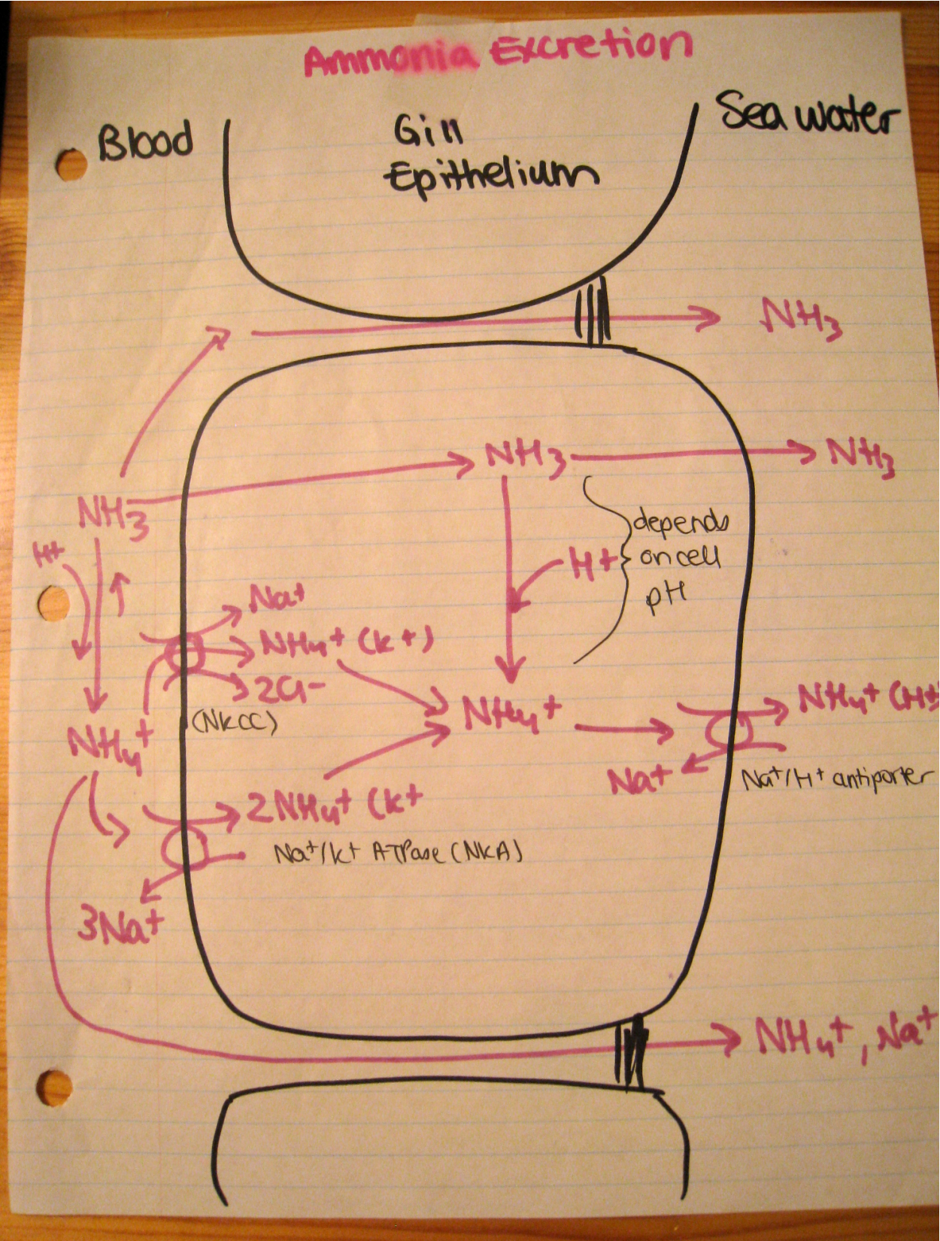

Slide 45
Concepts and Ideas – 2 Summary Sheets
Advice #2: Learning strategies – Strategies (con’t)
What for: Compilation of all sources of info (lecture notes, text, lab, online notes, etc.)
Example of Courses: good for all your courses!
Strategies: Pages summarizing and incorporating all information & answering overall “guiding questions” posted by professor
When to use: Anywhere. If you do this after each lecture, it will be easy to study for exams.

Slide 46
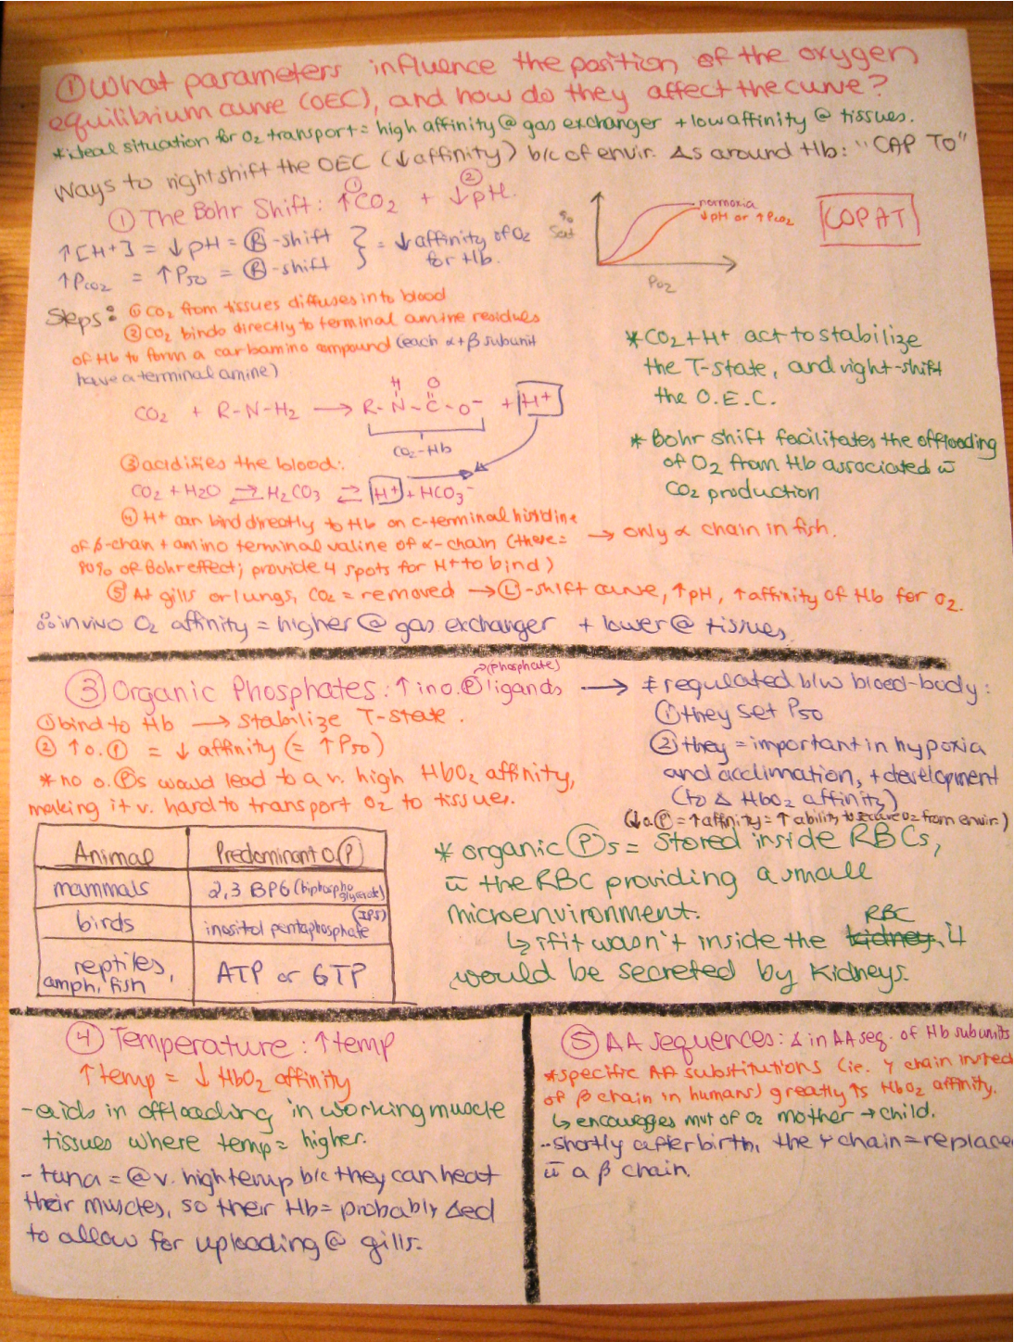
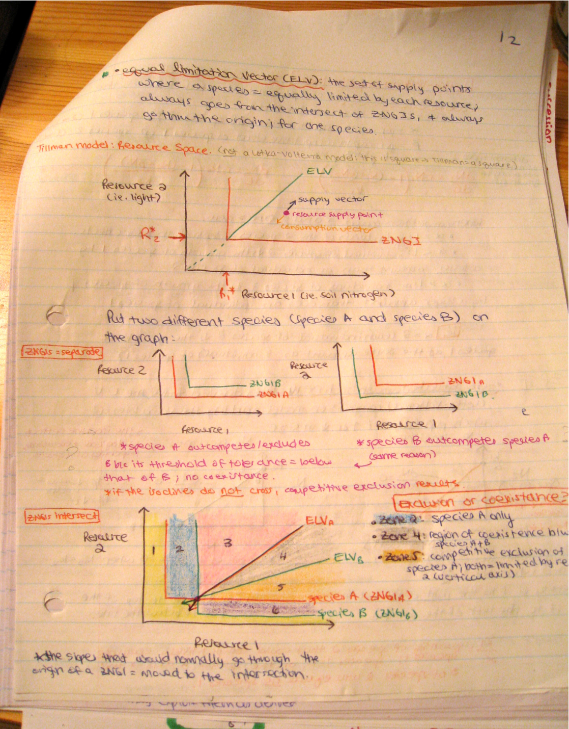

Slide 47
Problem-Based Courses
Advice #2: Learning strategies – Strategies (con’t)
What for : Problem-solving courses
Example of Courses: Genetics, Math, Chemistry
Strategies: Practice. Understand. Practice. Practice. Practice - Do not read answer key before doing problems.
Where to use: anywhere – especially useful to check answers with study groups

Slide 48
Advice #2: Learning strategies – Strategies (con’t)
Do NOT bother with
your lecture notes,
the teachers’ online notes
& textbook.
The week before the exam:
Use your
 Flash/Cue cards – Q & A
 Visual maps or summary
 Summary sheets
 Practice problems
 Last minute cram sheets
TEST YOURSELF: Hide everything & re-do from scratch.
Now, you know what you know & what you don’t know.
You know where to concentrate your efforts → cram sheets

Slide 49
Advice #2: Learning strategies – Review
Don’t do overnight cramming
Review often!
Information is rapidly forgotten – to counter this you must convert short term memory into long term memory

Slide 50
Advice #2: Learning strategies – Review (con’t)
Today’s lecture

Slide 51
Advice #2: Learning strategies – Review (con’t)
Today lecture
Today’s lecture
What happens to new information?

Slide 52
Advice #2: Learning strategies – Review (con’t)
Today’s lecture
What happens to new information?

Slide 53
Advice #2: Learning strategies – Review (con’t)
Today’s lecture
What happens to new information?

Slide 54
Advice #2: Learning strategies – Review (con’t)
Today’s lecture
What happens to new information?
The weekend
Before the final

Slide 55
Advice #2: Learning strategies – Review (con’t)
Today’s lecture
What happens if you REVIEW?
The weekend
Before the final

Slide 56
Advice #2: Learning strategies – Review (con’t)
Today’s lecture
The weekend
Before the final

Slide 57
Advice #2: Learning strategies – Review (con’t)
Today’s lecture
The weekend
Before the final
1ST REVIEW session: GOING THROUGH YOUR LECTURE NOTES
(CORNELL)

Slide 58
Advice #2: Learning strategies – Review (con’t)
Today’s lecture
The weekend
Before the final

Slide 59
Advice #2: Learning strategies – Review (con’t)
Today’s lecture
The weekend
Before the final
2ND REVIEW session: You finished the chapter (chapter 1) –
You make your CUE CARDS &/or VISUAL MAP and/or SUMMARY SHEETS for CHAPTER 1

Slide 60
Advice #2: Learning strategies – Review (con’t)
Today’s lecture
The weekend
Before the final

Slide 61
Advice #2: Learning strategies – Review (con’t)
Today’s lecture
3RD REVIEW session: You finished the next chapter (Chapter 2) – You review cue cards, visual map or summary sheets of CHAPTER 1

Slide 62
Advice #2: Learning strategies – Review (con’t)
Today’s lecture
The weekend
Before the final

Slide 63
Advice #2: Learning strategies – Review (con’t)
Today’s lecture
The weekend
Before the final
4TH REVIEW session: You finished the next chapter (Chapter 3) – You cue cards, visual map or summary sheets of CHAPTER 1

Slide 64
Advice #2: Learning strategies – Review (con’t)
Today’s lecture
Short term memory has become long term memory
The weekend
Before the final

Slide 65
Advice #2: Learning strategies – Review (con’t)
The week before the exam:
YOU WILL HAVE AN EASIER TIME!

Slide 66
ADVICE #3
Your most precious commodity is time
TIME MANAGEMENT!
DON’T PROCRASTINATE!

Slide 67
Advice #3: Time management
PER WEEK: ACADEMIA
25 h class
(lecture + labs + tutorials)
+ 2x(25 h) homework
(assignments + own studying + group study with friends + reviewing for midterms + library search + writing essays, papers, lab reports)
75h
PER WEEK: SLEEP
7h of sleep per nights x7 nights = 49h
PER WEEK: WHAT’S LEFT
24h x 7days = 168h
– 75h
– 49h
44h
average of 6.3h/day LEFT

Slide 68
Advice #3: Time management (con’t)
Lana’s time table
 | MONDAY | TUESDAY | WEDNESDAY | THURSDAY | FRIDAY | SATURDAY | SUNDAY
8-830 | MATH | MATH | MATH | PHYS LAB | MATH
830-9 | MATH | MATH | MATH | PHYS LAB | MATH
9-930 |  |  |  | PHYS LAB
930-10 |  | CHEM LAB |  | PHYS LAB
10-1030 | PHYSICS | CHEM LAB | PHYSICS | PHYS LAB | PHYSICS
1030-11 | PHYSICS | CHEM LAB | PHYSICS | PHYS LAB | PHYSICS
11-1130 | ENGLISH | CHEM LAB | ENGLISH |  | ENGLISH
1130-12 | ENGLISH | CHEM LAB | ENGLISH |  | ENGLISH
12-1230 |  | CHEM LAB
1230-1
1-130 | BIOLOGY |  | BIOLOGY |  | BIOLOGY
130-2 | BIOLOGY |  | BIOLOGY |  | BIOLOGY
2-230 |  |  |  | BIO LAB
230-3 | CHEM |  | CHEM | BIO LAB | CHEM
3-330 | CHEM |  | CHEM | BIO LAB | CHEM
330-4 |  |  |  | BIO LAB
4-430 |  |  |  | BIO LAB
430-5 |  |  |  | BIO LAB

Slide 69
Advice #3: Time management (con’t)
You have to prioritize and realize that you cannot do everything 100% perfectly like in high school!
Grade (%)
Mitchel’s paper.
2
4
6
8
Duration working on paper (h)

Slide 70
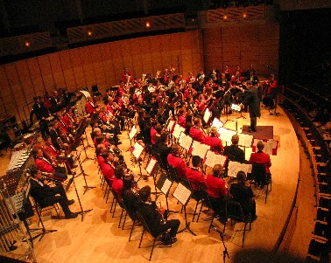
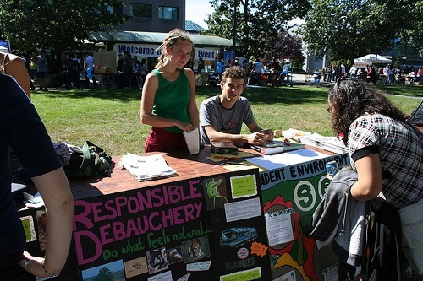
Student Life
ADVICE #4
Extracurricular
- Friends
- Volunteering
- Social
- Clubs & Societies
- Learn to network
EXPLORE!
FUN!
ENJOY!

Slide 71
Advice #4: Extracurricular (con’t)
Be part of a community
Do something life-giving
Get involved
Make the most of your university experience

Slide 72
OTHER ADVICES
Take courses that interest you!
No overload!
It’s okay to change plans
Go to your lectures
Turn off MSN, Facebook, Youtube, Twitter

Slide 73
CONCLUSION
Don’t lose sight of the BIG PICTURE
Find A SUCCESSFUL LEARNING STRATEGY
Gauge your time and use it efficiently
Balanced life
Be honest with yourself about your difficulties
ALWAYS GO TO CLASS

Slide 74
Tuum est
It’s yours!

